Slide 1
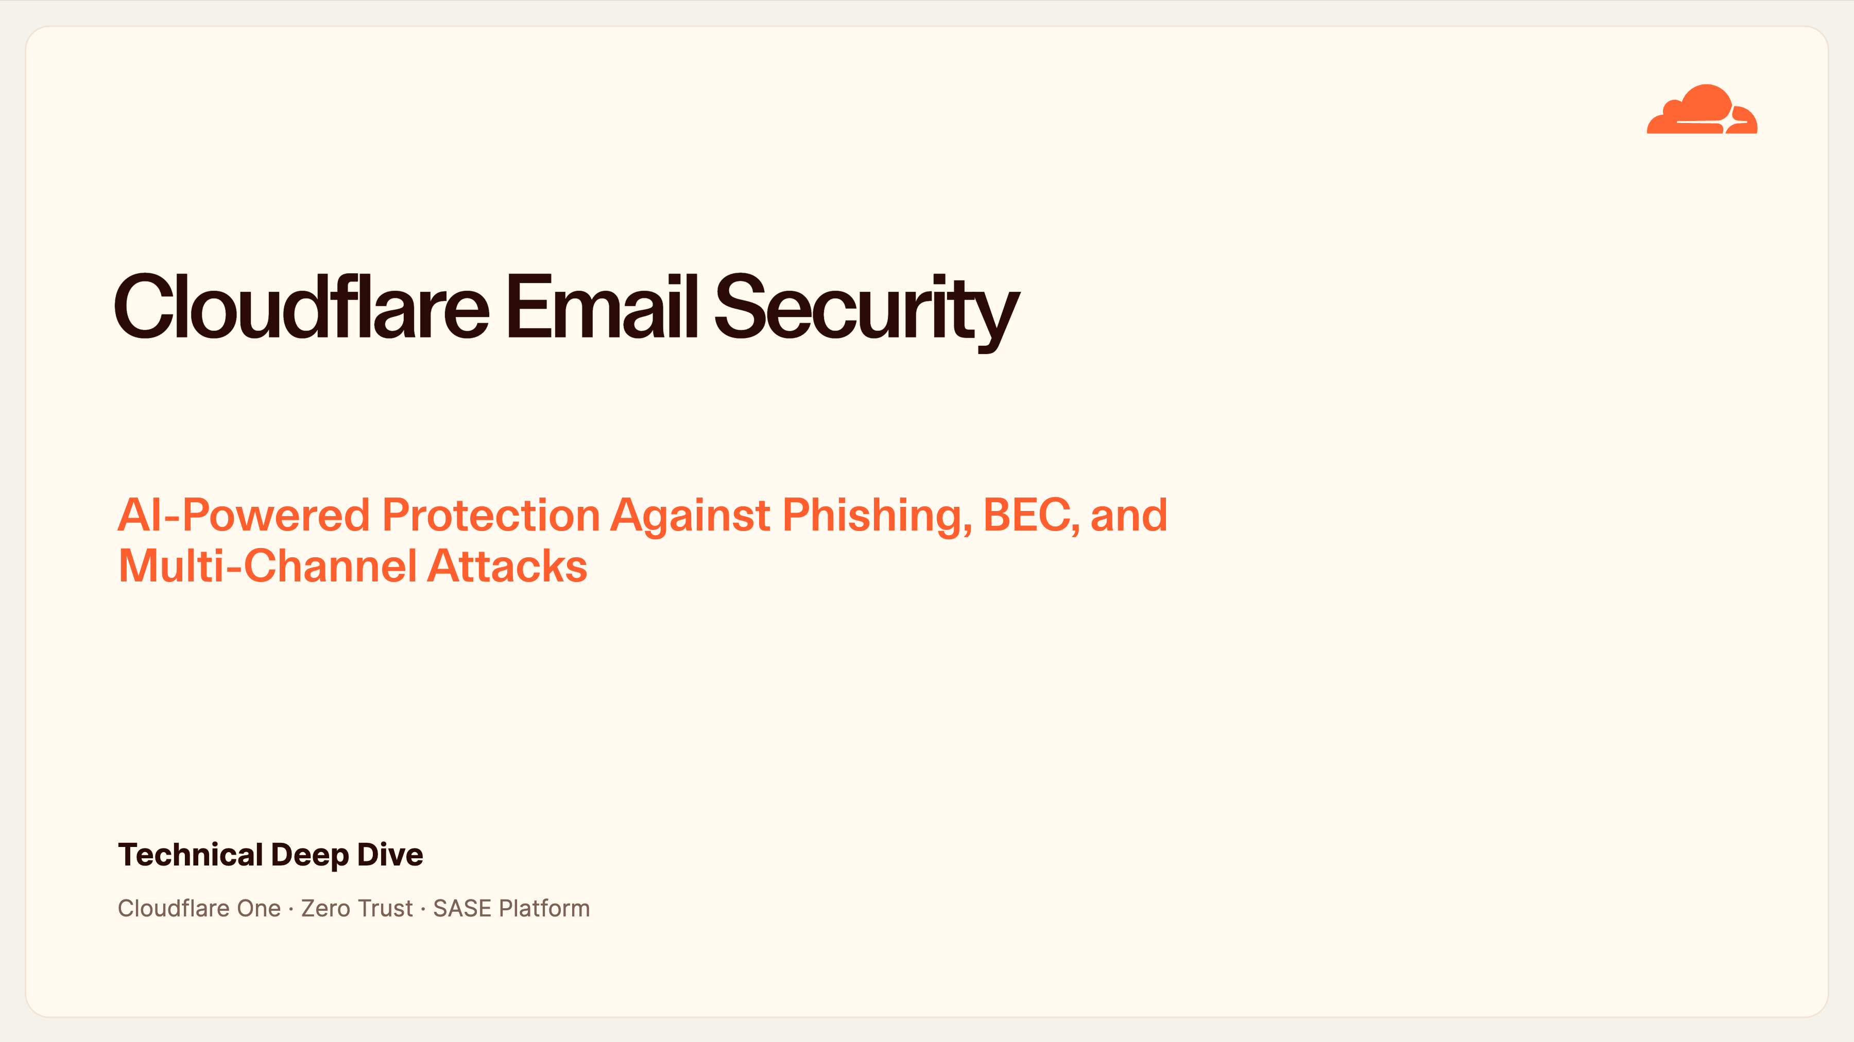
Notes:
Cloudflare Email Security — Cover
Welcome everyone. Today we're doing a technical deep-dive on Cloudflare Email Security — our AI-powered defense against phishing, business email compromise, and multi-channel attacks.
This fits into the wider Cloudflare One SASE platform, so email isn't a bolt-on product — it shares the same intelligence and controls as the rest of your Zero Trust stack. Set expectations: this is a technical session, so we'll go under the hood on architecture, detection, and deployment.

Slide 2
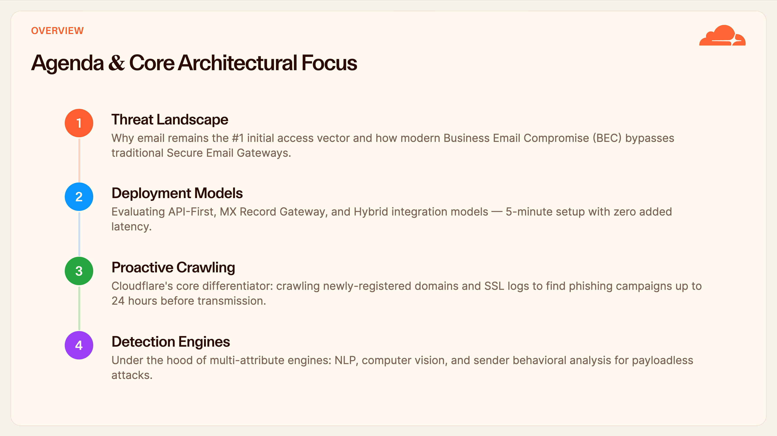
Notes:
Agenda
Here's our roadmap for the session. Four parts.
First, the threat landscape — why email is still the number one way attackers get in. Second, the deployment models, and how we go live in about five minutes with no added latency. Third, the piece that really sets us apart: proactive crawling, where we find phishing campaigns before they even send. And finally the detection engines under the hood. Feel free to hold questions until each section wraps.

Slide 3
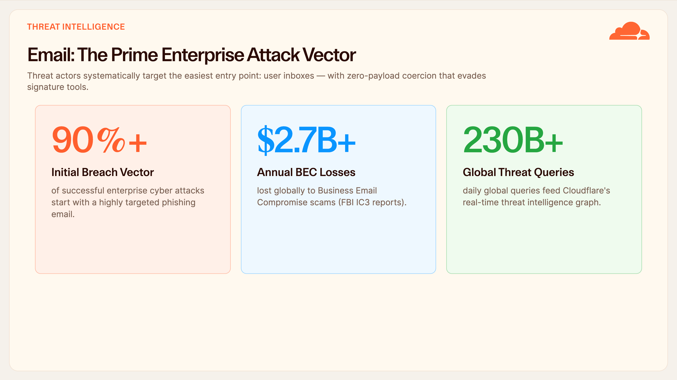
Notes:
Threat Landscape — Stats
Let's ground this in numbers. Over ninety percent of successful breaches start with a phishing email — the inbox is the front door. The FBI's IC3 puts BEC losses at over 2.7 billion dollars a year, and that's just what's reported.
The key shift: attackers have moved to zero-payload coercion — no link, no attachment, just a convincing message. Signature tools can't see that. Our advantage is scale: 230 billion daily threat queries feeding one intelligence graph.

Slide 4
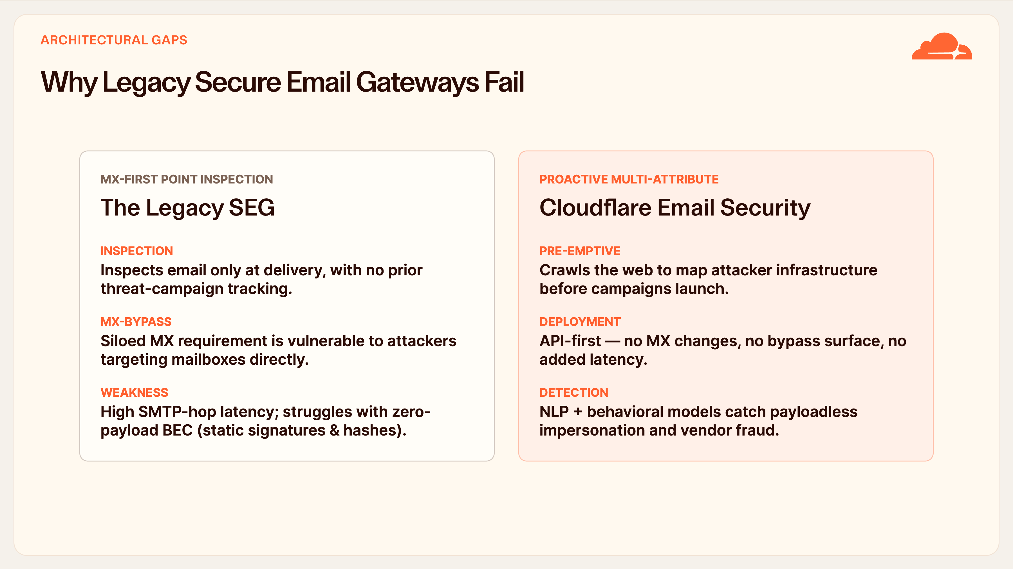
Notes:
Why Legacy SEGs Fail
This is the core contrast. Legacy Secure Email Gateways only inspect at the moment of delivery — they have no view of a campaign before it lands. They require you to point your MX record at them, which both adds SMTP-hop latency and creates a bypass surface: attackers just target the mailbox directly.
Our model is the opposite. We crawl the web ahead of time to map attacker infrastructure, deploy API-first with no MX changes, and use NLP and behavioral models to catch the payloadless attacks signatures miss.

Slide 5
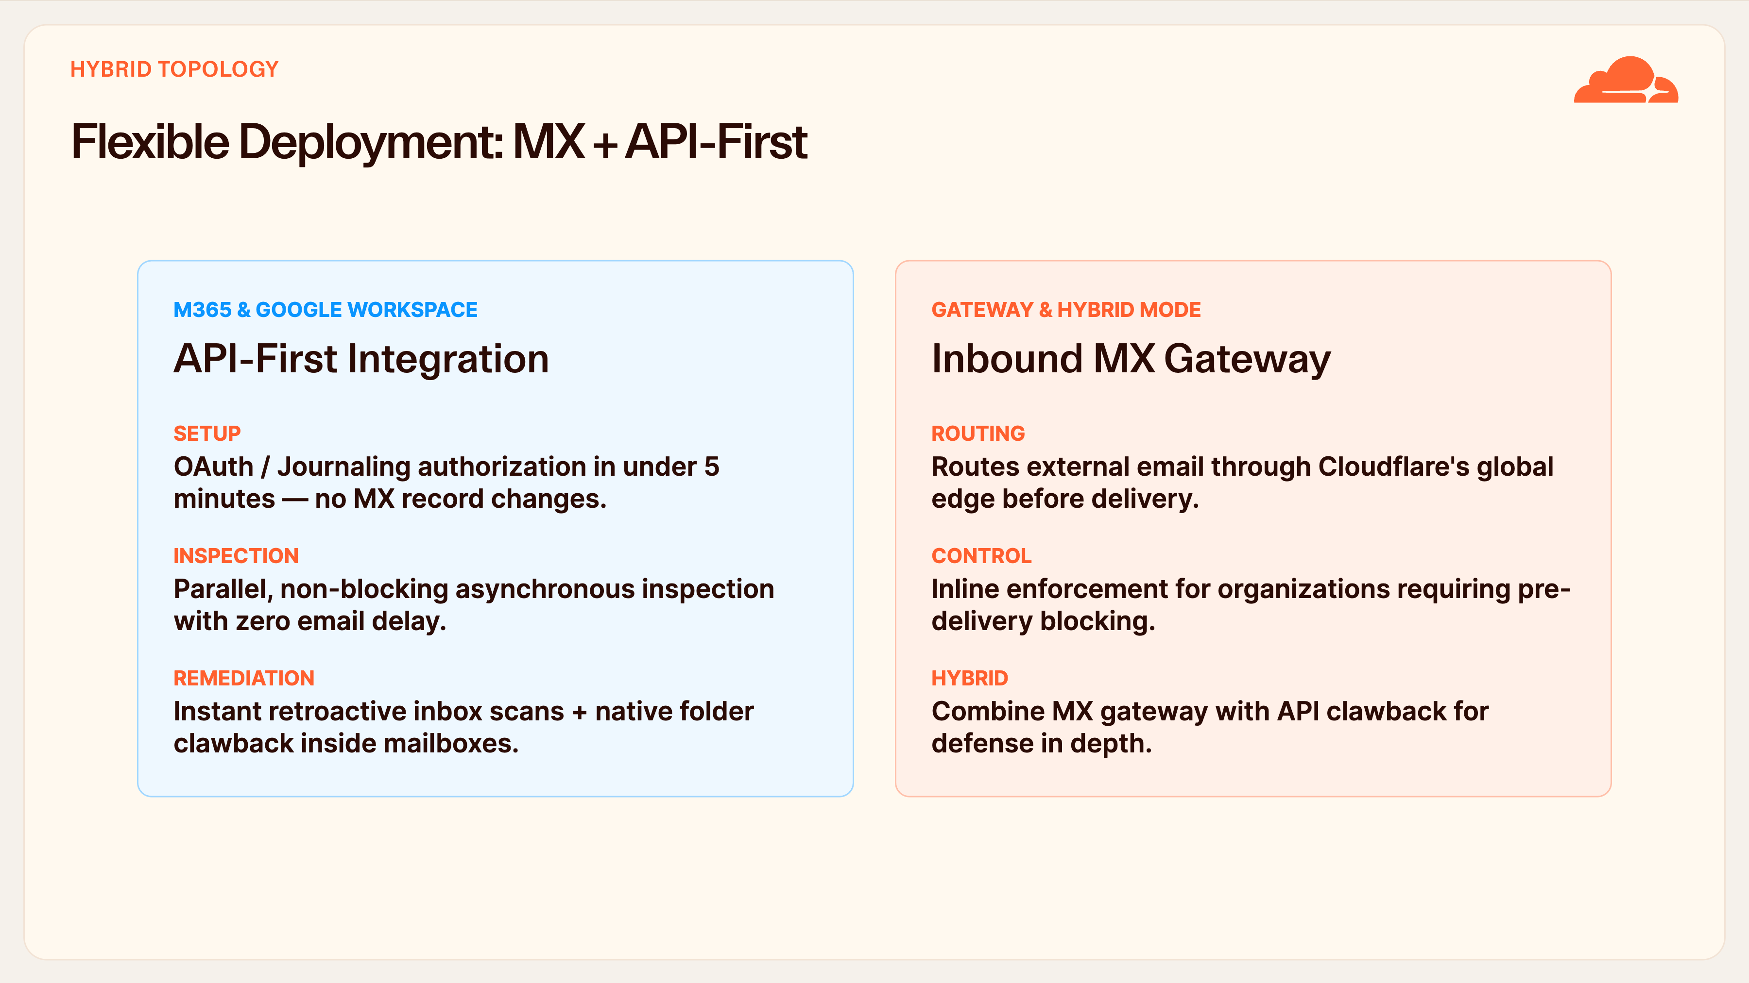
Notes:
Deployment Models
We meet you wherever you are. Most customers start API-first: an OAuth authorization to Microsoft 365 or Google Workspace, live in under five minutes, no MX changes. Inspection runs in parallel so there's zero delay to mail flow, and we can retroactively scan and claw back messages already sitting in inboxes.
If you need inline pre-delivery blocking, the MX gateway routes mail through our edge first. And you can run both — hybrid mode gives you inline enforcement plus API clawback for defense in depth.

Slide 6
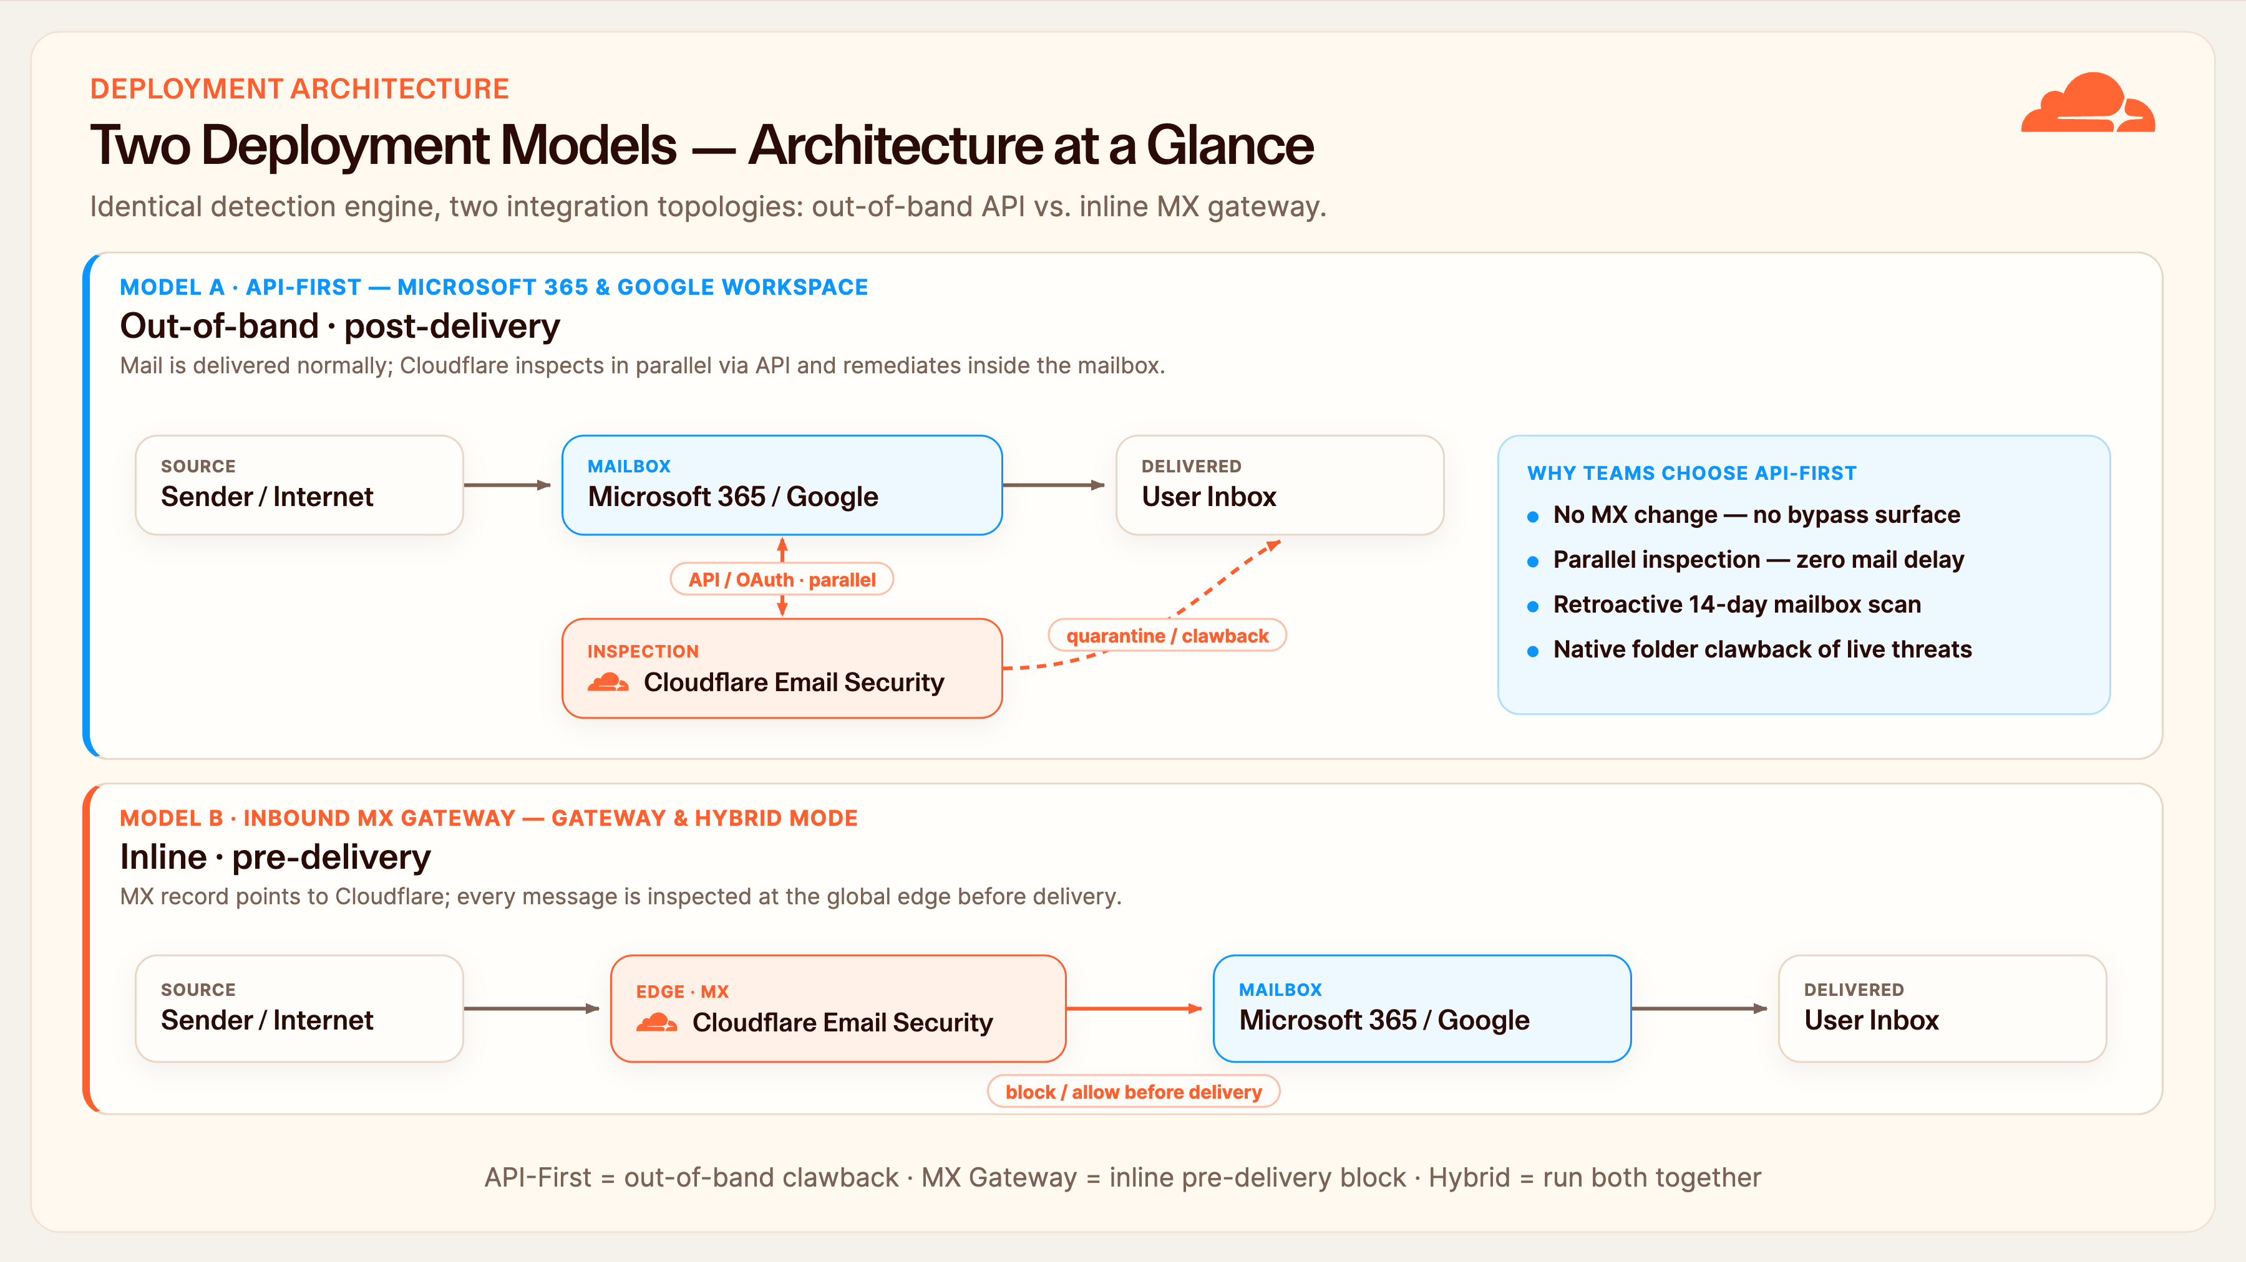
Notes:
Deployment Architecture — Diagram
Let me put the previous slide into a picture, because the two models behave very differently on the wire.
Model A, API-First, along the top: mail flows normally from the sender into Microsoft 365 or Google Workspace and lands in the inbox. Cloudflare sits off to the side, connected by API — that's the vertical arrow. We pull a copy in parallel, inspect it out-of-band, and if it's malicious we reach back into the mailbox and claw it back. Notice the mail path is never in-line, so there's zero delay and no MX change — and because we're in the mailbox, we can retroactively scan the last fourteen days.
Model B, the MX Gateway, along the bottom: the MX record points at Cloudflare, so every message hits our global edge first, gets inspected, and is blocked or allowed before it's ever delivered. That's inline, pre-delivery enforcement.
And hybrid is simply both lanes at once — inline blocking at the edge plus API clawback in the mailbox for defense in depth. Same detection engine in every case; only the integration point moves.

Slide 7
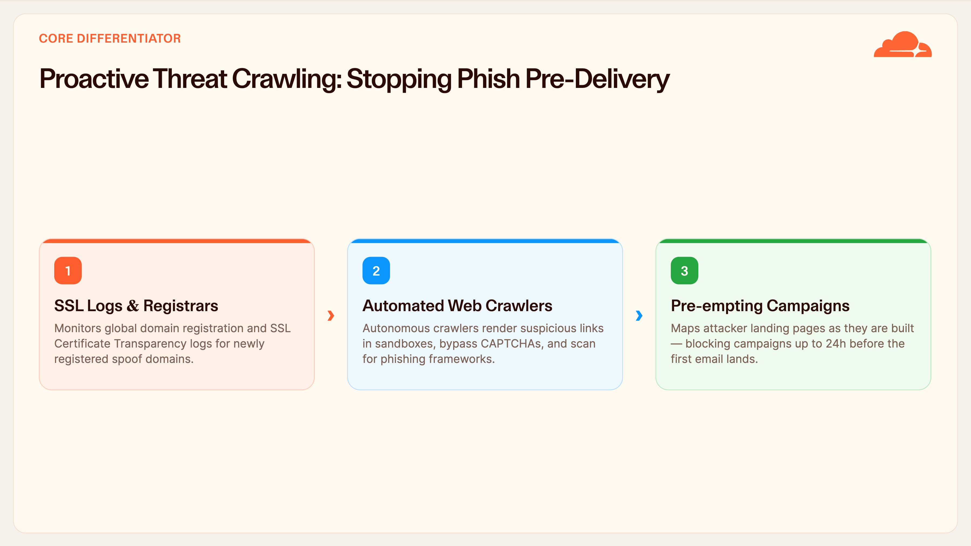
Notes:
Proactive Threat Crawling
This is the slide to slow down on — it's our biggest differentiator. Everyone else waits for the email to arrive. We go looking for the attack first.
We monitor domain registrations and SSL Certificate Transparency logs to spot newly registered lookalike domains. Our crawlers then render those suspicious pages in sandboxes, bypass CAPTCHAs, and fingerprint known phishing kits. Because we map the attacker's landing page while they're still building it, we can block a campaign up to twenty-four hours before the first email is ever sent.

Slide 8
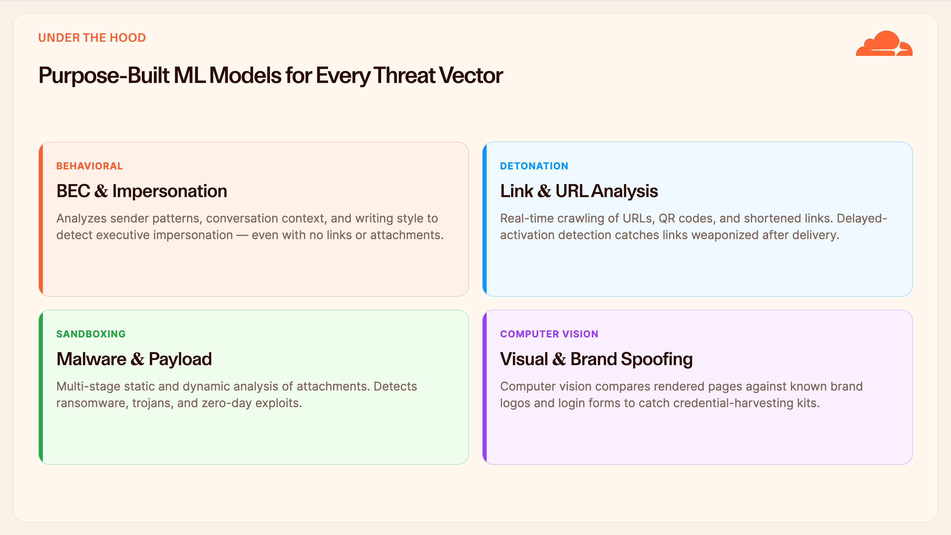
Notes:
Detection Engines
Under the hood, it's not one model — it's purpose-built engines per threat type. For BEC and impersonation we analyze sender patterns, conversation context, and even writing style, so we catch CEO-fraud emails that carry no link or attachment at all.
Link analysis detonates URLs, QR codes, and shorteners in real time, including delayed-activation links that go malicious after delivery. Attachments go through multi-stage sandboxing. And computer vision compares rendered pages to real brand logos and login forms to catch credential-harvesting kits.

Slide 9
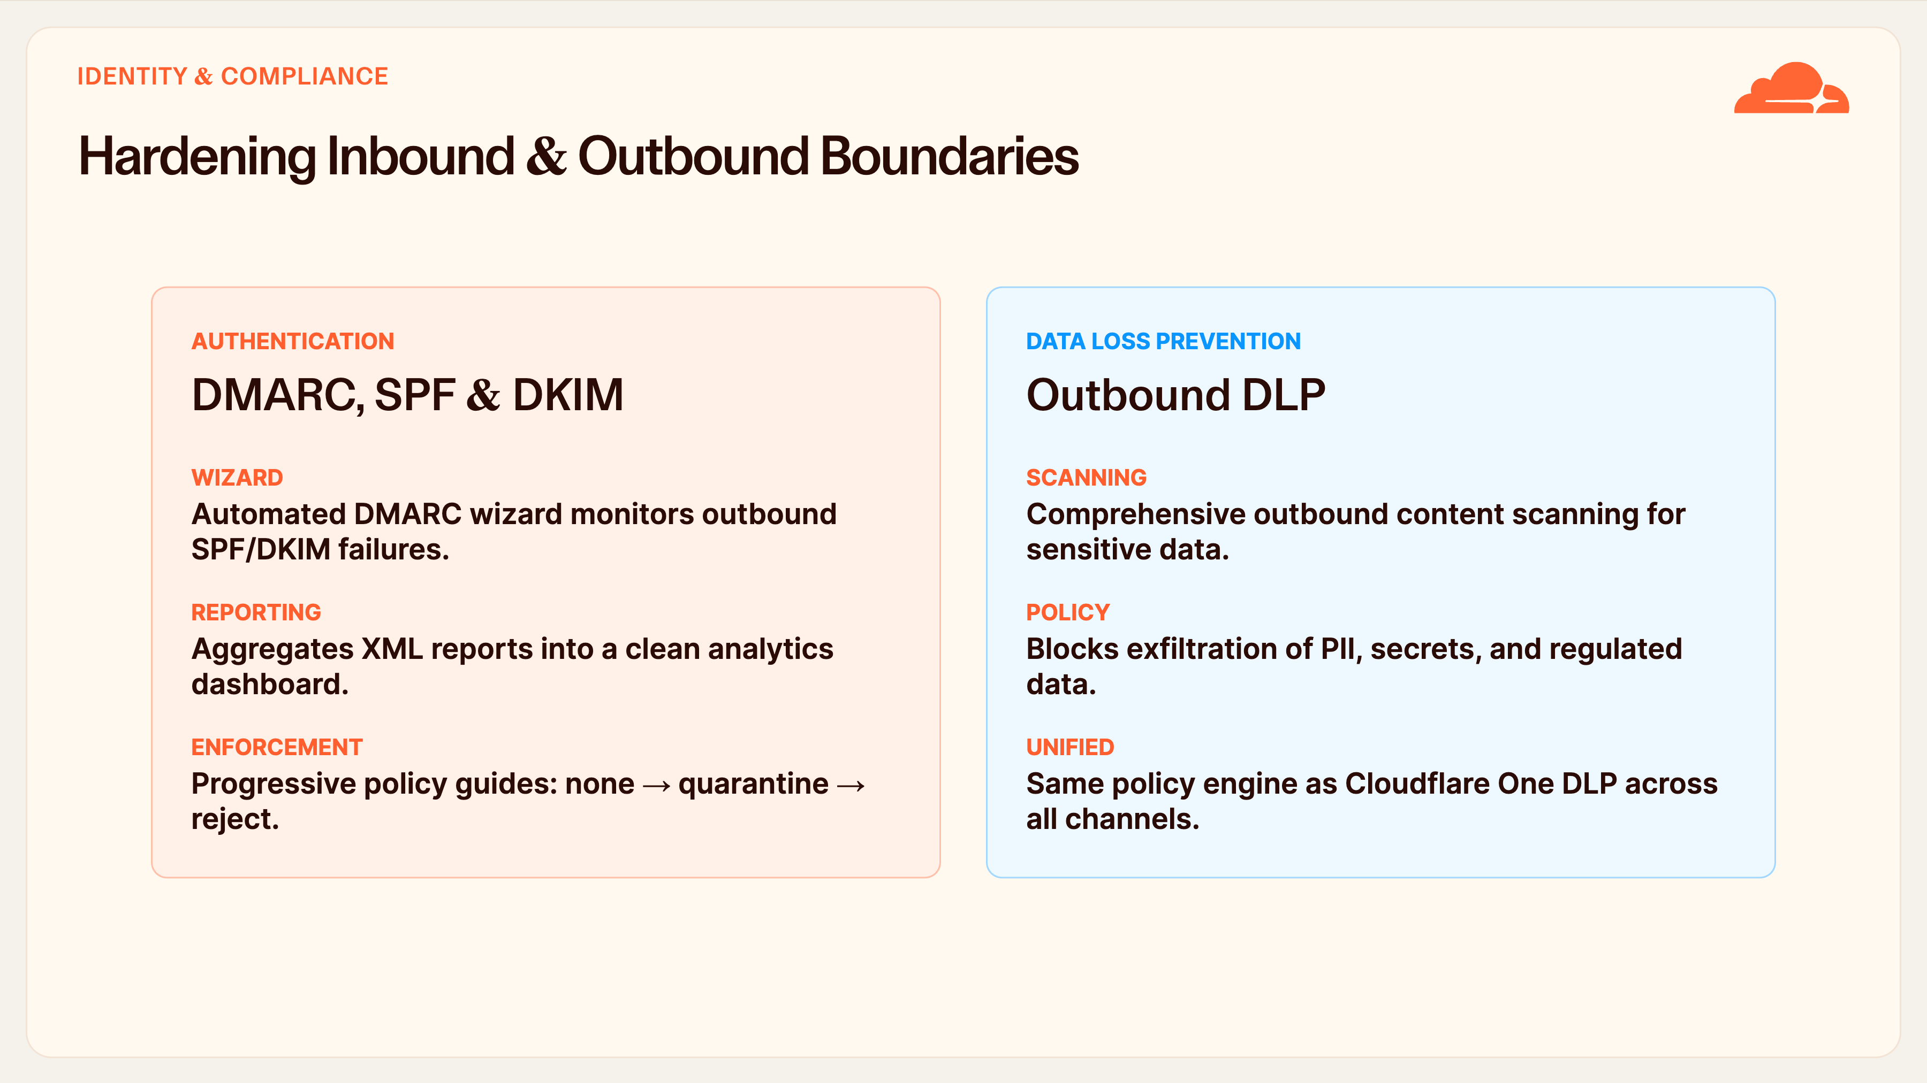
Notes:
Identity & Compliance
Email security isn't just inbound. On the authentication side, our DMARC management wizard watches your outbound SPF and DKIM, turns those noisy XML reports into a readable dashboard, and walks you safely from a 'none' policy through quarantine to full reject — which is where most teams get stuck.
On the outbound side, DLP scans for PII, secrets, and regulated data leaving the org. And crucially it's the same DLP engine as the rest of Cloudflare One — one policy across email, web, and SaaS.

Slide 10
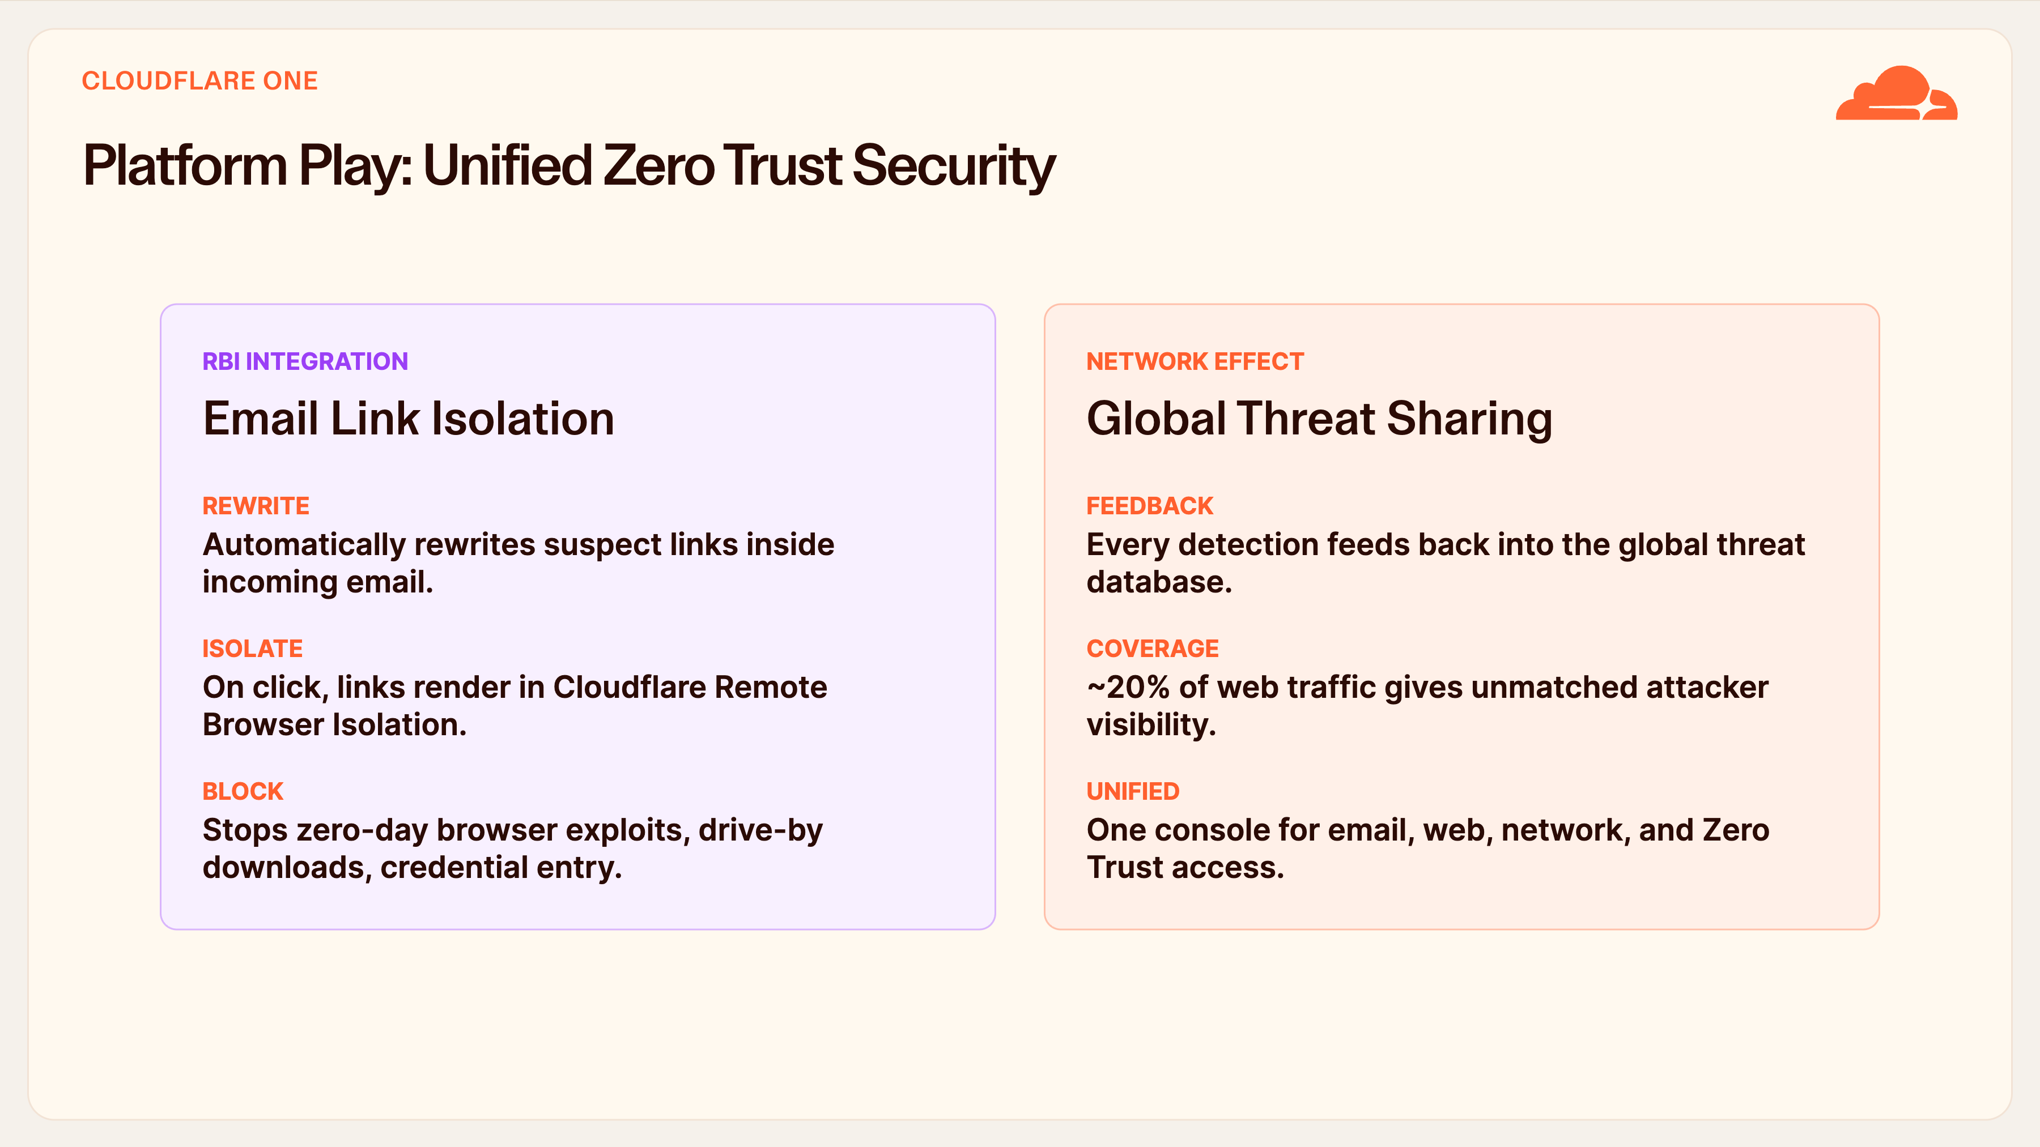
Notes:
Cloudflare One Platform Play
Here's where being part of a platform pays off. Email Link Isolation rewrites suspicious links in incoming mail; when a user clicks, the page opens inside Remote Browser Isolation — so even a zero-day browser exploit or credential-harvesting page can't touch the endpoint.
And it's a network effect: every detection feeds back into a threat graph that already sees around twenty percent of all web traffic. A threat we spot on one customer protects everyone else within seconds — all from one console.

Slide 11
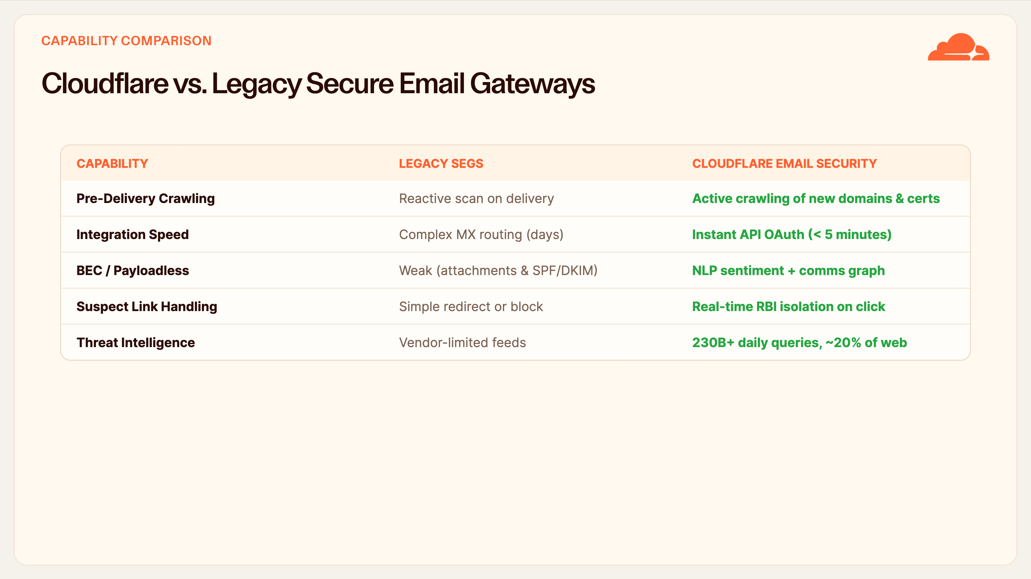
Notes:
Capability Matrix
If you take one slide back to your architects, make it this one. Side by side: legacy gateways scan reactively on delivery; we crawl proactively. They take days of MX routing to deploy; we're live via API in minutes. They lean on attachments and SPF/DKIM for BEC — which is exactly what payloadless attacks dodge — while we use NLP and a communications graph.
And on suspect links, they redirect or block; we isolate the click in a remote browser. It comes down to intelligence: vendor-limited feeds versus 230 billion queries a day.

Slide 12
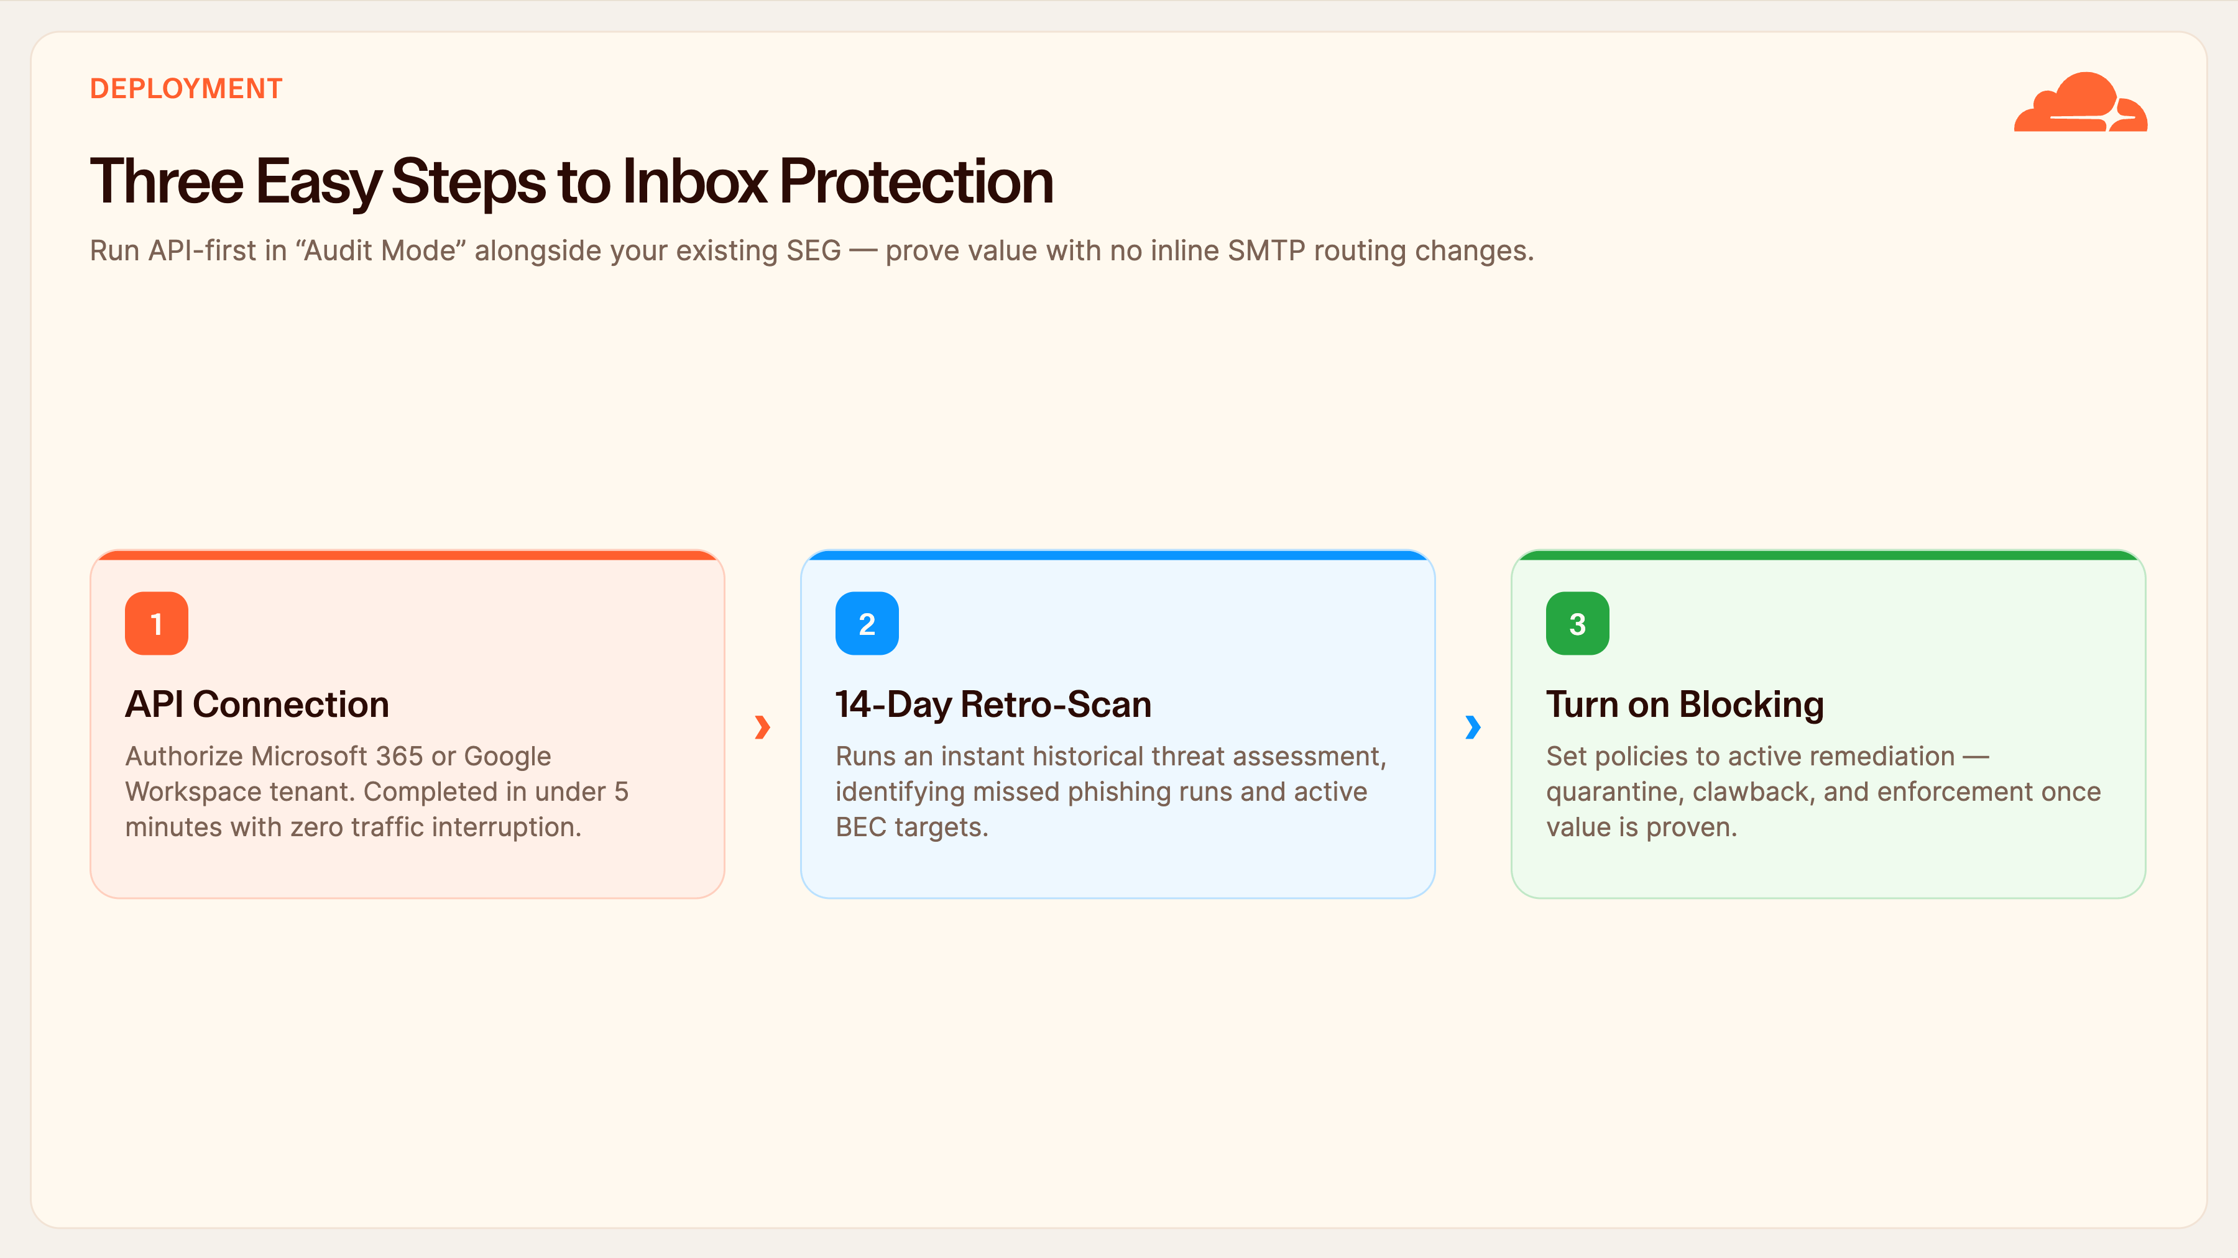
Notes:
Deployment — Three Steps
Deployment is genuinely three steps. Step one: authorize the M365 or Google tenant over API — under five minutes, no interruption to mail. Step two: we immediately run a fourteen-day retroactive scan of what's already in the mailboxes, surfacing phishing runs and active BEC targets that slipped past your current tools.
Step three, once you've seen the value, you flip from audit mode to active remediation — quarantine and clawback. The whole thing runs alongside your existing gateway, so there's no rip-and-replace and no routing risk.

Slide 13
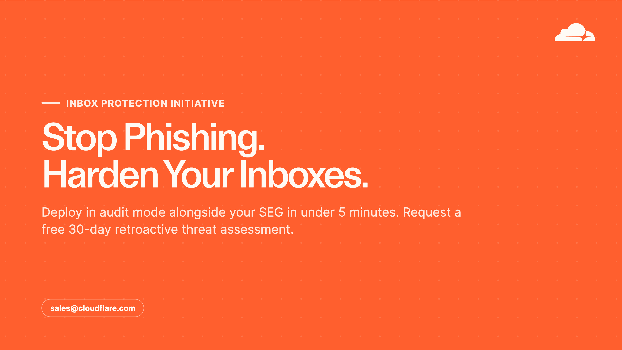
Notes:
Closing & Call to Action
Let me leave you with a simple, low-risk next step. Deploy us in audit mode via API, right alongside your existing gateway — it takes about five minutes and changes nothing about your mail flow.
We'll run a free thirty-day retroactive assessment and show you exactly what's getting through today. No routing changes, no risk — just visibility. Let's get that assessment scheduled. Thank you, and I'm happy to take questions.

