Slide 1
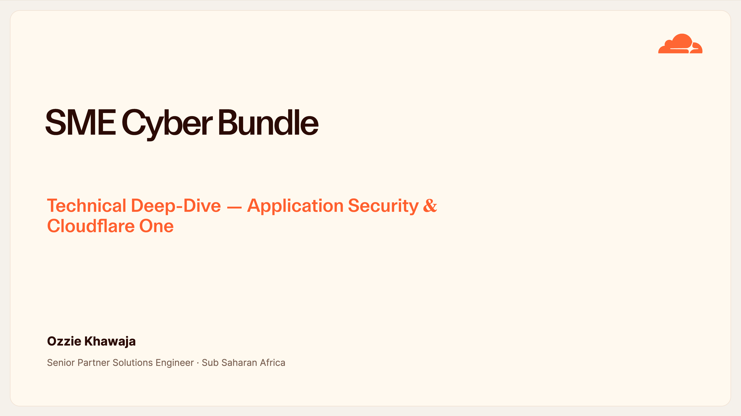
Notes:
SME Cyber Bundle — Cover
Good morning, and thank you for the time. Over the next twenty minutes I'll take the MTN team through the SME Cyber Bundle — what it is technically, and why it wins for your Nigeria customers.
The promise is simple: five security products, one platform, one global network. I'll structure this in four parts — first the threat landscape and why SMEs are exposed, then the application-security layer, then Cloudflare One for Zero Trust, and finally the platform that ties it all together.
I'll go feature by feature, but I'll always land on two things: what each capability does for the SME end customer, and what it means commercially for MTN. Keep your questions coming as we go — there's time at the end of each part.

Slide 2
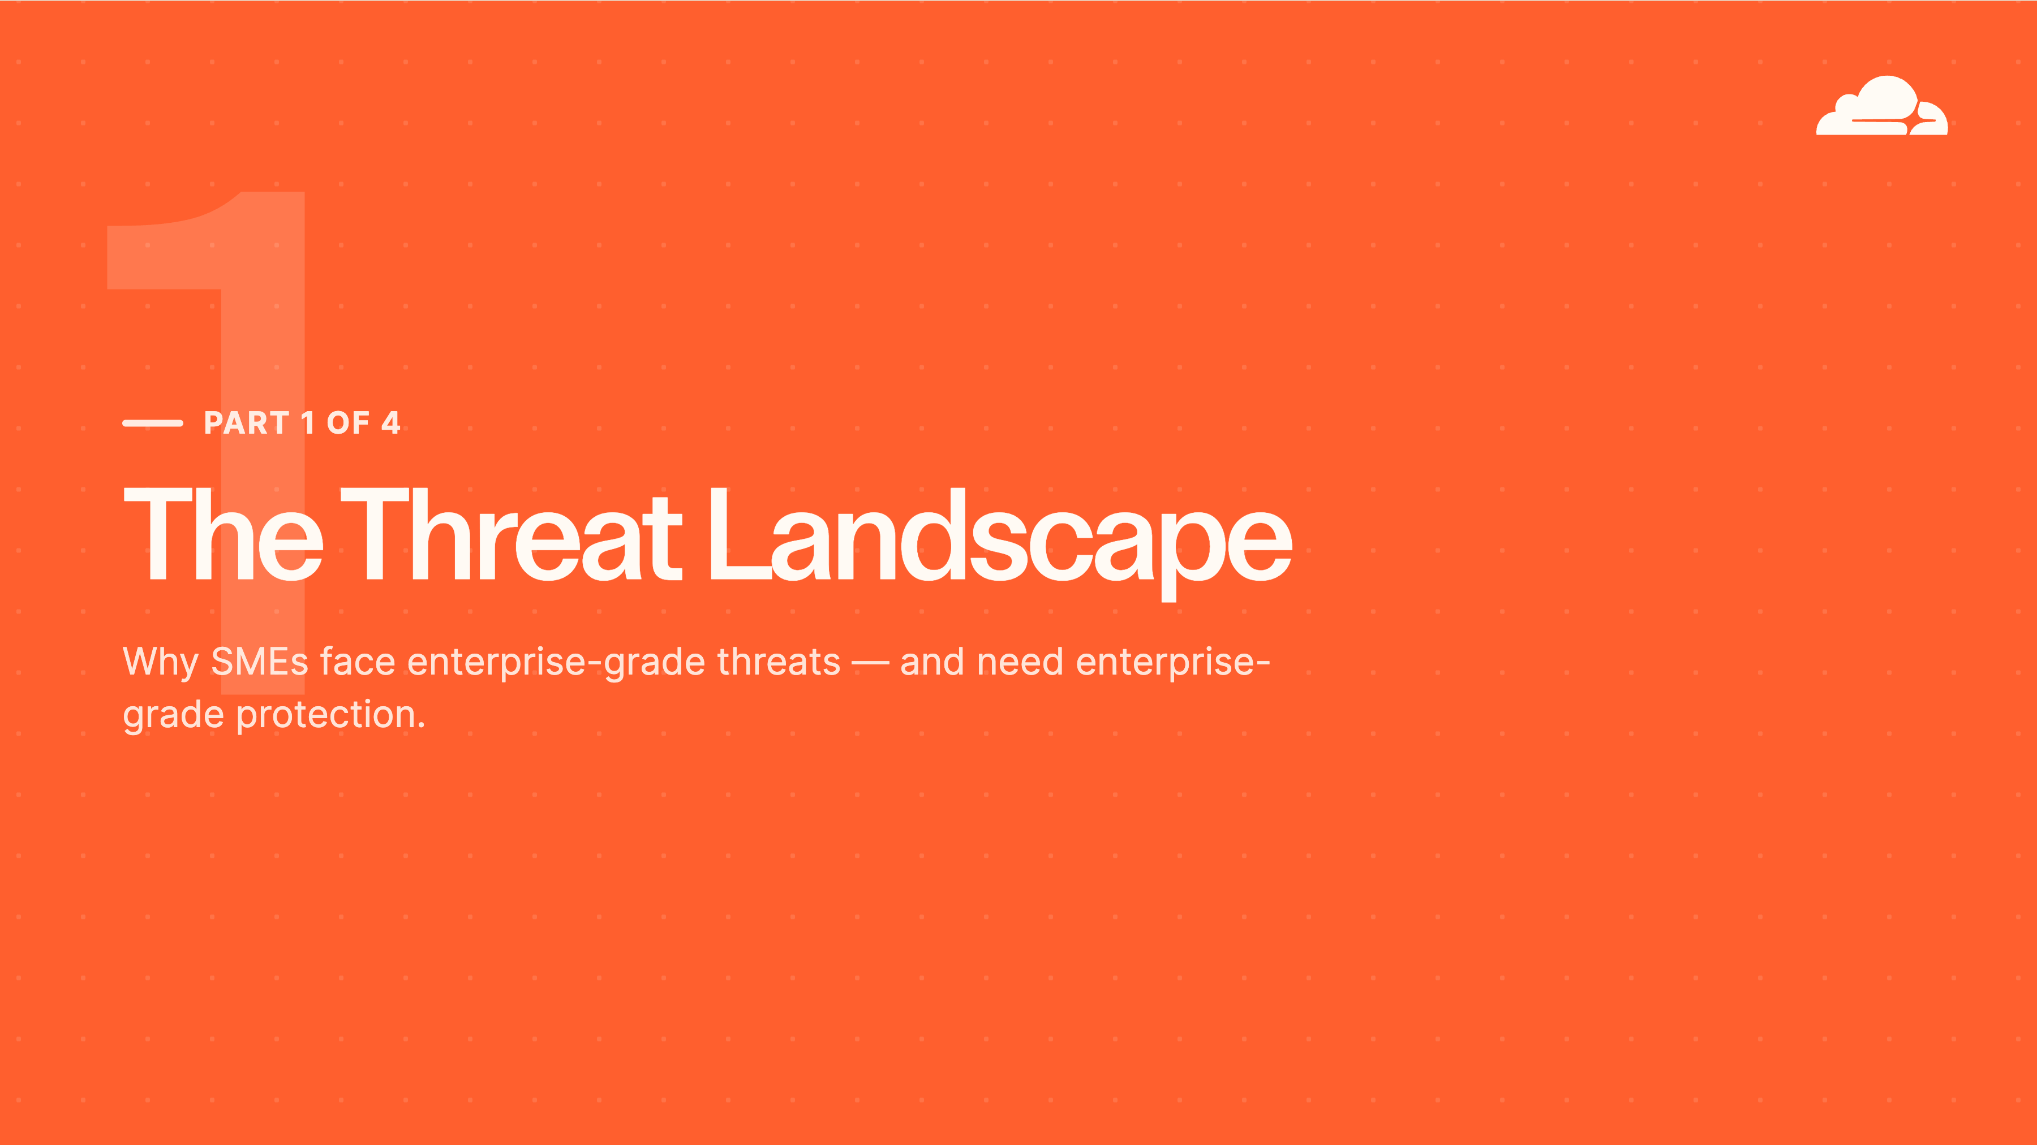
Notes:
Part 1 — Threat Landscape
Part one: the why. There's a persistent myth that SMEs fly under the radar. They don't. Modern attacks are automated — botnets scan every reachable IP address on the internet, indiscriminately. A Nigeria retailer or clinic gets probed by exactly the same tooling as a global bank. The only real difference is that the SME has no security team to notice or respond.
And remember the market context: Africa's largest economy and its fintech capital, so there is real money and real data behind these businesses. Nigeria carries some of the continent's highest rates of credential stuffing and card-not-present fraud. So the question this whole section answers is: how do we give that SME genuine enterprise-grade protection — without enterprise-grade cost, headcount, or complexity?

Slide 3
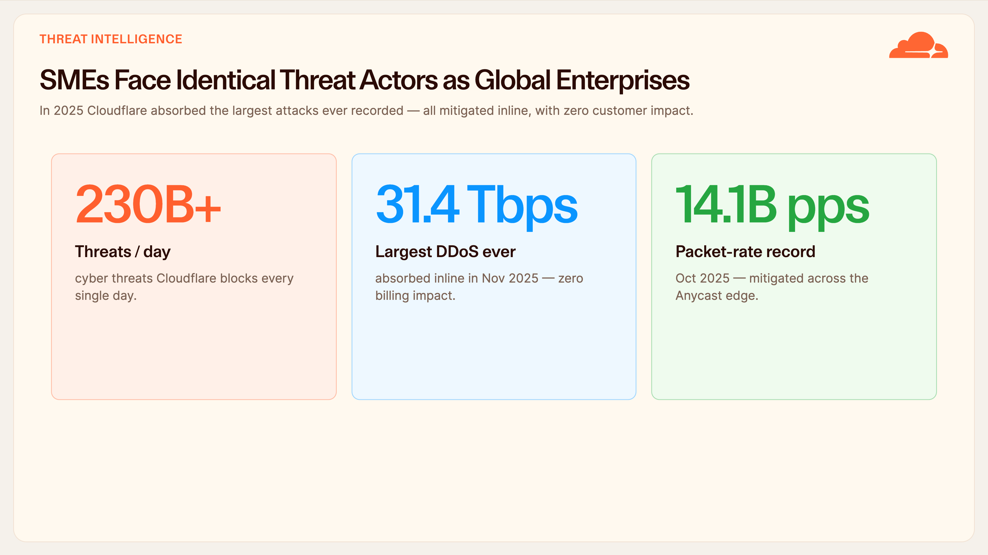
Notes:
Threat Landscape — Scale
Three numbers to set the scale. We block over 230 billion cyber threats a day across the network. In 2025 we absorbed the largest DDoS in history — 31.4 terabits per second — and separately the highest packet-rate attack ever recorded, 14.1 billion packets per second. To put that in context, either of those would instantly saturate the total international bandwidth of most countries.
But the bragging rights aren't the point. The point is how they were handled: every one was mitigated inline, automatically, by the network itself — no war-room, no human in the loop, and critically, zero billing impact to the customer. There was no overage invoice for absorbing a record-breaking attack.
That's the leap for an SME. This is protection they could never build, staff, or afford on their own, and it's on from day one. For MTN, that is the value proposition in a single slide: you're not reselling a box, you're reselling the world's largest security network.

Slide 4
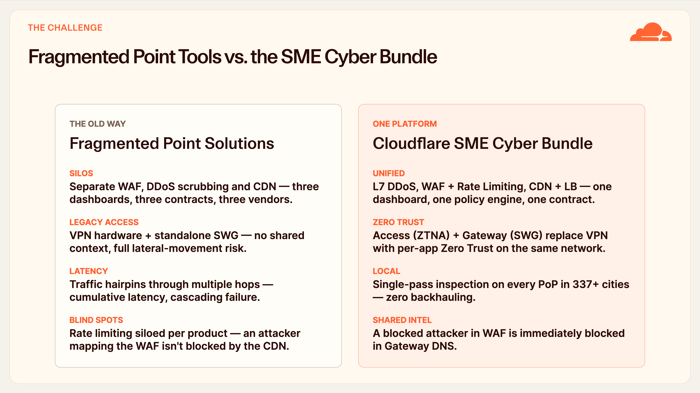
Notes:
The Challenge — Fragmentation
This is the problem we replace. On the left is how most Nigeria SMEs buy security today, if they buy it at all: a separate WAF from one vendor, a separate DDoS scrubbing service from another, a separate CDN, plus a physical VPN appliance and a standalone web proxy. That's three or four dashboards, three or four renewals, and — when something breaks at 2am — vendors who all point at each other.
There are two hidden costs here. First, latency: traffic hairpins through each appliance and each hop, and in our region that compounds badly. Second, blind spots: because the tools are siloed, an attacker who's busy mapping the WAF isn't being stopped by the CDN or the DNS layer — there's no shared context.
On the right is the bundle: the same five capabilities on one platform, one policy engine, one contract, with shared threat intelligence. A block in the WAF is instantly a block in Gateway DNS. The benefit for the lean SME is dramatically fewer tools to run and no integration work. The benefit for MTN is one clean product to provision, bill, and support — and far fewer escalations.

Slide 5
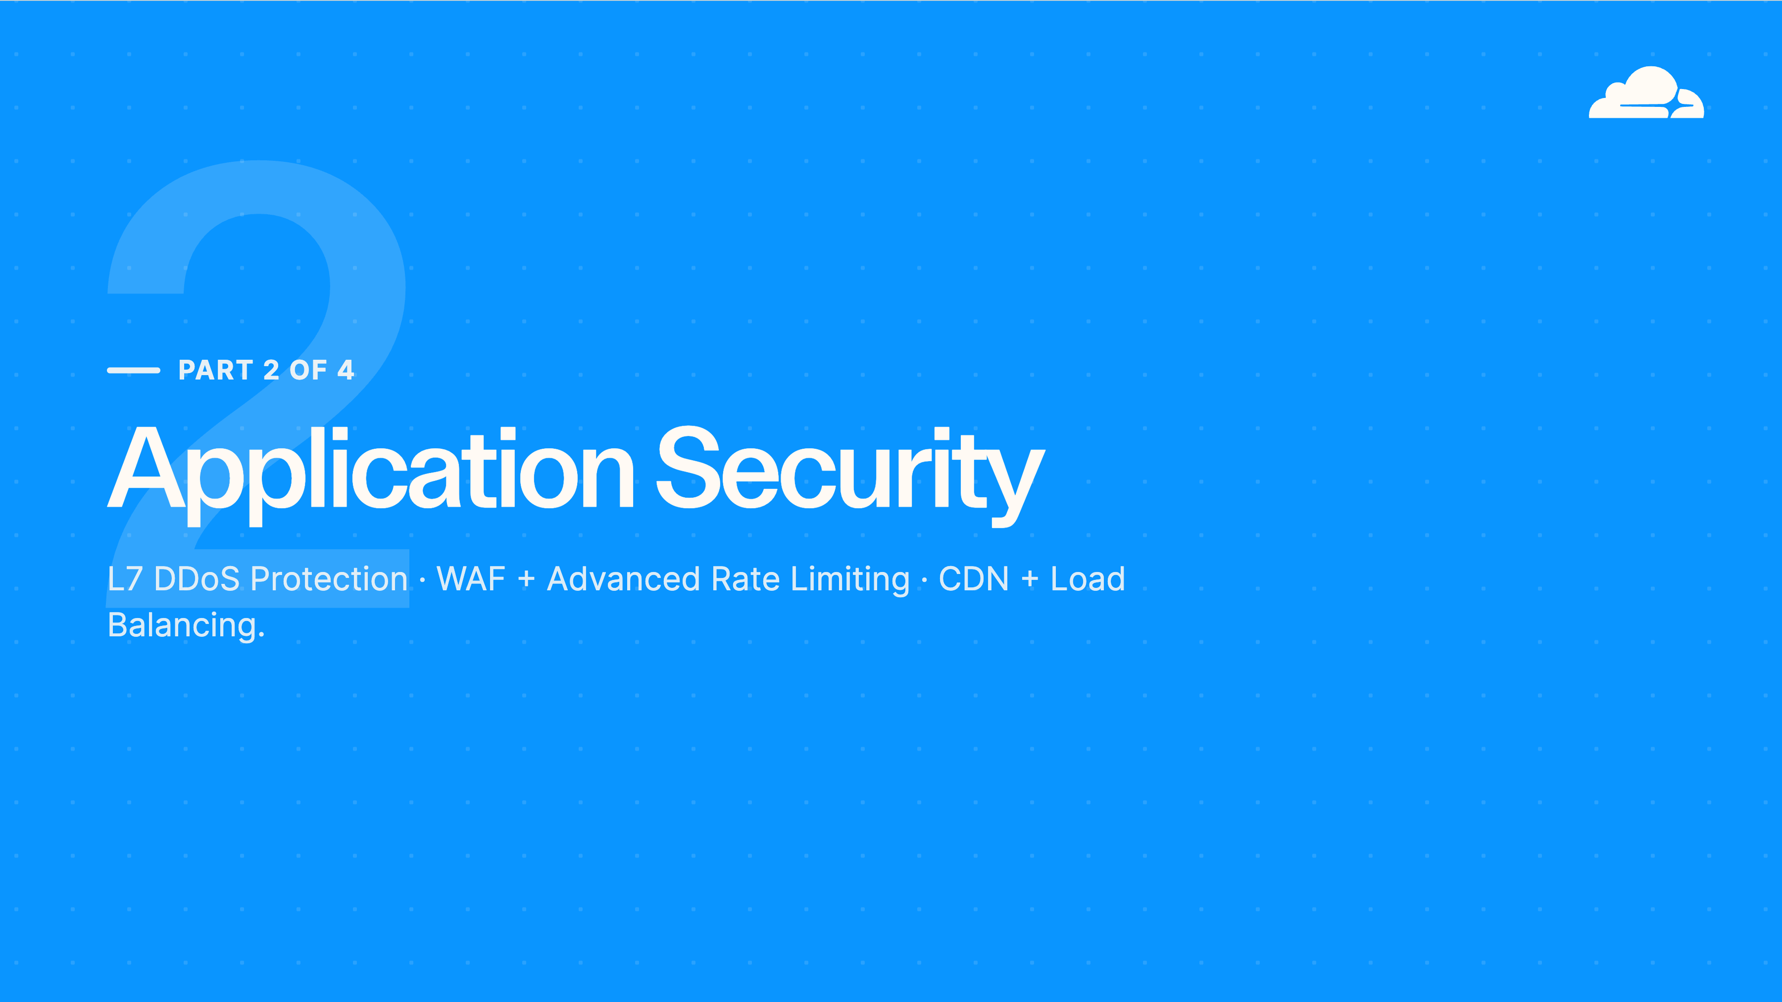
Notes:
Part 2 — Application Security
Part two — application security. This is everything that protects a customer's public-facing web properties and APIs: Layer 7 DDoS protection, the WAF with advanced rate limiting, and CDN with load balancing.
These are the three components most customers switch on first, and there's a good reason — it's the fastest possible win. There's no software to install and no hardware to ship. You change one DNS record to point at Cloudflare, and their site is protected, cached, and faster the very same day. That immediacy is a great opening move for MTN's sales motion.

Slide 6
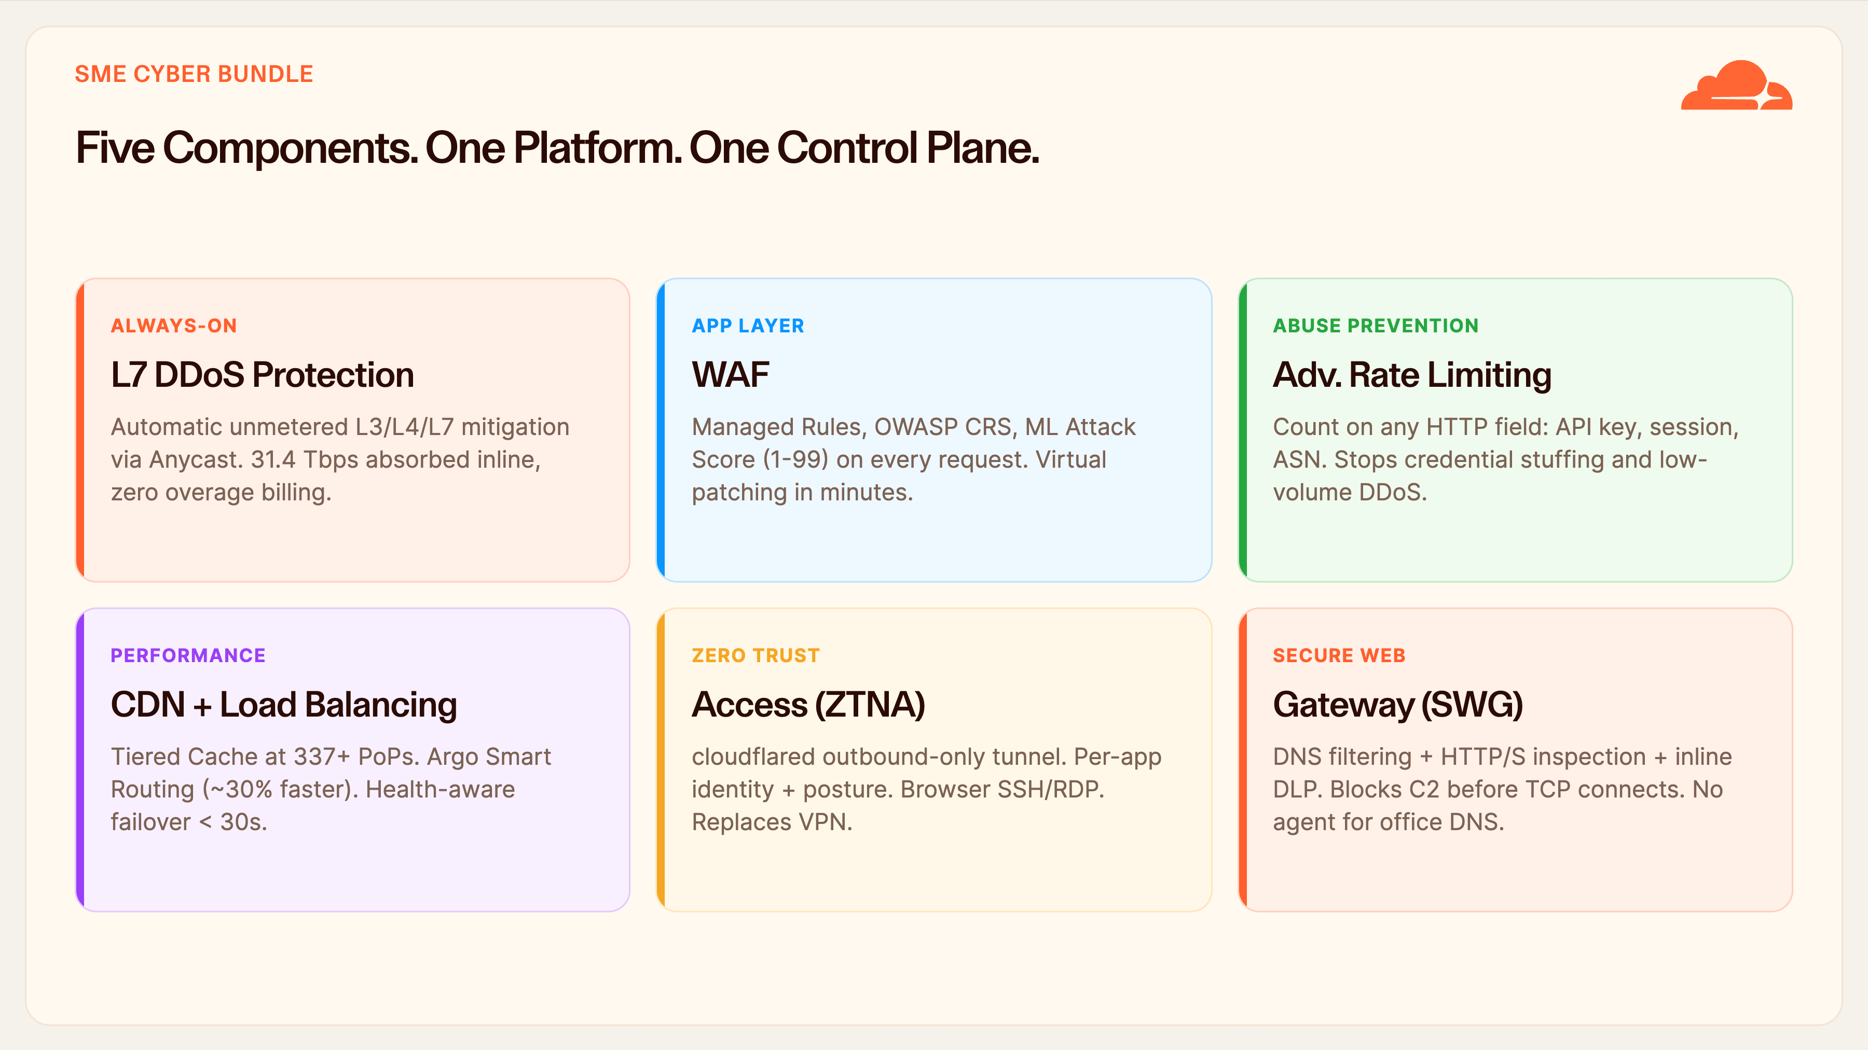
Notes:
Five Components Overview
Here's the whole bundle on one slide. Three application-security components — L7 DDoS, WAF with advanced rate limiting, and CDN with load balancing. Plus two Cloudflare One components — Access and Gateway — that replace the corporate VPN and secure the users' web browsing.
The headline, though, isn't any single box — it's the control plane underneath all five: one dashboard, one policy engine, one API. A rule you write once can reference identity, threat score, and geography together, because it's all the same system.
For an SME with no dedicated security staff, that unification is the real operational win — there's nothing to stitch together, and no integration project. For MTN it means one onboarding flow and one bill, no matter which of the five components a given customer takes — and a natural upsell path from two products to five. Let me now take each one in turn.

Slide 7
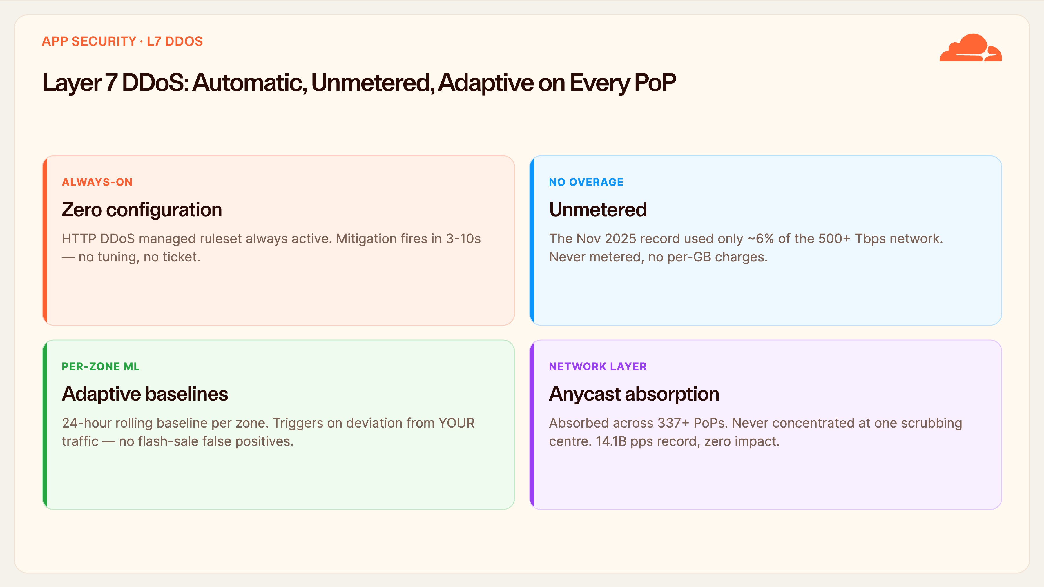
Notes:
L7 DDoS Protection
Let's start with Layer 7 DDoS. Feature one: it's always-on with zero configuration. The HTTP DDoS managed ruleset is live the moment traffic is proxied, and mitigation fires in three to ten seconds — no thresholds to tune, no ticket to raise, no analyst on call. For an SME that means an attack is over before anyone even knows it started.
Feature two, and this is the one that lands commercially: it's unmetered. That 31-terabit record attack used only about six percent of our network capacity, and the customer is never billed per gigabit of attack traffic. That's the difference between staying online and receiving a surprise five-figure invoice from a traditional scrubbing provider.
Feature three is adaptive baselines — per-zone machine learning builds a rolling 24-hour picture of each customer's normal traffic, so a payday surge or a marketing promo isn't misread as an attack. No false positives blocking real buyers.
And because it's all Anycast, attacks are absorbed across all 337-plus PoPs, never funnelled back to a single scrubbing centre. Business value in one line: the customer's site simply stays up, and MTN never takes the outage call.

Slide 8
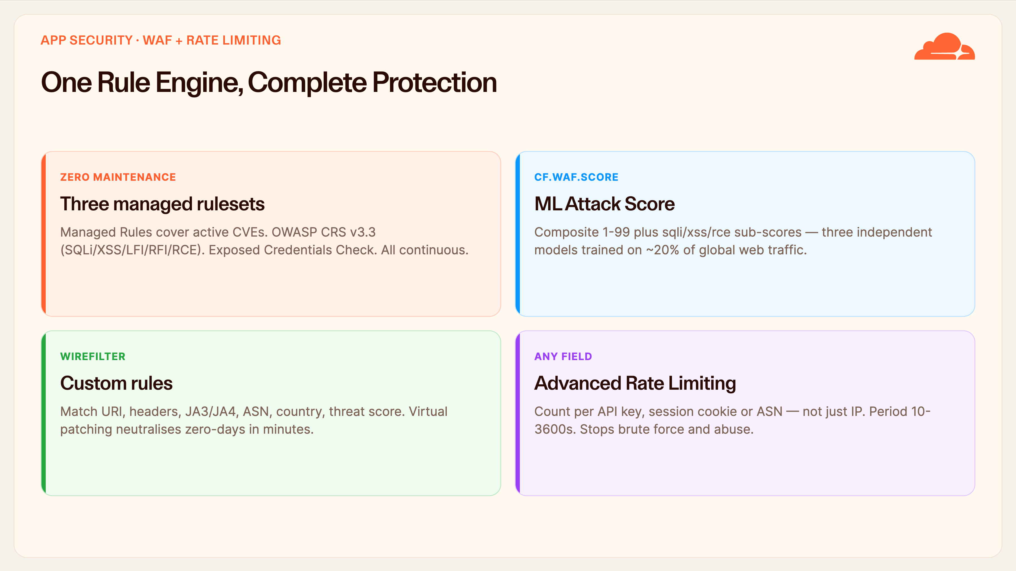
Notes:
WAF + Rate Limiting
The WAF is really one rule engine doing four jobs. First, three managed rulesets run continuously with zero maintenance on the customer's side: our own coverage for active CVEs, the OWASP Core Rule Set for SQL injection, cross-site scripting and the rest, and an exposed-credentials check that flags logins using already-breached passwords.
Second, and this is what sets us apart — every single request also gets a machine-learning Attack Score from one to ninety-nine, with separate sub-scores for SQLi, XSS and RCE. Because those models are trained on roughly twenty percent of all web traffic, we catch novel zero-day patterns before a signature for them even exists.
Third, custom rules use our Wirefilter syntax to match on almost any attribute — URI, headers, JA3 fingerprint, ASN, country, threat score. That's how we virtually patch a zero-day in minutes, protecting the customer instantly instead of waiting for them to patch their own software.
Fourth, advanced rate limiting counts on any field — an API key, a session cookie, an ASN — not just source IP. That's precisely what stops the credential-stuffing, account-takeover and card-testing fraud that hits Nigeria merchants hardest. Business value: fewer breaches, fewer chargebacks, and a protected brand reputation.

Slide 9
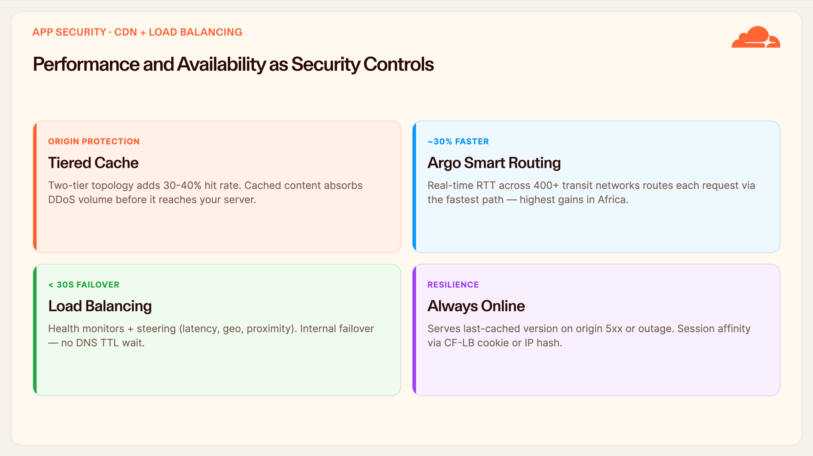
Notes:
CDN + Load Balancing
People file CDN under performance, but here it doubles as a security control. Tiered Cache uses a two-tier topology that lifts cache-hit rates by thirty to forty percent, which means most requests never touch the customer's origin at all — and cached content absorbs DDoS volume before it can ever reach their server. Caching is DDoS protection.
Argo Smart Routing then measures real-time round-trip times across more than 400 transit networks and steers each request down the fastest available path, avoiding congestion. The gains are largest exactly here in Nigeria, where the public internet is congested and default routes are often indirect — riding IXPN peering in Lagos and the WACS, MainOne and Equiano submarine landings instead of bouncing through Europe.
Load Balancing adds health-aware failover in under thirty seconds — with no DNS-TTL wait, because the failover happens inside our network — plus steering by latency, geography, or proximity. And Always Online will serve the last-good cached copy of the site even if the origin is completely down.
The benefit to the SME is concrete: a faster site that converts better, and one that never shows a paying customer an error page. For a business, that's revenue protection, not just security.

Slide 10
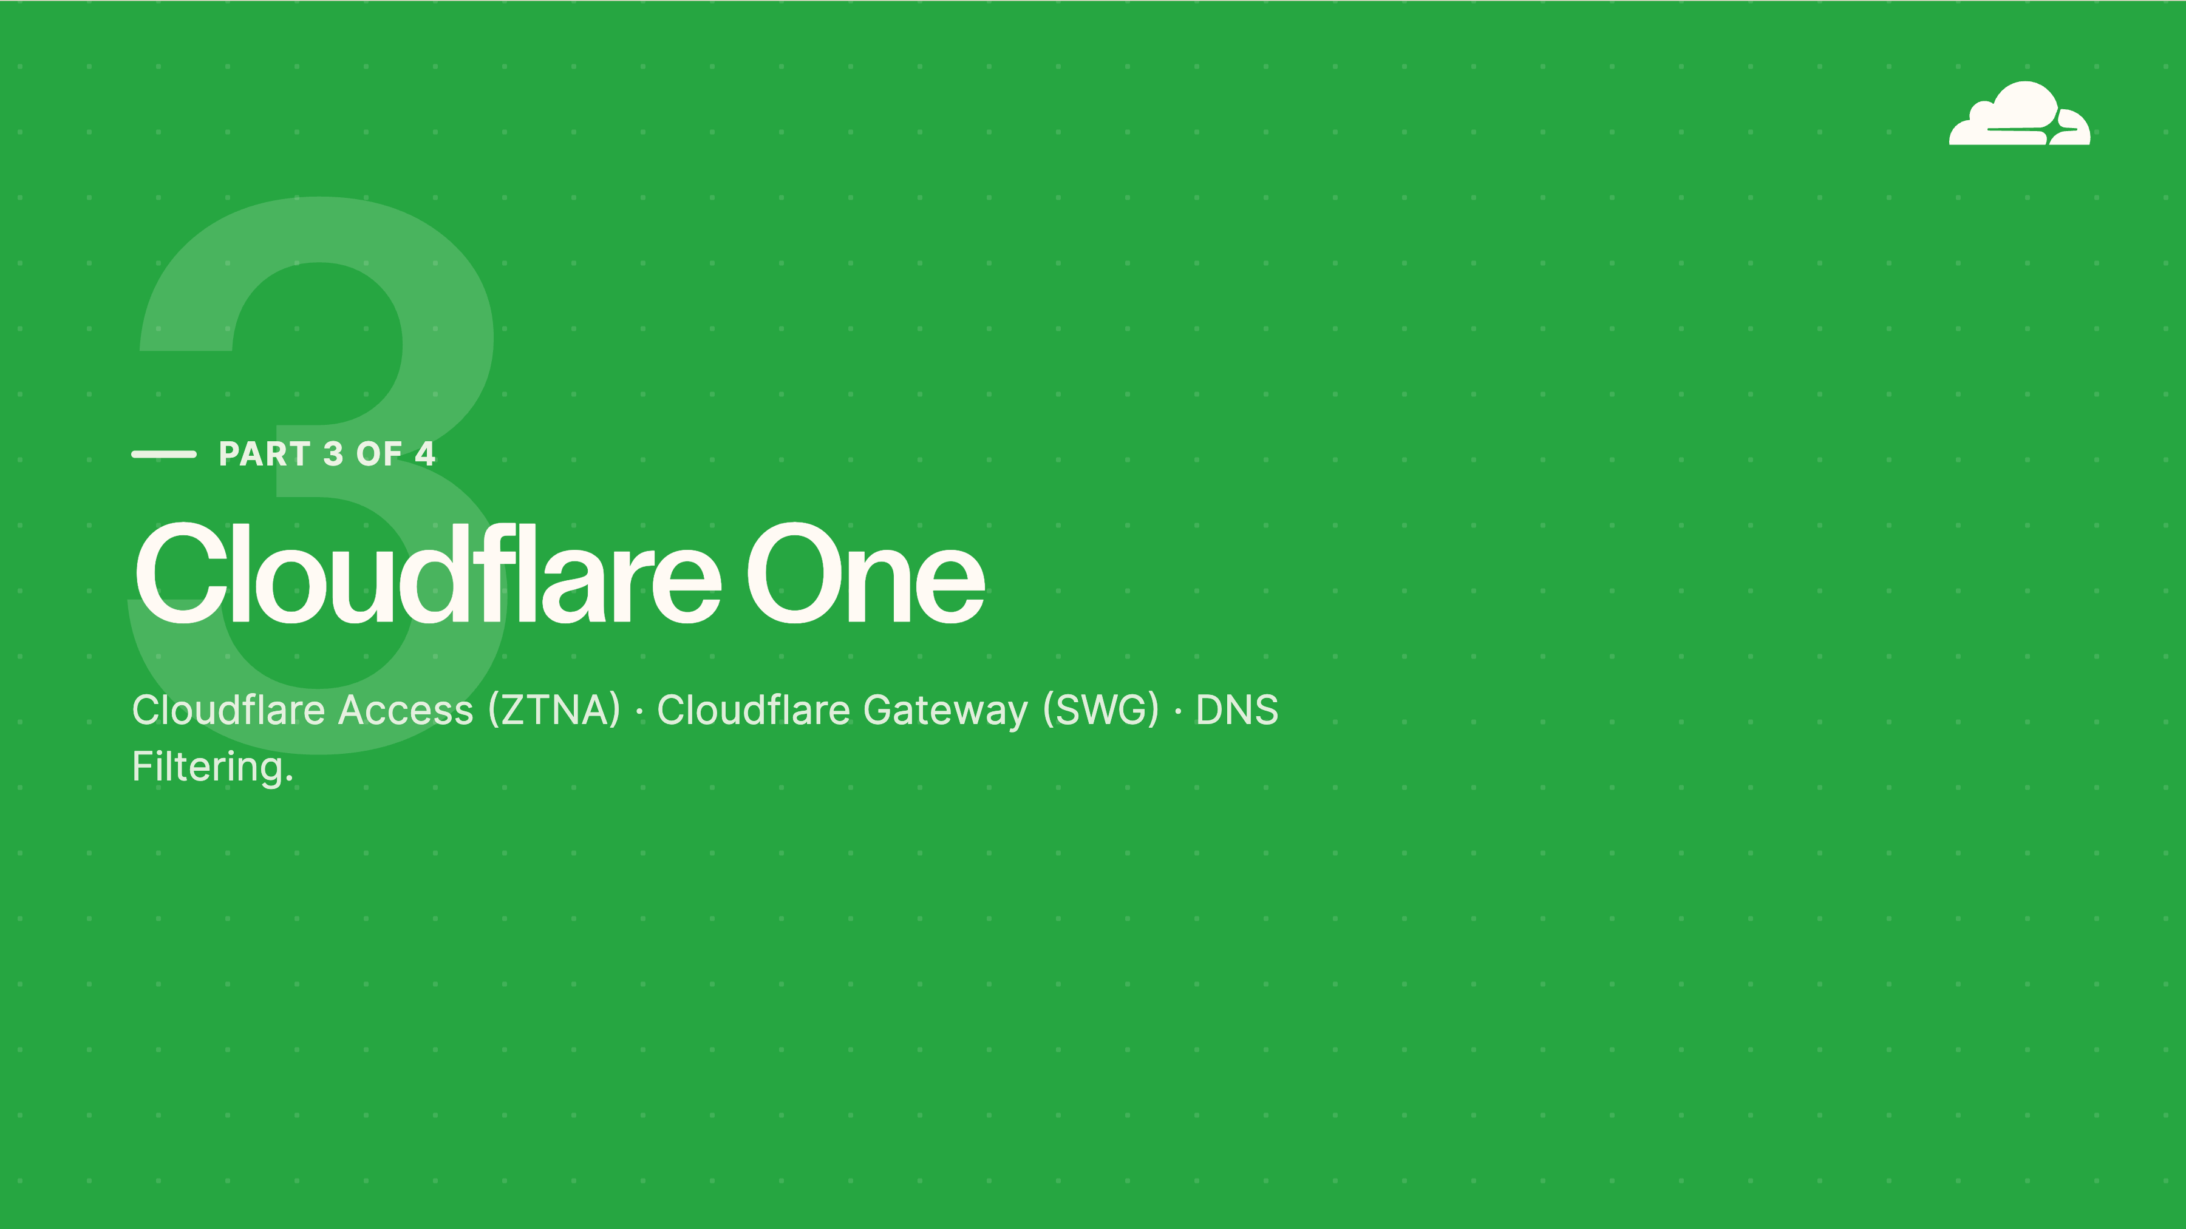
Notes:
Part 3 — Cloudflare One
Part three shifts the focus. So far we've protected the customer's websites; now we protect their people and their internal systems. This is Cloudflare One — our Zero Trust layer.
Two components. Access, which retires the traditional VPN for reaching internal applications. And Gateway, our secure web gateway with DNS filtering that protects users as they browse. The key thing: both run on the same network and the same dashboard as everything we've already covered. There is no second stack for the SME to buy, and no second console for MTN to support.

Slide 11
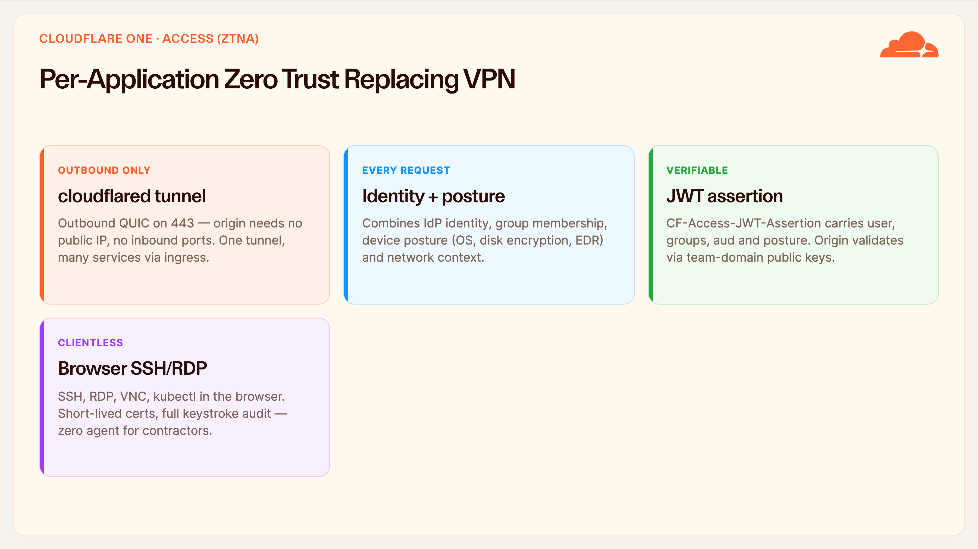
Notes:
Access (ZTNA)
Access replaces the VPN with per-application Zero Trust. It starts with the cloudflared tunnel: a lightweight connector that dials outbound over QUIC on 443. Because it's outbound-only, the customer's origin needs no public IP and no open inbound ports whatsoever — that single fact removes most of their internet-facing attack surface. One tunnel can front many internal services.
Then the model flips from 'trust once at login' to 'verify every request'. Each request is evaluated against identity from their IdP, group membership, device posture — OS version, disk encryption, is the EDR agent running — and network context, together.
Every proxied request carries a signed JWT, the CF-Access-JWT-Assertion, that the origin can independently verify against your team-domain public keys, so the app itself gets cryptographic proof of who's calling.
And for contractors or third parties, they get browser-based SSH, RDP and VNC with short-lived certificates and full keystroke audit — zero agent to install. For a Nigeria SME whose staff are on personal laptops and shared machines, this is enterprise access control they could never stand up alone — and it retires the annual VPN-appliance licence and its maintenance headache entirely.

Slide 12
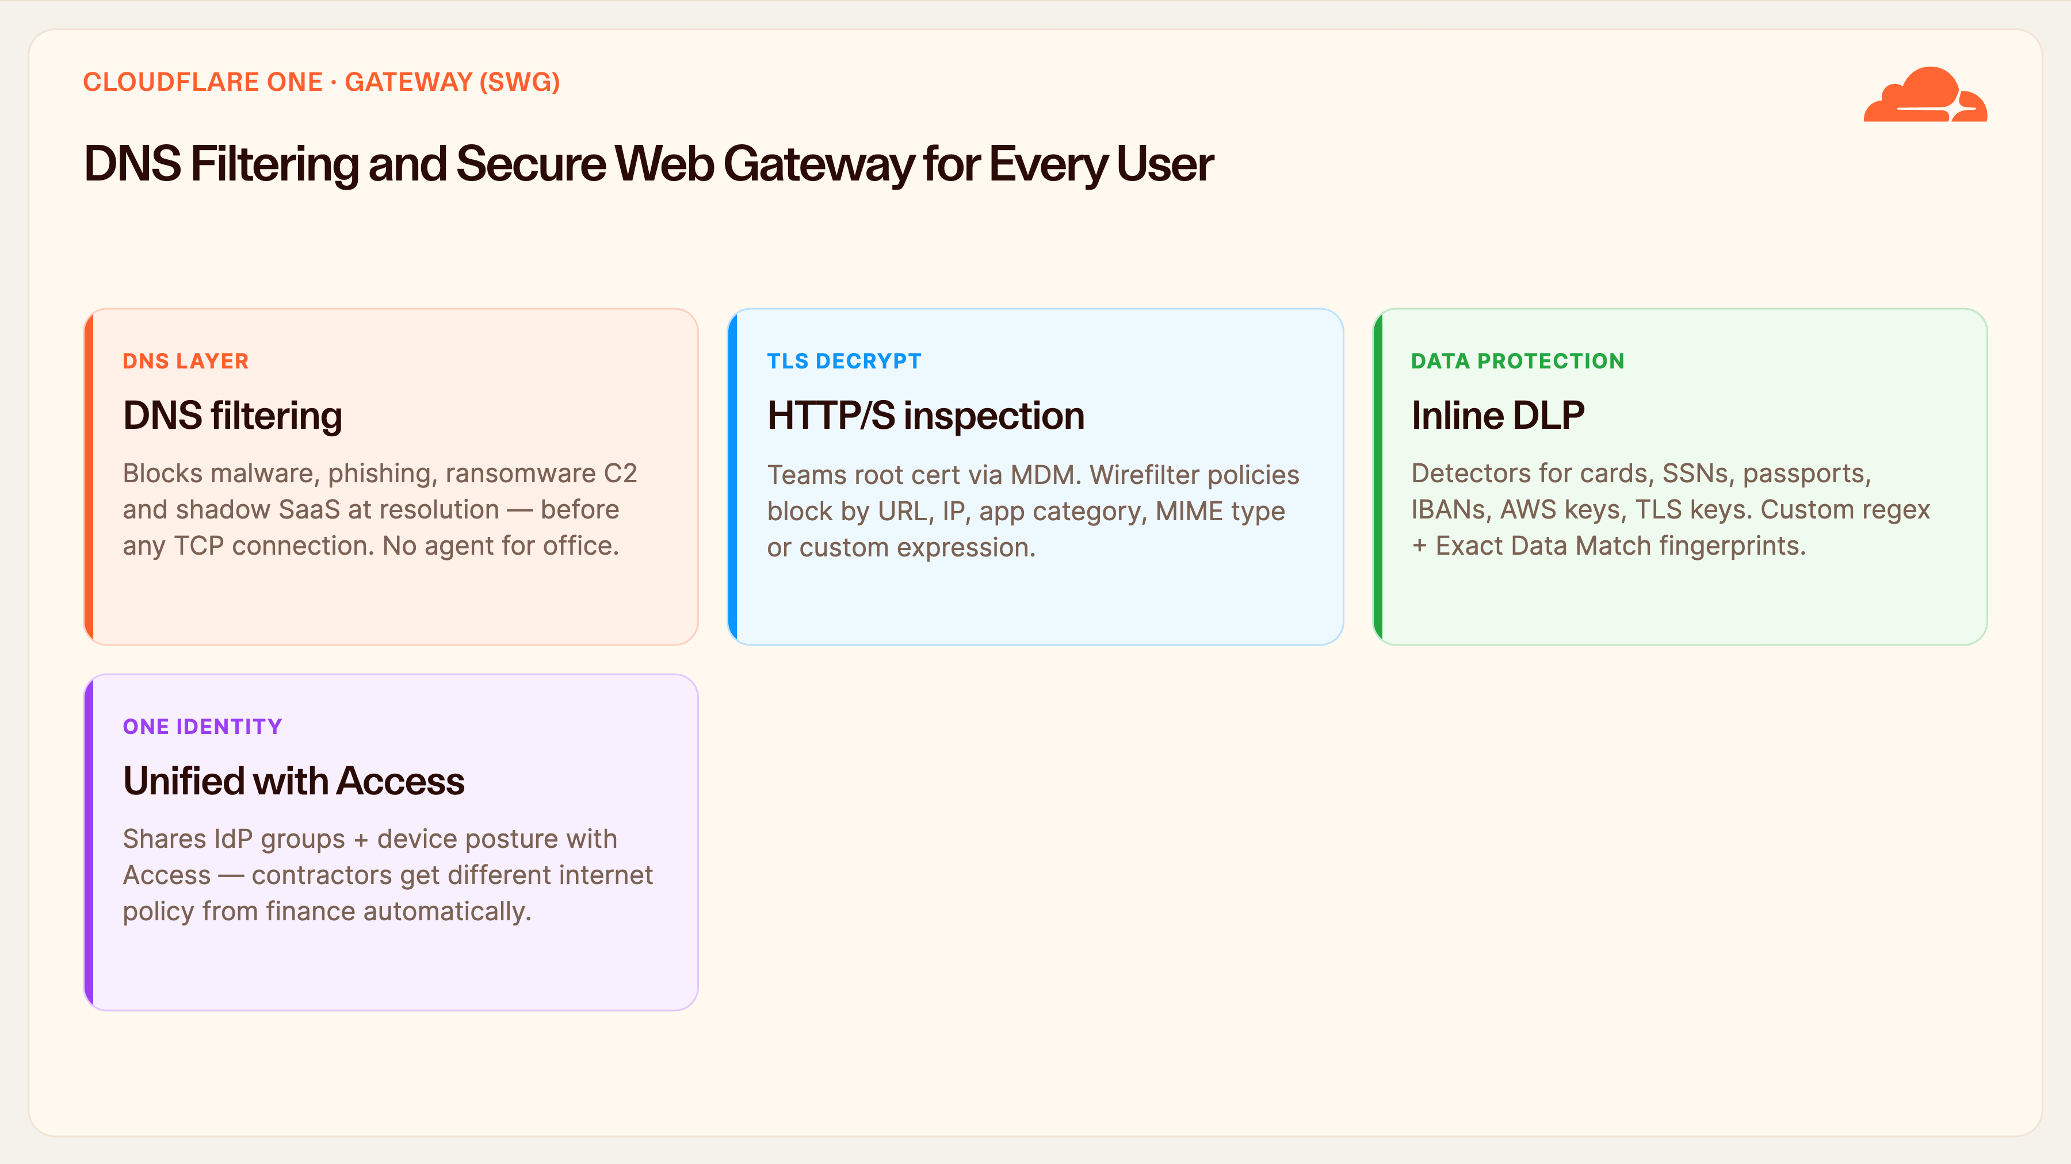
Notes:
Gateway (SWG)
Gateway secures the outbound side — what the customer's users reach out to on the internet. It works in layers. First, DNS filtering: it blocks malware, phishing, and ransomware command-and-control at the moment of DNS resolution, before a TCP connection is ever established. That stops most attacks at the cheapest possible point, and for a whole office it needs no agent at all — you simply point the network resolver at Cloudflare.
Second, when they want deeper control, HTTP/S inspection with TLS decryption — rolled out via a Teams root certificate through MDM — lets you filter by URL, IP, application category, MIME type, or a custom Wirefilter expression.
Third, inline DLP inspects that traffic and stops sensitive data from leaving — card numbers, national IDs, passports, IBANs, cloud keys — using built-in detectors, custom regex, or exact-data-match fingerprints.
And because Gateway shares the same identity and device posture as Access, a contractor automatically gets a different internet policy than the finance team — one identity model across inbound and outbound. For businesses that must satisfy the NDPA 2023 and the NDPR, that data-control and audit story is a compliance selling point, not just a security one — and compliance is often what actually closes the deal.

Slide 13
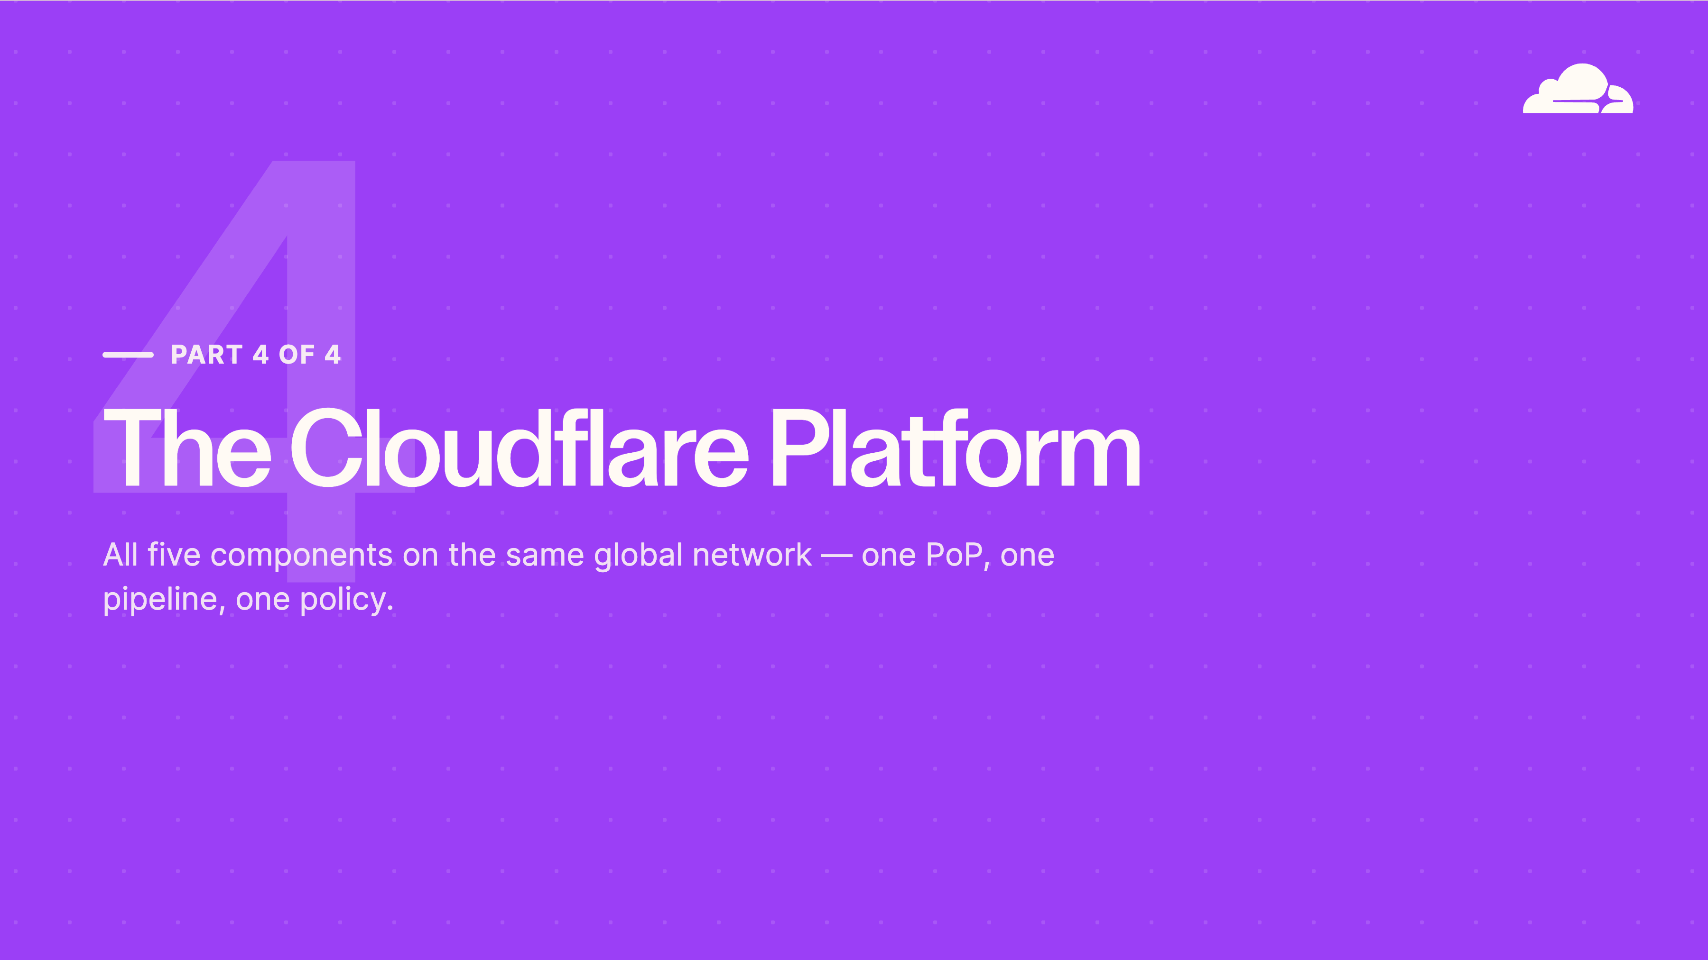
Notes:
Part 4 — The Platform
The last part is the platform that ties it all together. Everything we've discussed runs on one global network — one PoP, one software pipeline, one policy engine. A single request is inspected once, in one pass, at one location near the user.
This architecture is what makes the bundle genuinely more than five products bolted together — and it's the part that competitors who assembled their portfolios through acquisitions simply cannot replicate, because their products still run on separate stacks.

Slide 14
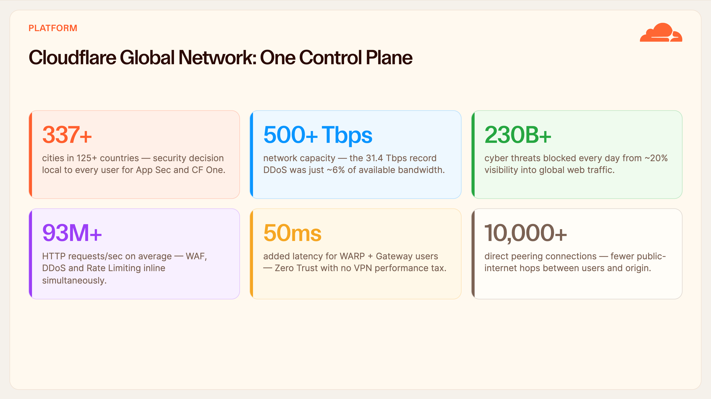
Notes:
Platform — By the Numbers
These figures describe one network doing all of it simultaneously. 337-plus cities in 125-plus countries means the security decision is made local to the user — no backhauling traffic to Europe and back. 500-plus terabits of capacity is why even record attacks barely register. And our roughly twenty-percent visibility into global web traffic is where the intelligence comes from: we see a novel attack land on someone else first, and we've already blocked it for your customer.
93 million HTTP requests a second on average — with WAF, DDoS and rate limiting all running inline on every one of them. 10,000-plus direct peering connections means fewer public-internet hops between users and origin.
But watch the fifty-millisecond figure especially. That's the total added latency for a Zero Trust user going through WARP and Gateway. Better security with no VPN performance tax — protection that is genuinely invisible to the end user. For MTN, that's the difference between a security product customers tolerate and one they don't even notice.

Slide 15
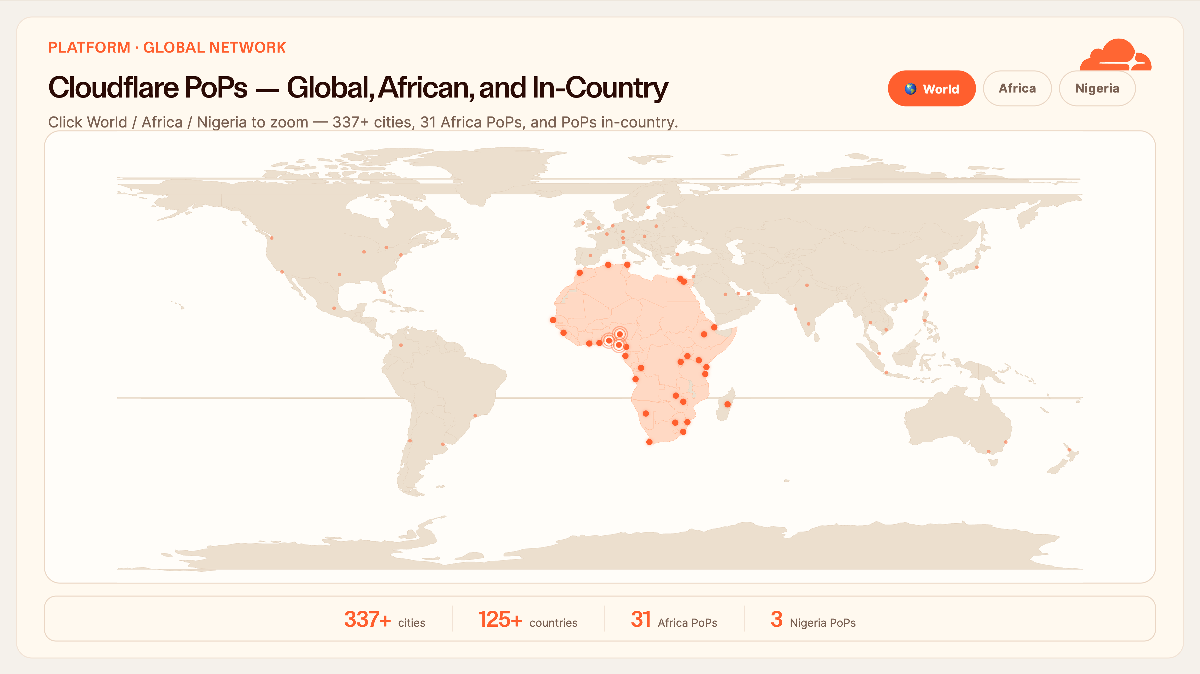
Notes:
Nigeria PoPs — Interactive Map
This is the map I like to close the network story on — and it's interactive, so let me walk through it with the buttons.
Start at World view. Every orange dot is a Cloudflare PoP, and the important thing is that each one runs the exact same full stack — WAF, DDoS, Access, Gateway. There's no 'lite' edge; a customer in Nigeria gets identical capability to one in London.
Now let me click Africa. 31 PoPs across 22 countries, and you can see the continent is genuinely covered. This is not a distant cloud reached over a slow undersea link — it is infrastructure physically on the continent.
And now Nigeria — Lagos, Abuja, Port Harcourt. Because we have PoPs in-country, traffic is inspected and served locally instead of hair-pinning out to Europe and back. Three concrete benefits: lower latency for the customer's own users, so their site feels fast; better data locality, which matters directly for the NDPA 2023 and the NDPR; and it rides IXPN peering in Lagos and the WACS, MainOne and Equiano submarine landings. The message for the MTN team is simple — we are already on your doorstep, so this is a local service you're selling, not a foreign one.

Slide 16
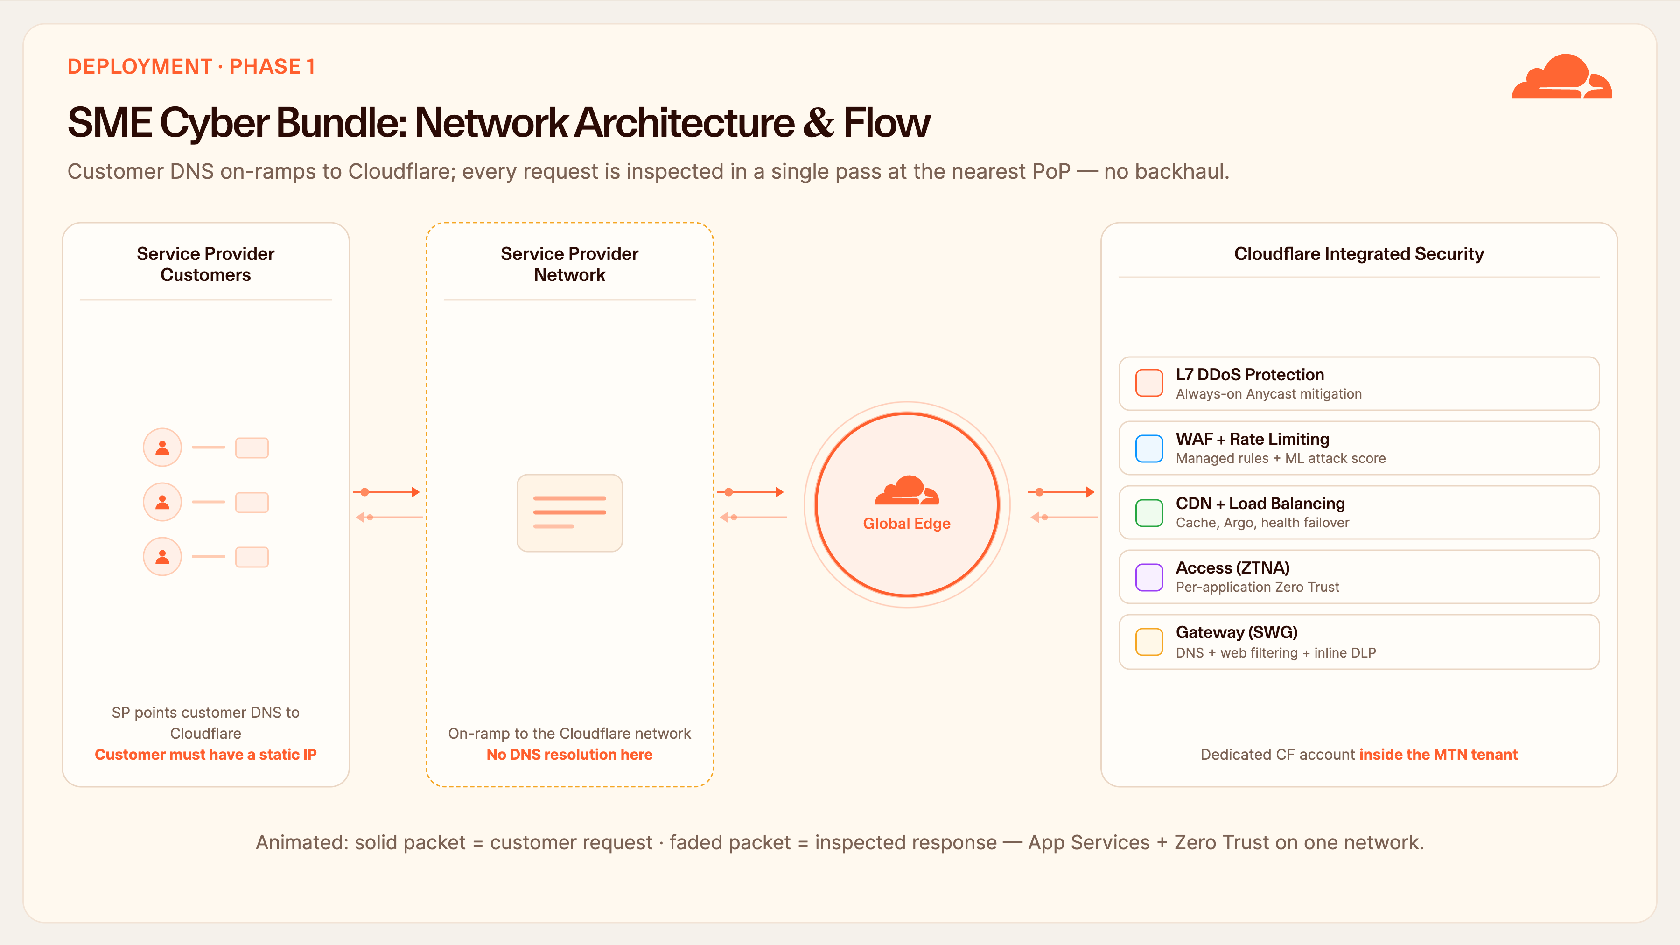
Notes:
Deployment Flow
Operationally, here's exactly how MTN delivers this to an SME. Step one: as the service provider, you change the customer's DNS to Cloudflare's; the customer just needs a static IP for their origin. That's the entire on-ramp — no appliance is shipped and nothing is installed on their premises.
Step two: their traffic now on-ramps to our network. DNS queries are resolved by Cloudflare and answered back through the MTN network, and every request gets single-pass inspection at the nearest PoP.
Step three, and this is the commercial heart of it: each customer gets their own dedicated Cloudflare account nested inside the MTN tenant, with the application services and Zero Trust components enabled per what they've bought. So MTN owns the billing relationship and the overarching control, while each SME gets fully isolated policy and their own dashboard.
That's a clean wholesale model. You provision in minutes rather than weeks, there's no logistics or hardware, and you can upsell from App Security into Zero Trust account by account, at your own pace.

Slide 17
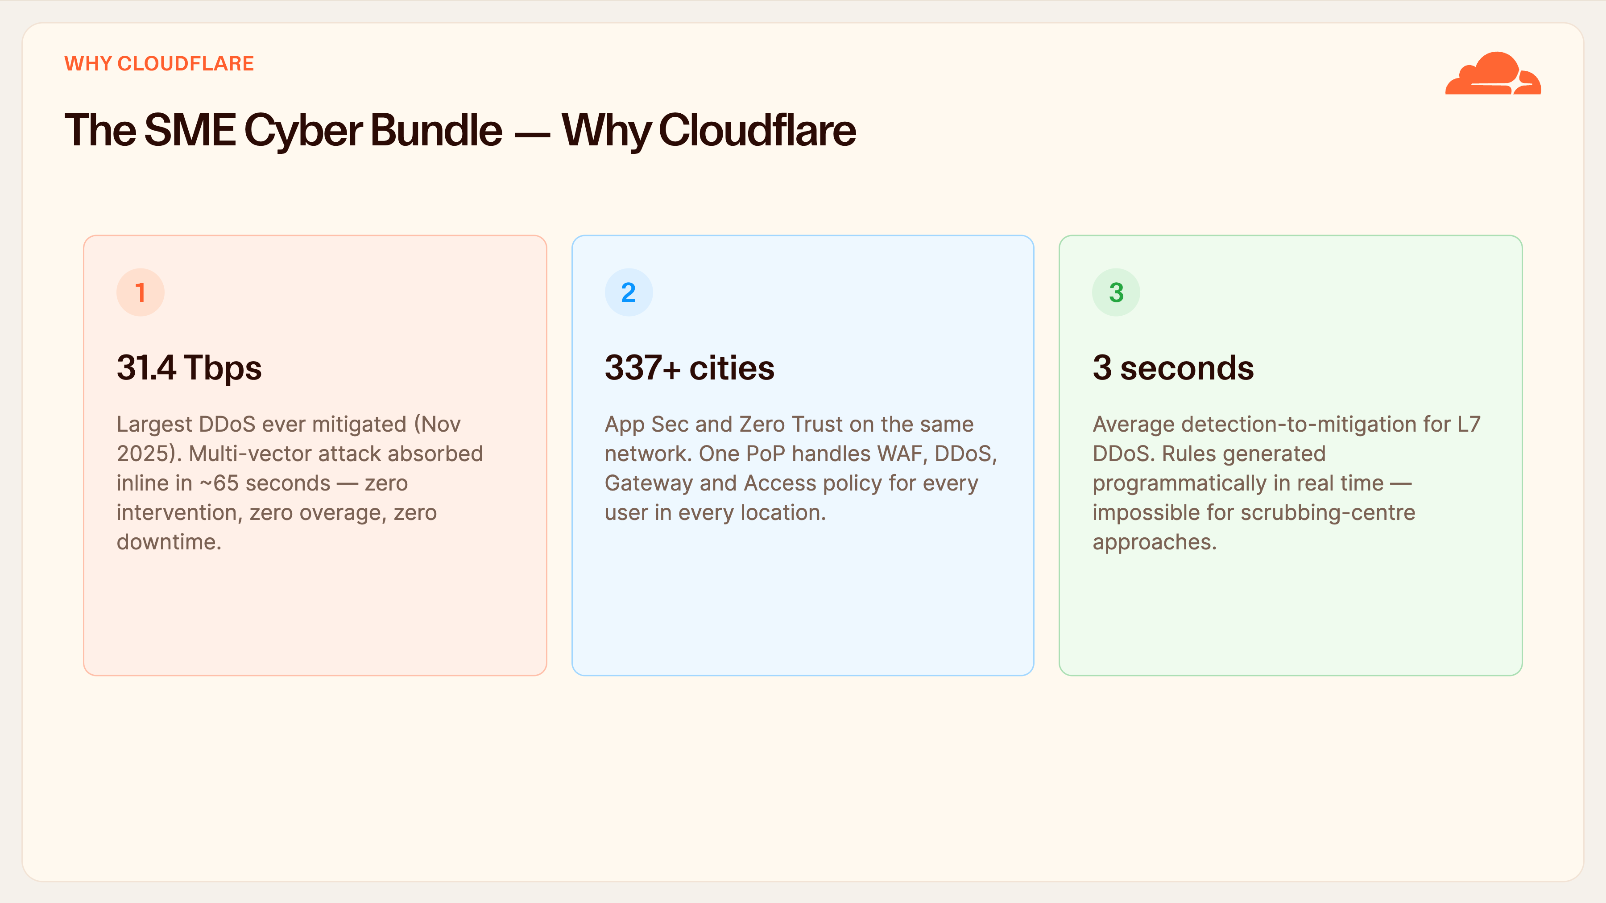
Notes:
Why Cloudflare
If the customer walks away remembering three things, make it these. First, 31.4 terabits — the largest DDoS ever recorded, a multi-vector attack absorbed inline in about sixty-five seconds with zero human intervention and zero overage. That's proof of scale. Second, 337-plus cities running both application security and Zero Trust on the same network — proof there's no separate stack to manage. Third, three seconds — our average detection-to-mitigation time for an L7 attack, because the rules are generated programmatically in real time, which a scrubbing-centre model architecturally cannot match.
So, features, benefits, business value in one sentence: five products, one platform, one network — and an SME in Nigeria gets protection that used to be reserved for banks, delivered and billed by MTN.

Slide 18
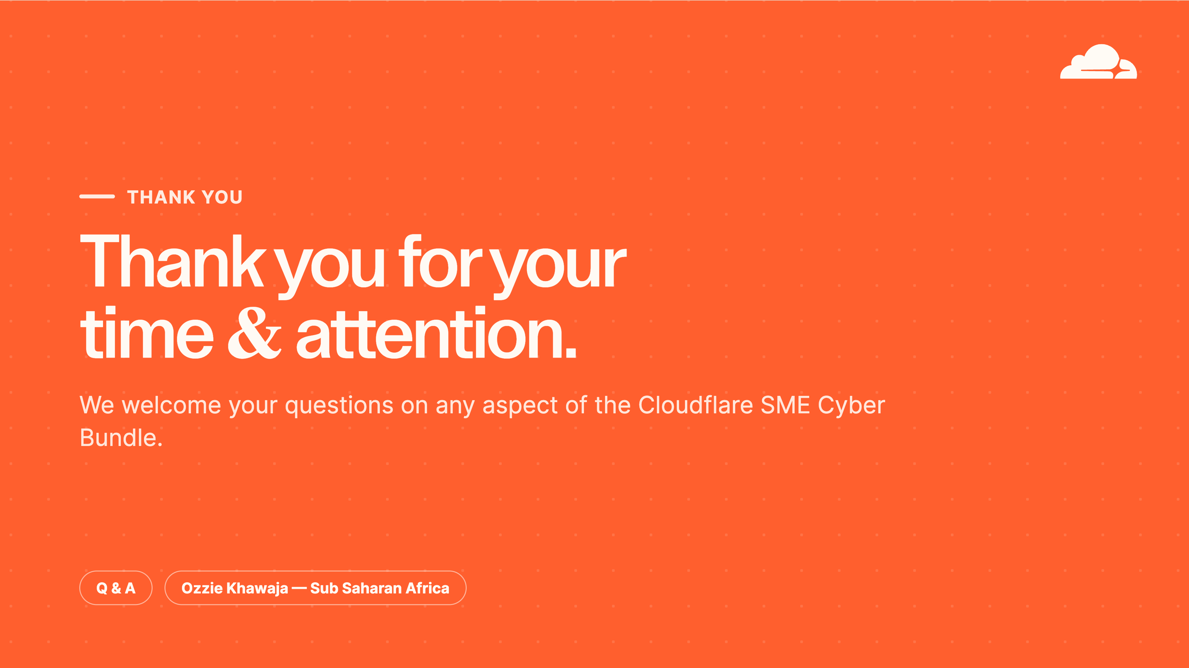
Notes:
Thank You / Q&A
That's the SME Cyber Bundle — five components, one platform, one network, and PoPs right here in Nigeria. Thank you for your time.
Let's open it up — whether it's the deployment model, the commercials inside the MTN tenant, the NDPA 2023 and the NDPR compliance, or any technical detail, nothing's off limits. What questions can I answer?

