Slide 1
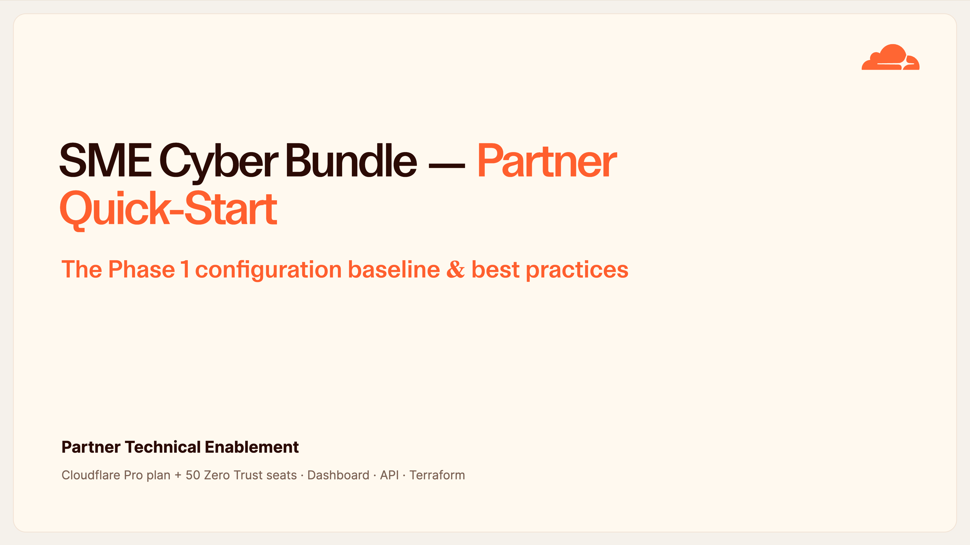
Notes:
SME Cyber Bundle — Partner Quick-Start
Welcome. Over this session I'll take the partner technical team through exactly how we provision the SME Cyber Bundle for an end customer — the prescriptive defaults, the dashboard click-paths, and the API/Terraform equivalents for doing it at scale.
The goal is that by the end, anyone here can stand up a consistent, auditable security baseline on any customer zone. This maps one-to-one to the Phase 1 feature matrix, so keep it as your working reference.
Two framing points: everything is written for the Pro plan plus the 50 included Zero Trust seats, and it's designed to be repeatable — you stamp the same baseline onto every customer.

Slide 2
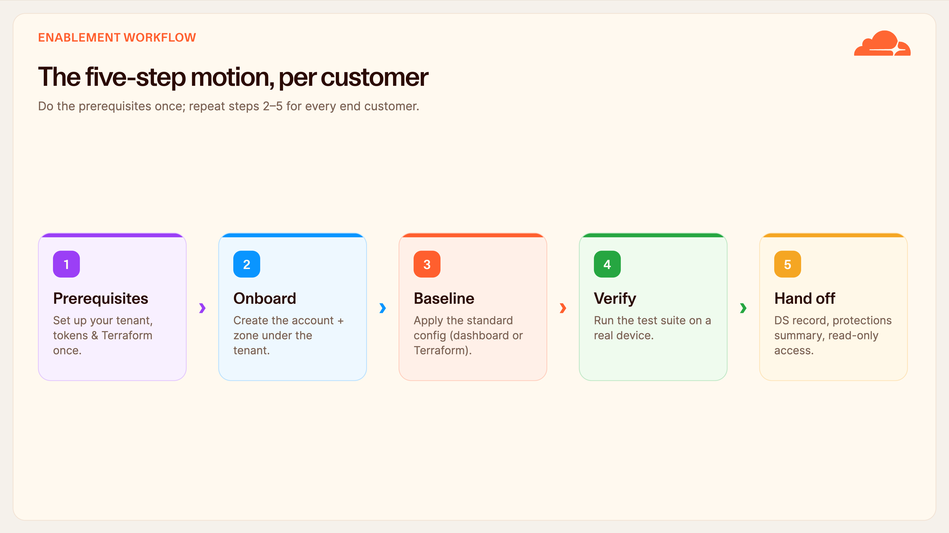
Notes:
The five-step motion
This is the whole motion on one slide. The prerequisites — tenant access, a scoped API token, your Terraform setup — you do once for the partner tenant. Then for each new customer you repeat four steps: onboard the account and zone, apply the baseline, verify, and hand off.
The key mindset: the baseline is not something you reinvent per customer. It's the same prescriptive set of settings every time. For scale, that means Terraform; for a one-off, it's the dashboard click-paths. We'll cover both.
Hold onto this five-step shape — the rest of the deck fills in the detail of each step.

Slide 3
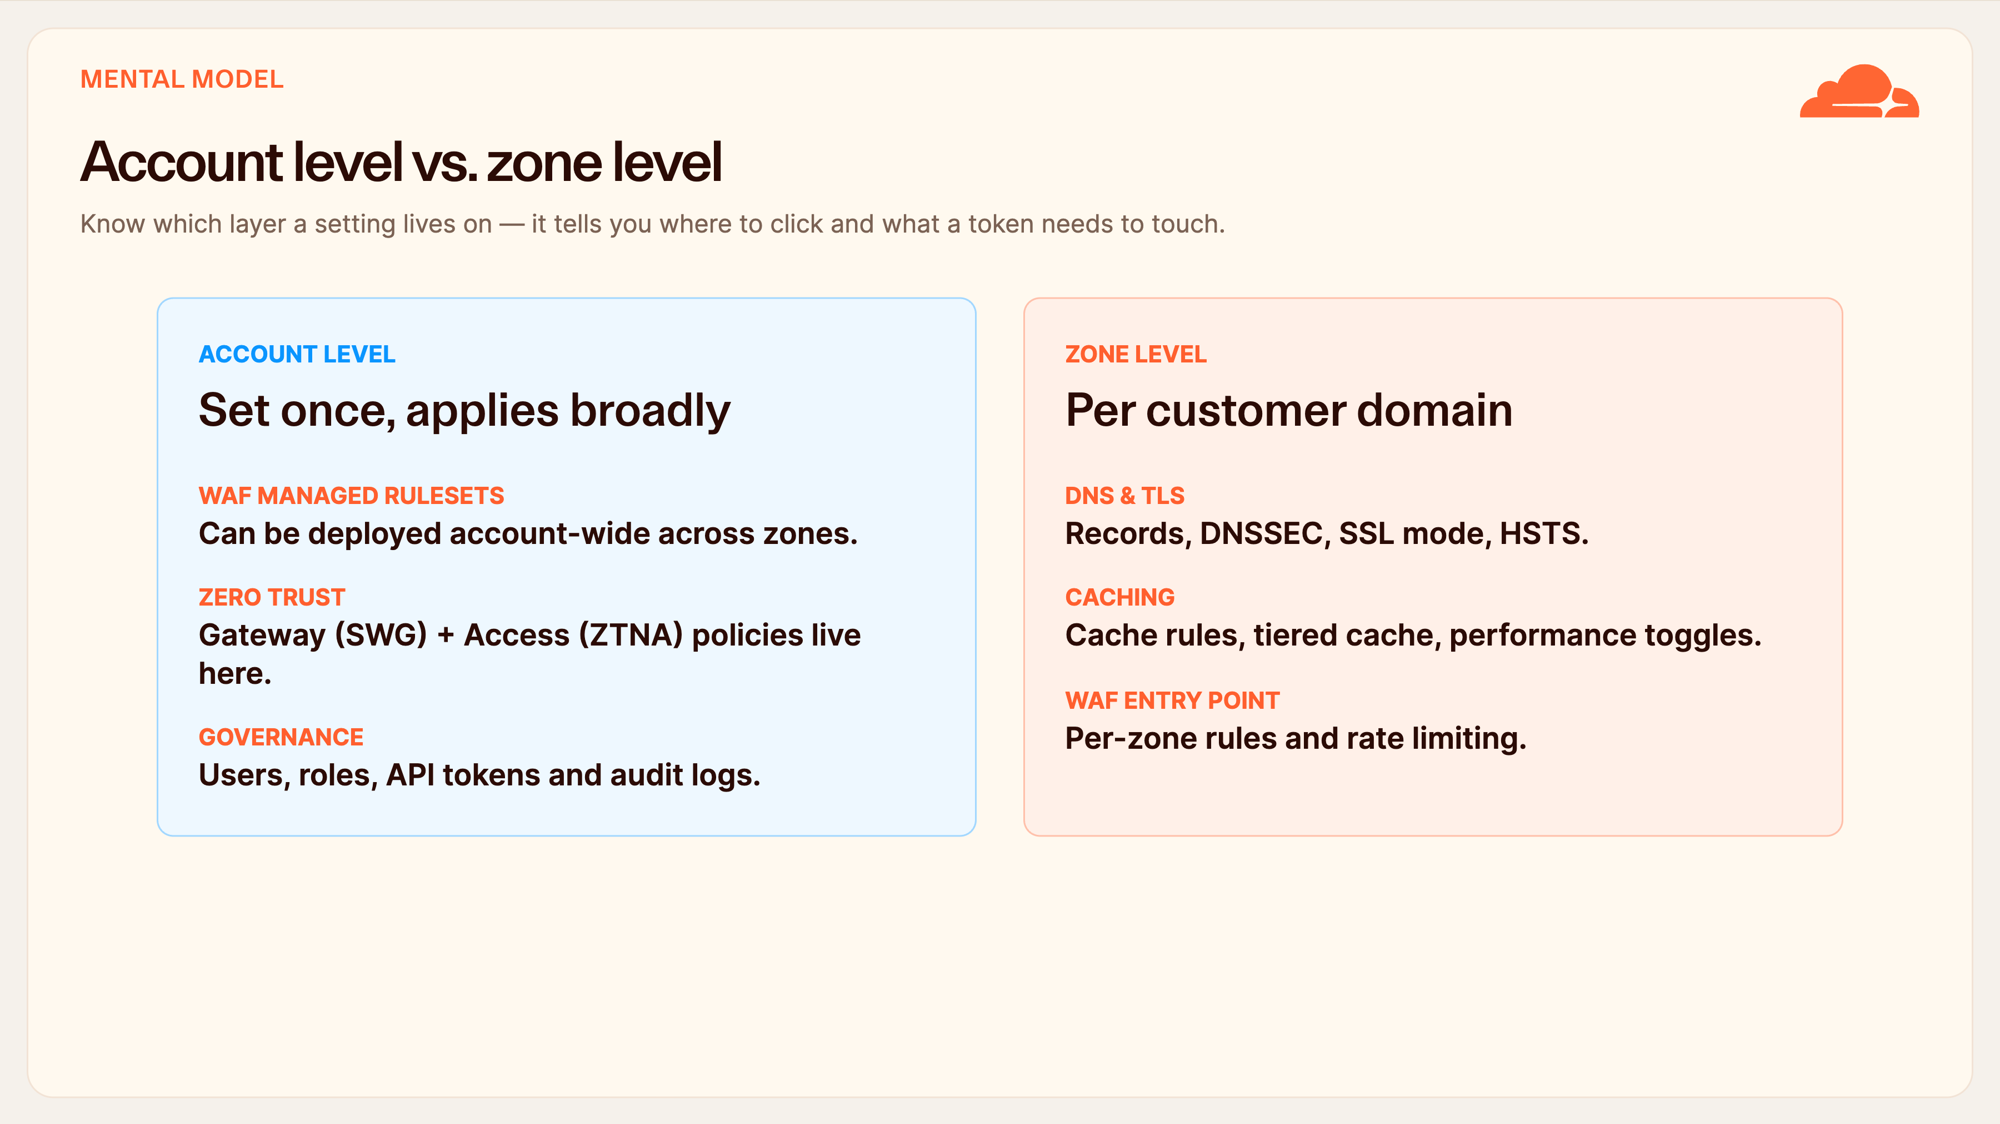
Notes:
Account level vs. zone level
Before we touch a single setting, internalise this split, because it saves a lot of confusion.
Account-level things are set once and apply broadly: the WAF managed rulesets can be pushed account-wide, all of Zero Trust — Gateway and Access — lives at the account, and so do your users, roles and tokens.
Zone-level things are per customer domain: DNS, DNSSEC, TLS, caching, and the per-zone WAF entry point and rate limiting.
Why it matters: when you're hunting for a setting, this tells you which dashboard to open, and when you scope an API token, it tells you whether you need account permissions, zone permissions, or both.

Slide 4
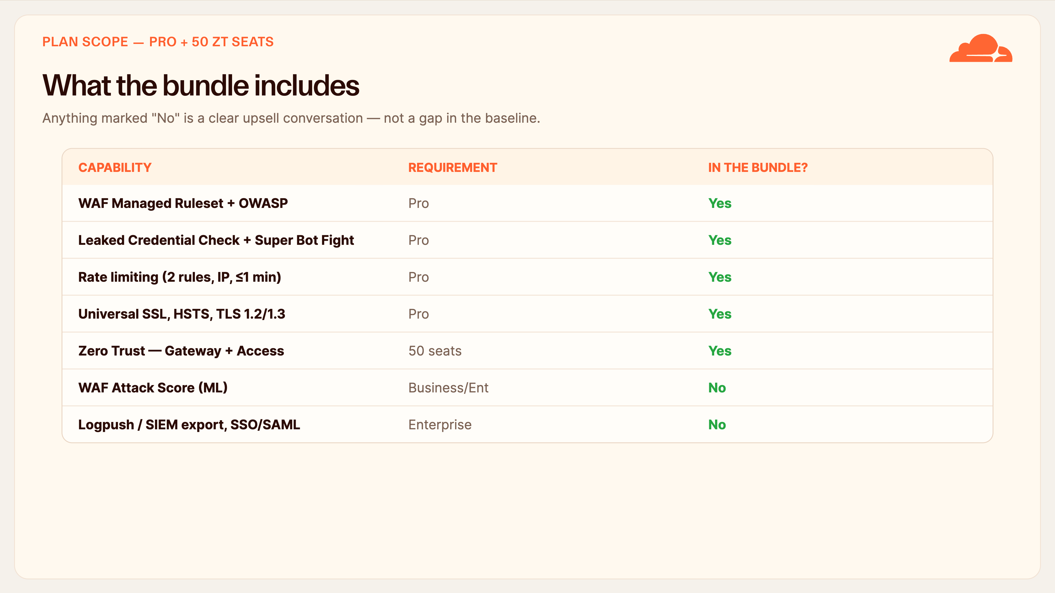
Notes:
What the bundle includes
Set expectations up front so nobody tries to enable something that isn't entitled. The green column is your quick yes/no.
Included on Pro plus the 50 Zero Trust seats: the WAF Managed Ruleset and OWASP, Leaked Credential Check, Super Bot Fight Mode, two rate-limiting rules, the full TLS control set, and — importantly — both Gateway and Access. Zero Trust is part of the baseline here, not an add-on.
Not included: the ML-based WAF Attack Score, log export to a SIEM, and dashboard SSO. Those need Business or Enterprise. Treat each of those as a clean upsell conversation when a customer's requirements call for them — not as something missing from what we deliver today.

Slide 5
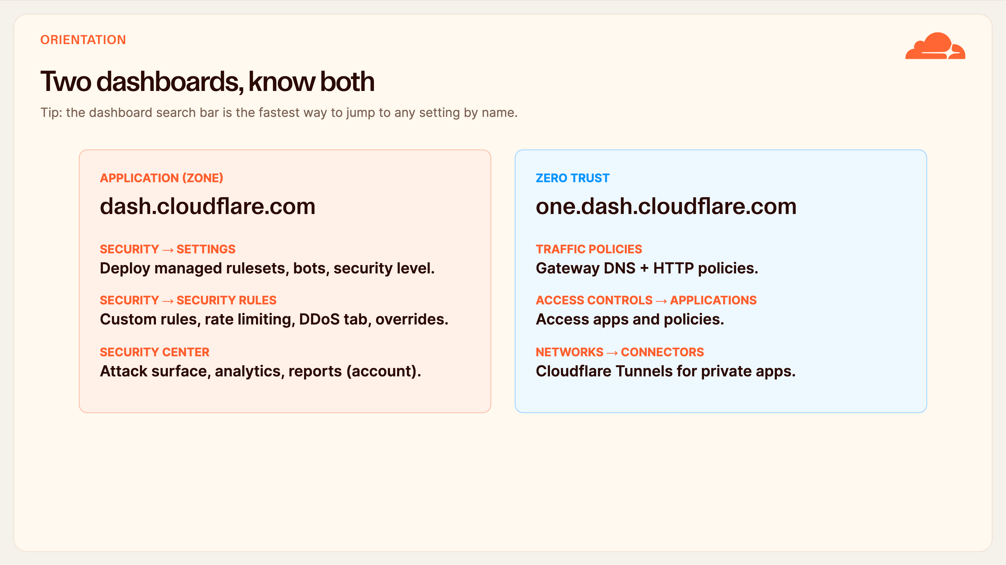
Notes:
Two dashboards, know both
There are two dashboards and it trips people up, so let's anchor it.
The application, or zone, dashboard at dash.cloudflare.com is where security for a website lives. Security → Settings is where you deploy managed rulesets and set bot and security levels. Security → Security rules holds custom rules, rate limiting, and the DDoS tab.
The Zero Trust dashboard at one.dash.cloudflare.com is a different surface. Gateway policies are under Traffic policies, Access apps under Access controls, and Tunnels under Networks → Connectors.
Honestly, the fastest way to find anything is the search bar at the top of every page — type the setting name and jump straight to it.

Slide 6
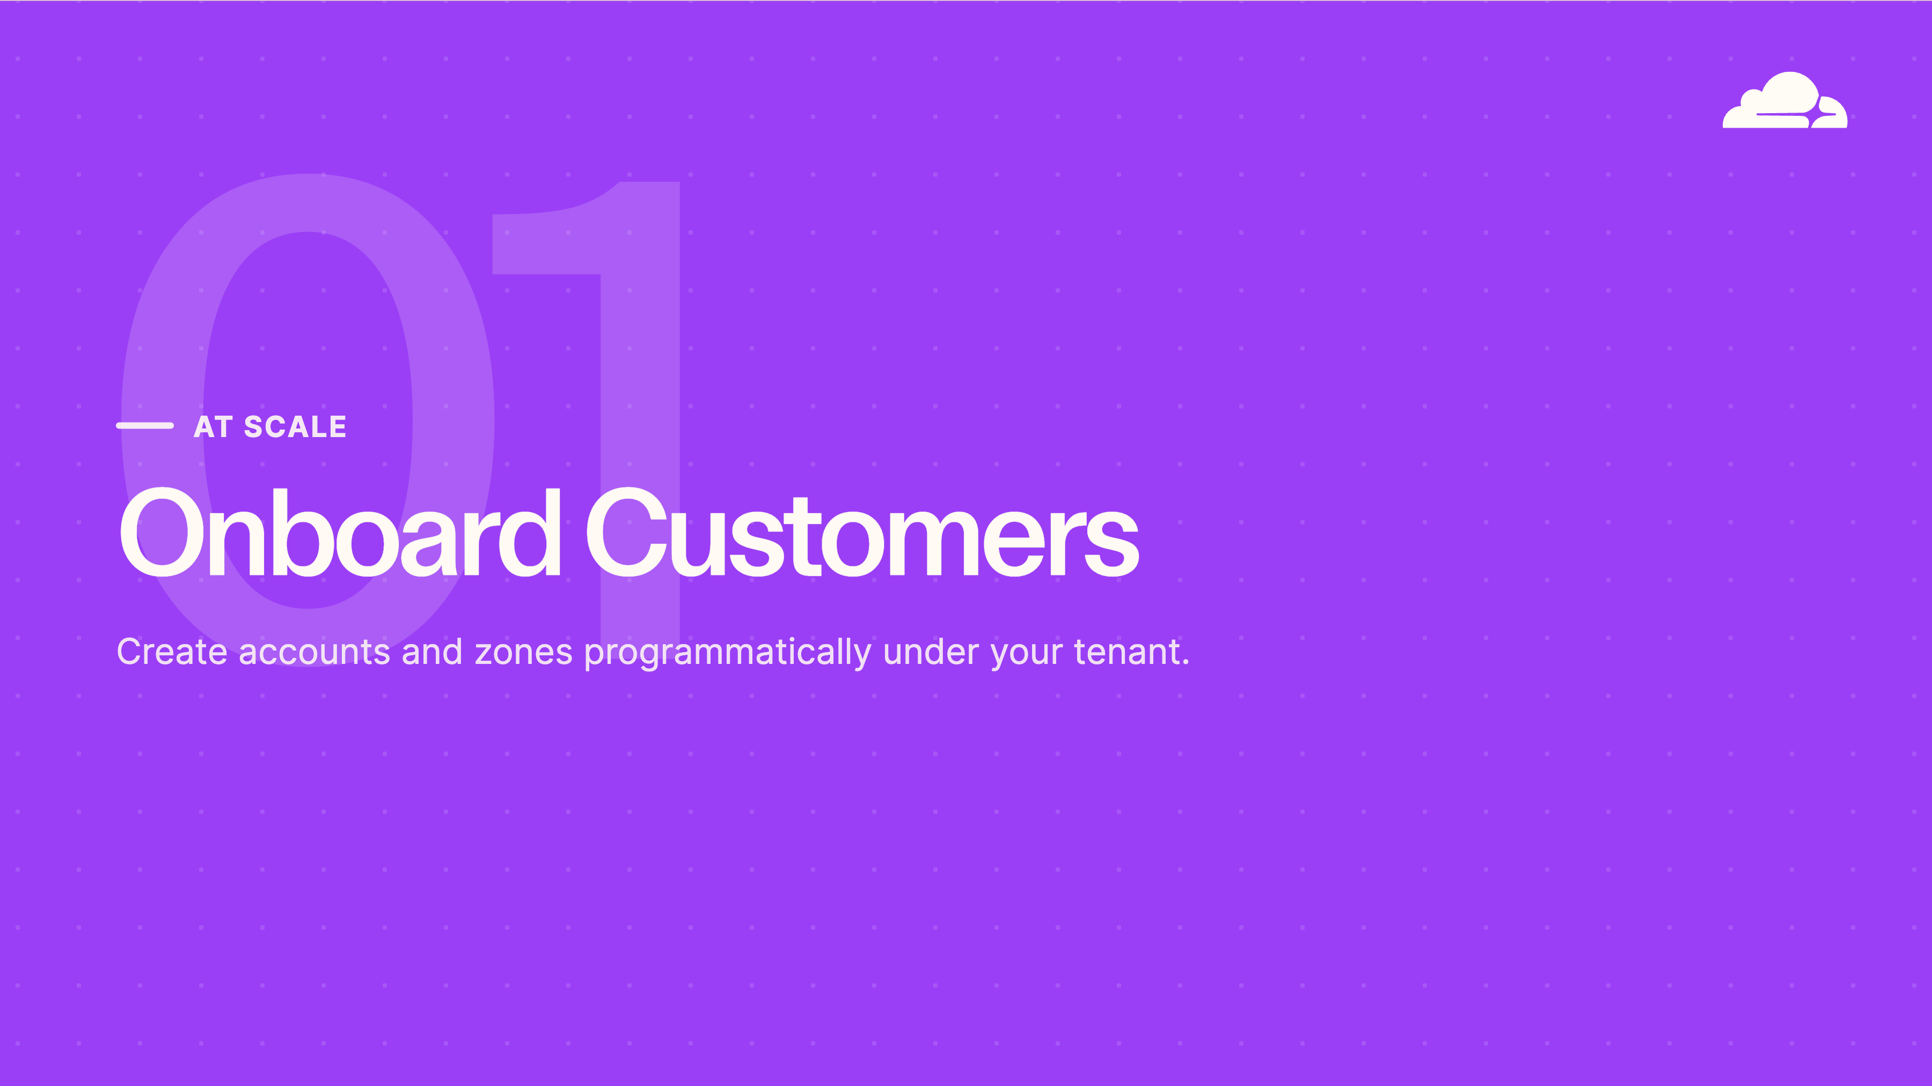
Notes:
Onboard at scale
Part one: getting a customer onto the platform in a repeatable way. This is the tenant pattern — the reseller flow that lets the partner create and own end-customer accounts programmatically, so onboarding the hundredth customer is as clean as the first.

Slide 7
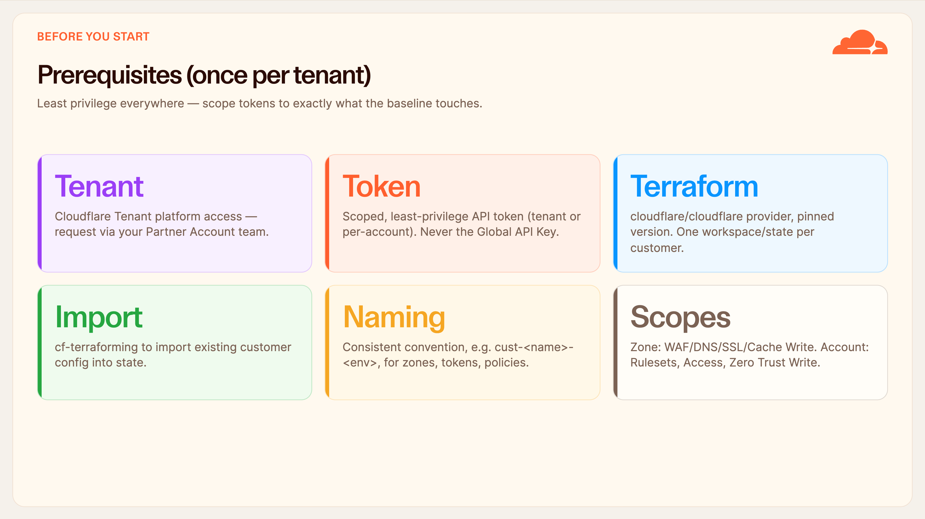
Notes:
Prerequisites (once per tenant)
These are the one-time prerequisites for the partner tenant. Get them right and every customer after is fast.
You need Tenant platform access — your Cloudflare Partner Account team provisions that. You need a scoped API token; least privilege, and never the Global API Key. You need Terraform with the Cloudflare provider pinned to a specific version, and — this is the discipline that matters — one workspace and state file per customer.
cf-terraforming lets you import a customer's existing config into state so you're not fighting drift. And agree a naming convention early; cust-name-env keeps zones, tokens and policies auditable.
On token scopes: at the zone you need WAF, DNS, SSL and Cache write; at the account you need Rulesets, Access and Zero Trust write.

Slide 8
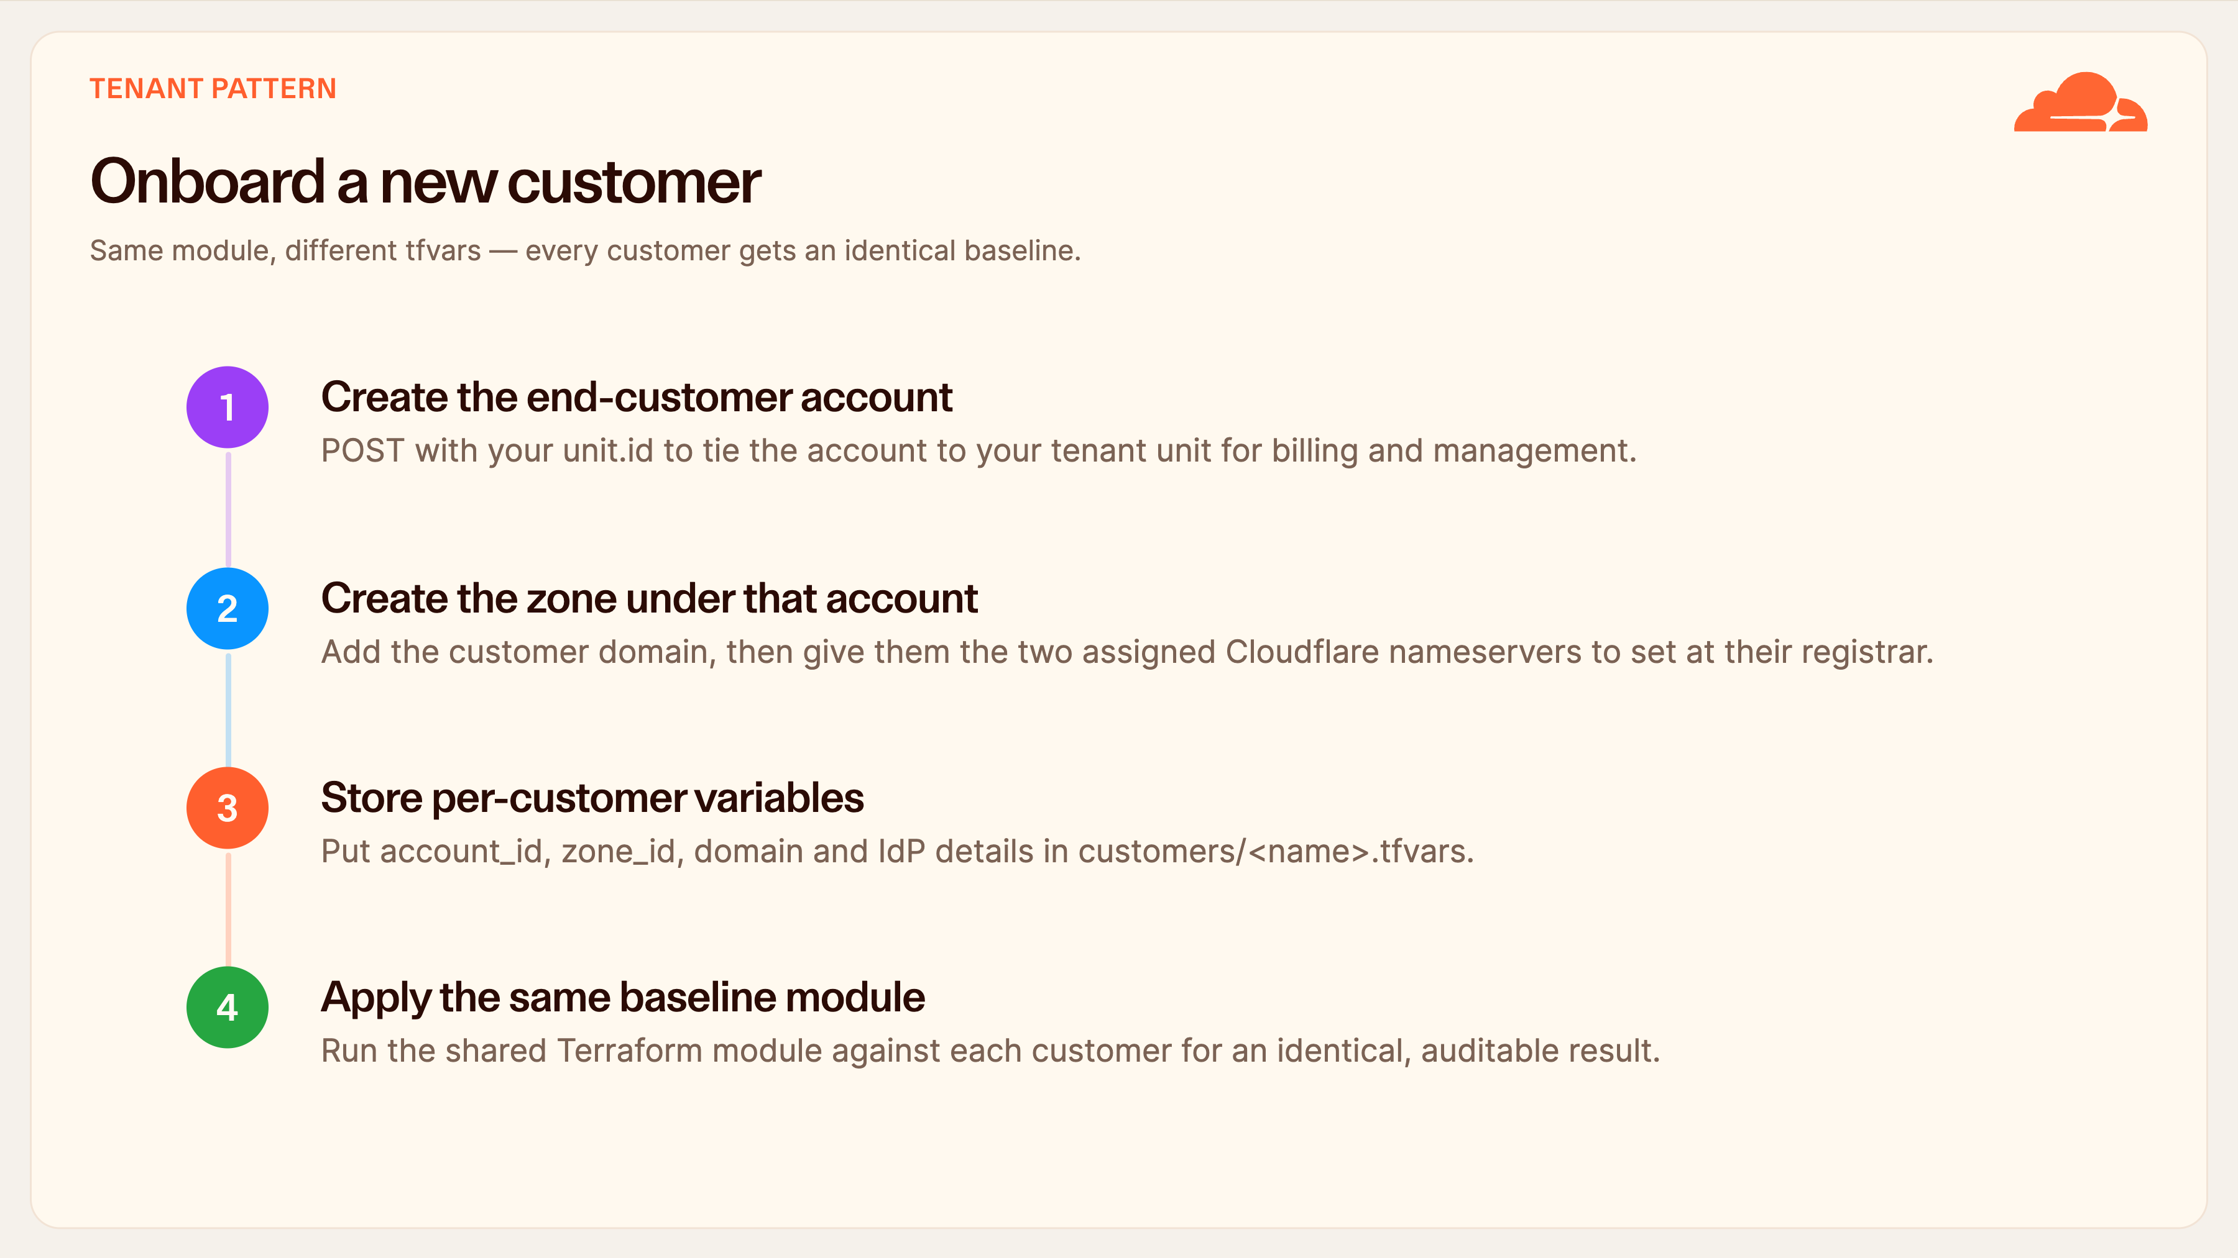
Notes:
Onboard a new customer
Here's the tenant onboarding flow, four steps.
First, create the end-customer account with a POST that includes your unit.id — that's what ties the new account to your tenant unit for billing and management. The exact body fields depend on your tenant contract; the tenant console shows the values available to you.
Second, create the zone under that account and hand the customer their two Cloudflare nameservers to set at the registrar. Until they delegate, the zone won't go active.
Third and fourth are the scale trick: store that customer's variables in a tfvars file, then apply the same baseline Terraform module. Same module, different tfvars — so every customer provably gets the identical baseline.

Slide 9
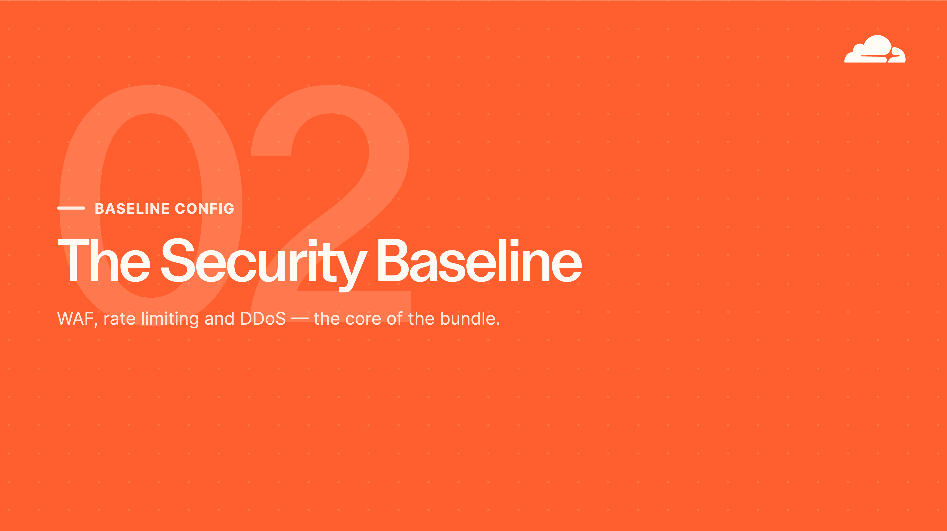
Notes:
The security baseline
Part two is the heart of the bundle: application security. WAF first, then a proper walk through rate limiting because that's the one people find fiddly, then DDoS. These are the settings that stop the automated attacks hitting SME customers every day.

Slide 10
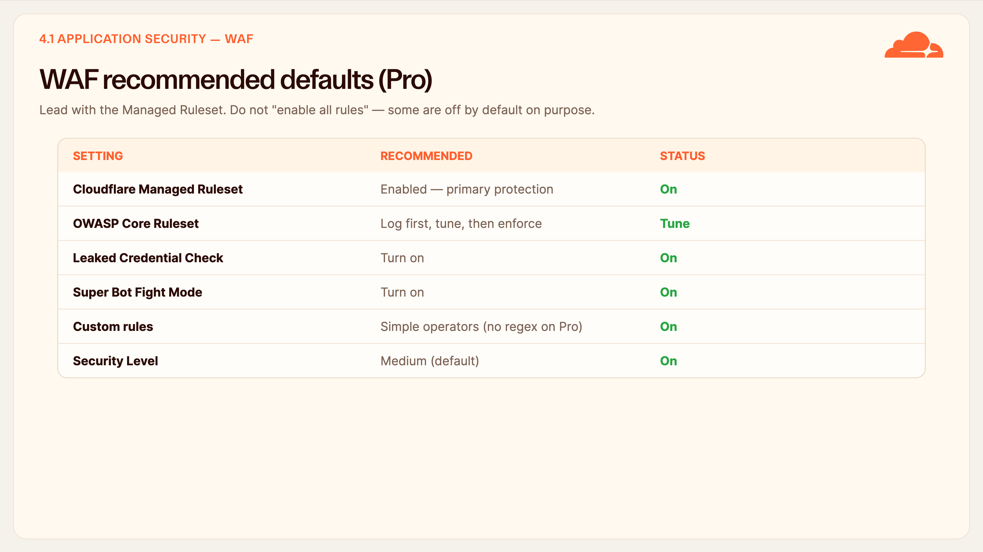
Notes:
WAF recommended defaults
The WAF baseline, and there's an important piece of Cloudflare guidance here, not just opinion.
Lead with the Cloudflare Managed Ruleset — that's your primary managed protection on Pro. Cloudflare explicitly warns that the OWASP Core Ruleset is prone to false positives and adds only marginal benefit on top of the Managed Ruleset. So deploy OWASP after the Managed Ruleset, in Log mode first, tune it, and only then raise it to enforce.
Turn on Leaked Credential Check and Super Bot Fight Mode. Custom rules use simple operators — equals, contains, in — remember regex is not available on Pro.
And do not click 'enable all rules'. Some Managed Ruleset rules are disabled by default on purpose; enabling everything causes false positives.

Slide 11
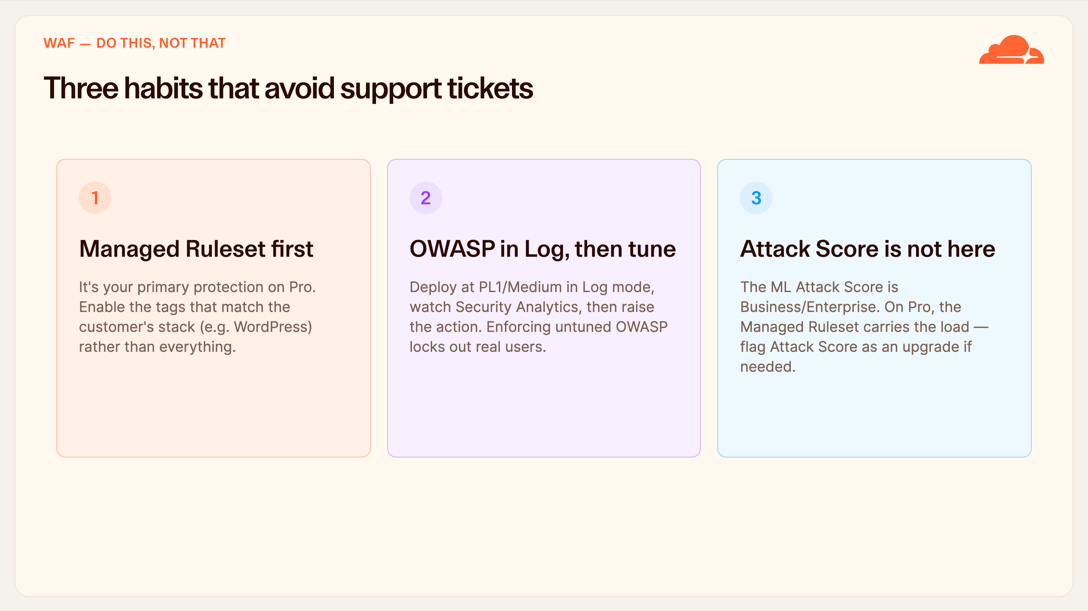
Notes:
Three habits that avoid support tickets
Three habits to drill in, because they're the difference between a clean rollout and a wave of support tickets.
One: Managed Ruleset first, and enable the tags that match the customer's actual stack — if it's a WordPress site, enable the WordPress tag — rather than blanket-enabling rules.
Two: OWASP always goes in Log mode first at the default paranoia level, you watch Security Analytics to see what it would have blocked, and only then do you raise the action. An untuned OWASP ruleset in enforce mode will block legitimate users.
Three: set expectations that the ML Attack Score isn't in this bundle. On Pro the Managed Ruleset does the heavy lifting. If a customer genuinely needs Attack Score, that's a Business or Enterprise upgrade.

Slide 12
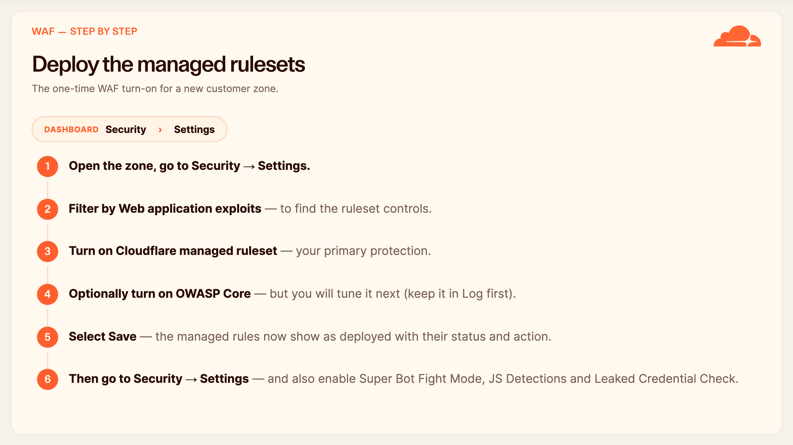
Notes:
Deploy the managed rulesets
Let's do the WAF turn-on click by click, because this is the first thing you'll do on every new zone.
Open the customer's zone and go to Security, then Settings. Filter the list by 'Web application exploits' so you're looking at the right controls. Turn on the Cloudflare managed ruleset — that's the primary protection. You can turn on OWASP Core here too, but remember we tune it before enforcing, so it goes in Log mode first. Hit Save, and the managed rules view will show each ruleset deployed with its status and action.
While you're in Security → Settings, this is also where you switch on Super Bot Fight Mode, JS Detections, and Leaked Credential Check. That's the whole baseline WAF turn-on in one place.

Slide 13
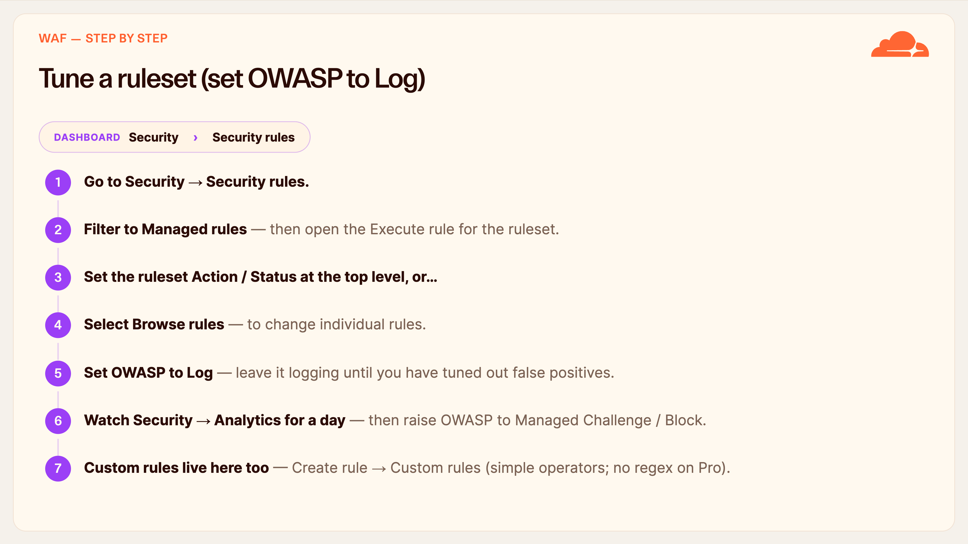
Notes:
Tune a ruleset (set OWASP to Log)
This is the tuning step — the one that keeps you out of trouble with OWASP.
Go to Security, Security rules. Filter to Managed rules and open the Execute rule for the ruleset you deployed. From there you can set the action and status at the ruleset level, or click Browse rules to adjust individual rules. For OWASP, set it to Log — you want it observing, not blocking, until you've tuned it.
Leave it logging for about a day, watch Security → Analytics to see what it would have blocked, and only then raise it to Managed Challenge or Block. This same screen — Create rule, Custom rules — is where you build User-Agent, IP, geo and lockdown rules, remembering Pro uses simple operators and no regex.

Slide 14
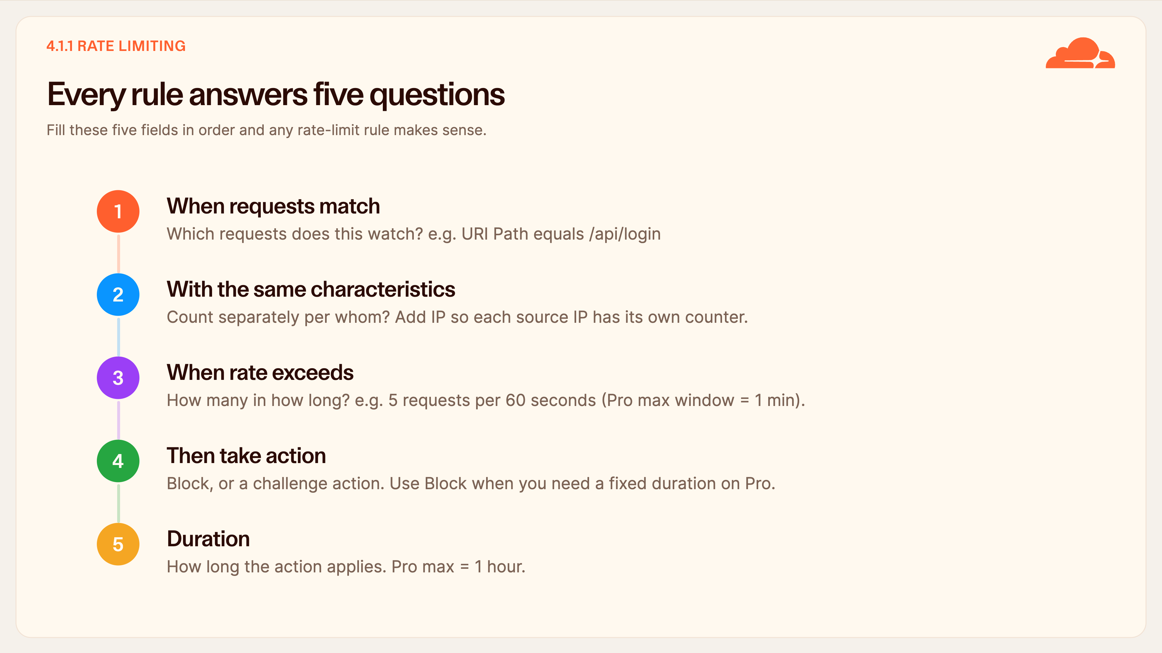
Notes:
Every rule answers five questions
Rate limiting looks cryptic, so here's the trick: every rule is just five fields, filled in order.
One, when requests match — the filter for what's in scope, like the login path. Two, with the same characteristics — who you count separately; add IP so each source IP gets its own counter. The data centre is always included automatically, you don't add it.
Three, when rate exceeds — how many requests in how long; on Pro the window maxes at one minute. Four, the action — and note a Pro gotcha: challenge actions throttle rather than applying a fixed duration, so use Block when you want a fixed block time. Five, duration — how long the action stays, up to one hour on Pro.
Master those five and every rule reads plainly.

Slide 15
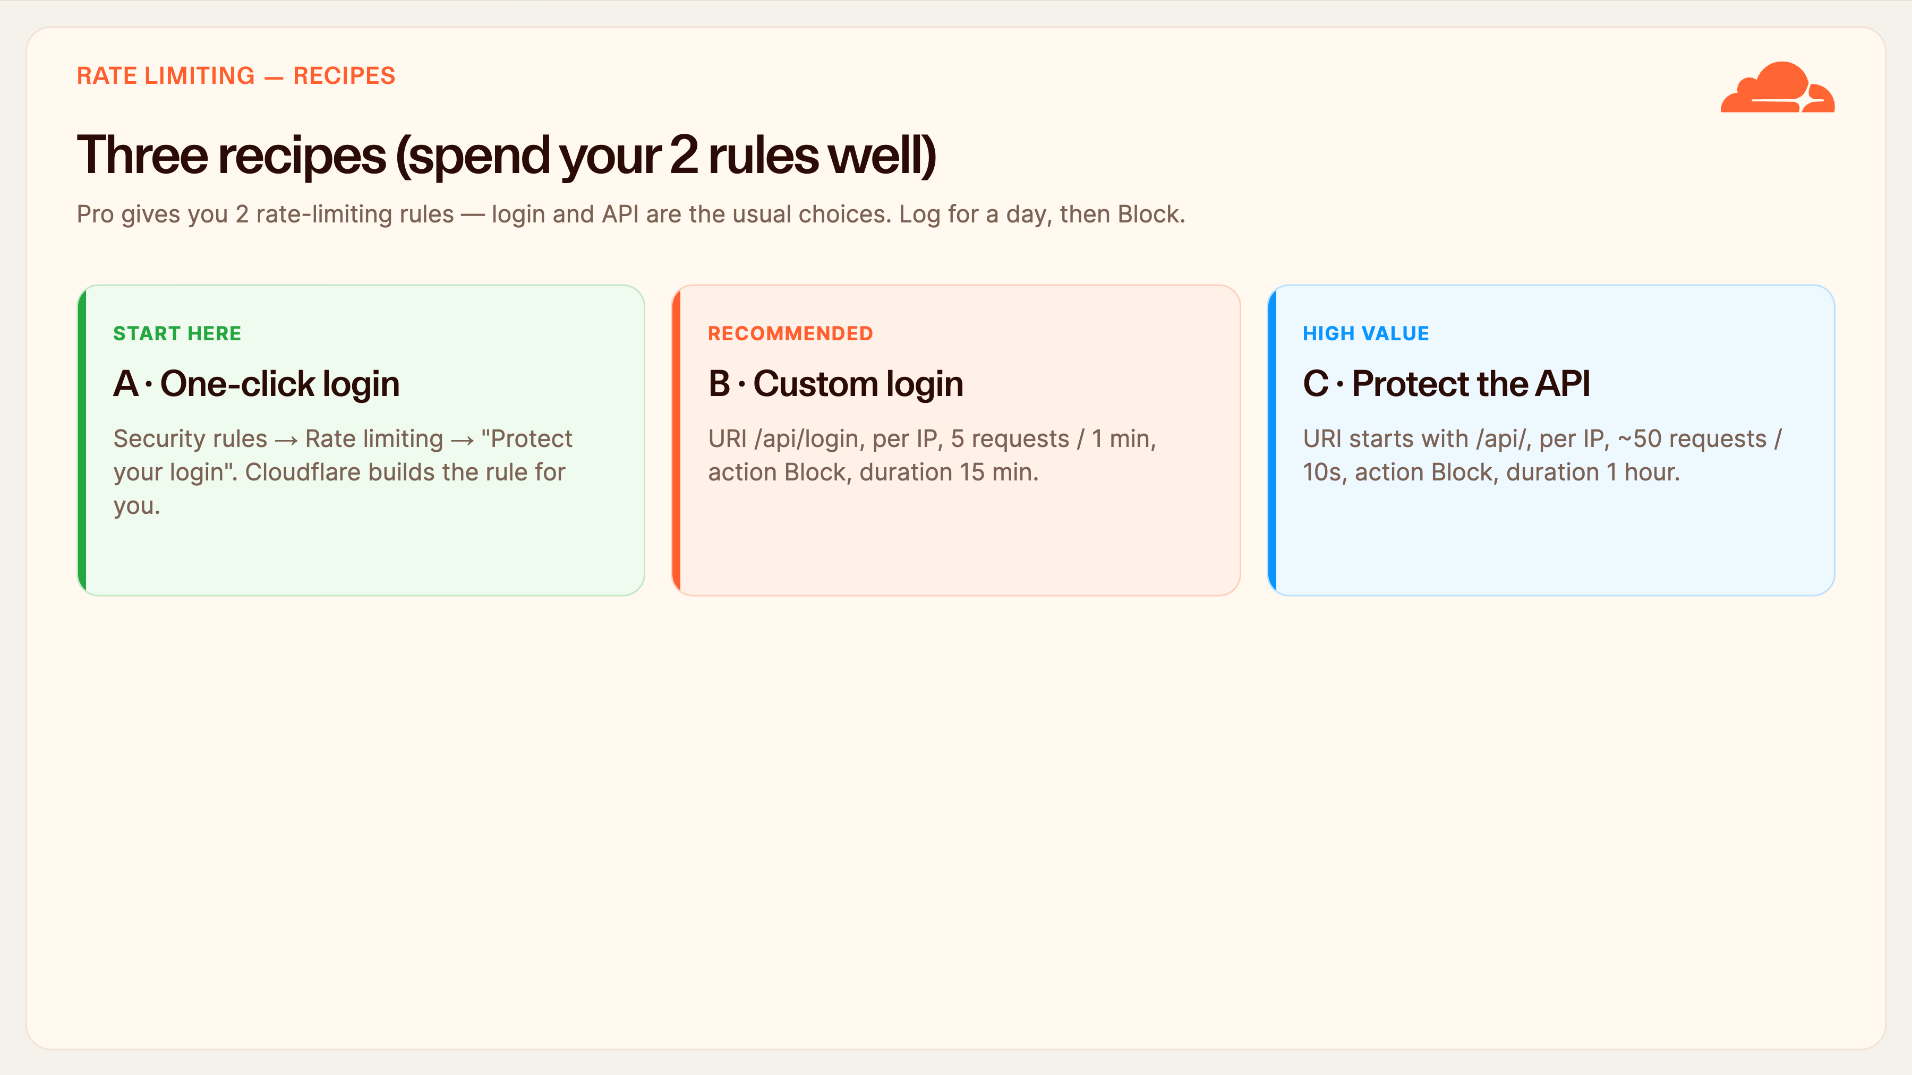
Notes:
Three recipes
Three ready-made recipes. Remember Pro gives you exactly two rate-limiting rules, so spend them on your highest-value endpoints — usually login and API.
Recipe A is the easiest and where beginners should start: Security rules, Rate limiting, 'Protect your login', enter the login URL, save. Cloudflare builds the whole rule for you — more than five attempts, then block.
Recipe B is the recommended custom baseline: match the login path, count per IP, five requests per minute, action Block, duration fifteen minutes.
Recipe C protects the API: path starts with /api/, per IP, about fifty requests per ten seconds, Block for an hour.
Workflow tip for all three: set the action to Log for a day, check Analytics to see how often it would fire, then switch to Block. That avoids locking out real users.

Slide 16
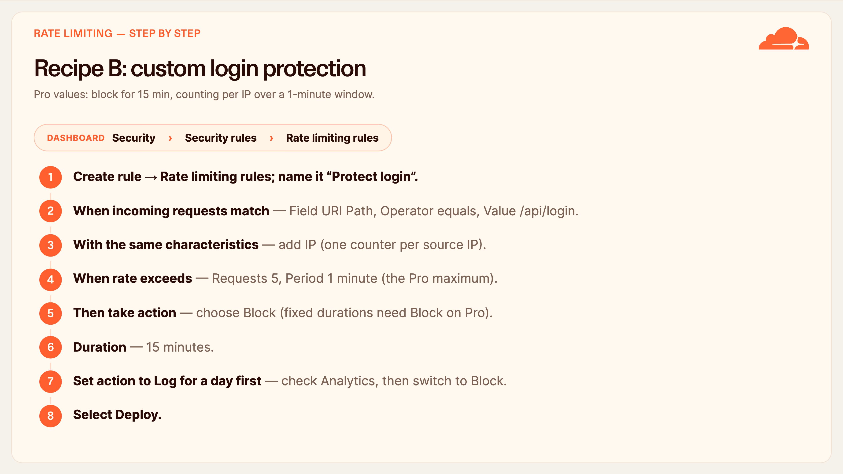
Notes:
Recipe B: custom login protection
Here's the recommended login-protection rule, field by field, so anyone can reproduce it.
Create rule, Rate limiting rules, name it 'Protect login'. Under 'When incoming requests match', set Field to URI Path, Operator equals, Value slash-api-slash-login. Under 'With the same characteristics', add IP so each source IP is counted separately. Under 'When rate exceeds', enter Requests 5 and Period 1 minute — that's the Pro maximum window. For action choose Block, because on Pro a fixed duration needs Block; challenge actions throttle instead. Set Duration to 15 minutes.
One strong habit: set the action to Log for a day first, check Security Analytics to see how often it would fire, then flip it to Block. Then Deploy. That sequence protects the login without ever locking out a real user by surprise.

Slide 17
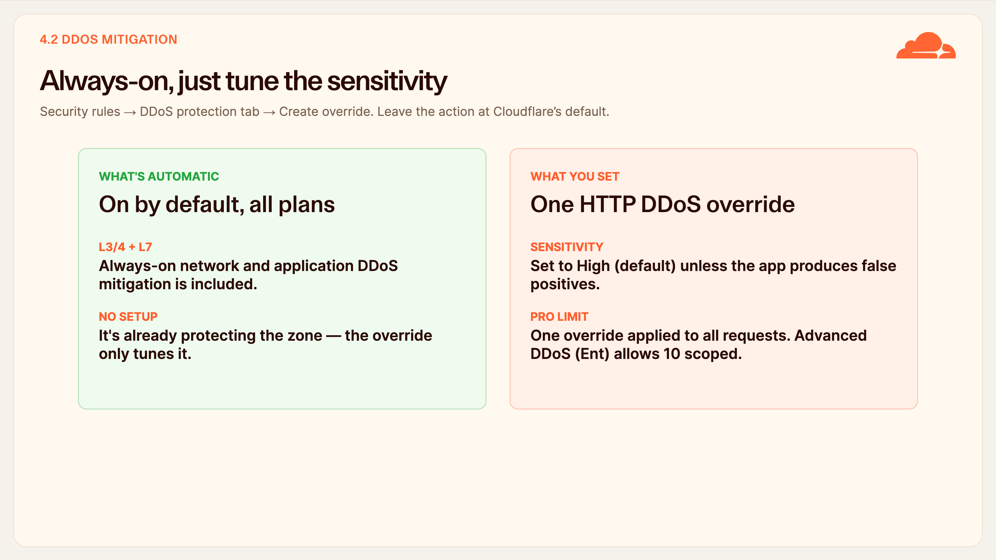
Notes:
Always-on, just tune the sensitivity
DDoS is the easiest section because most of it is automatic.
Always-on L3/4 and L7 DDoS mitigation is included on every plan — it's already protecting the zone before you do anything. So this step isn't 'turn on DDoS protection', it's 'tune the existing protection'.
Go to Security rules, the DDoS protection tab, and Create override. Set ruleset sensitivity to High, which is the default, unless a specific customer app is producing false positives — then dial it back. Leave the action at Cloudflare's default.
One plan fact to know: on Pro you get a single override applied to all requests. The Advanced DDoS Protection subscription, an Enterprise add-on, is what unlocks up to ten scoped overrides. For SME customers, the single high-sensitivity override is the right baseline.

Slide 18
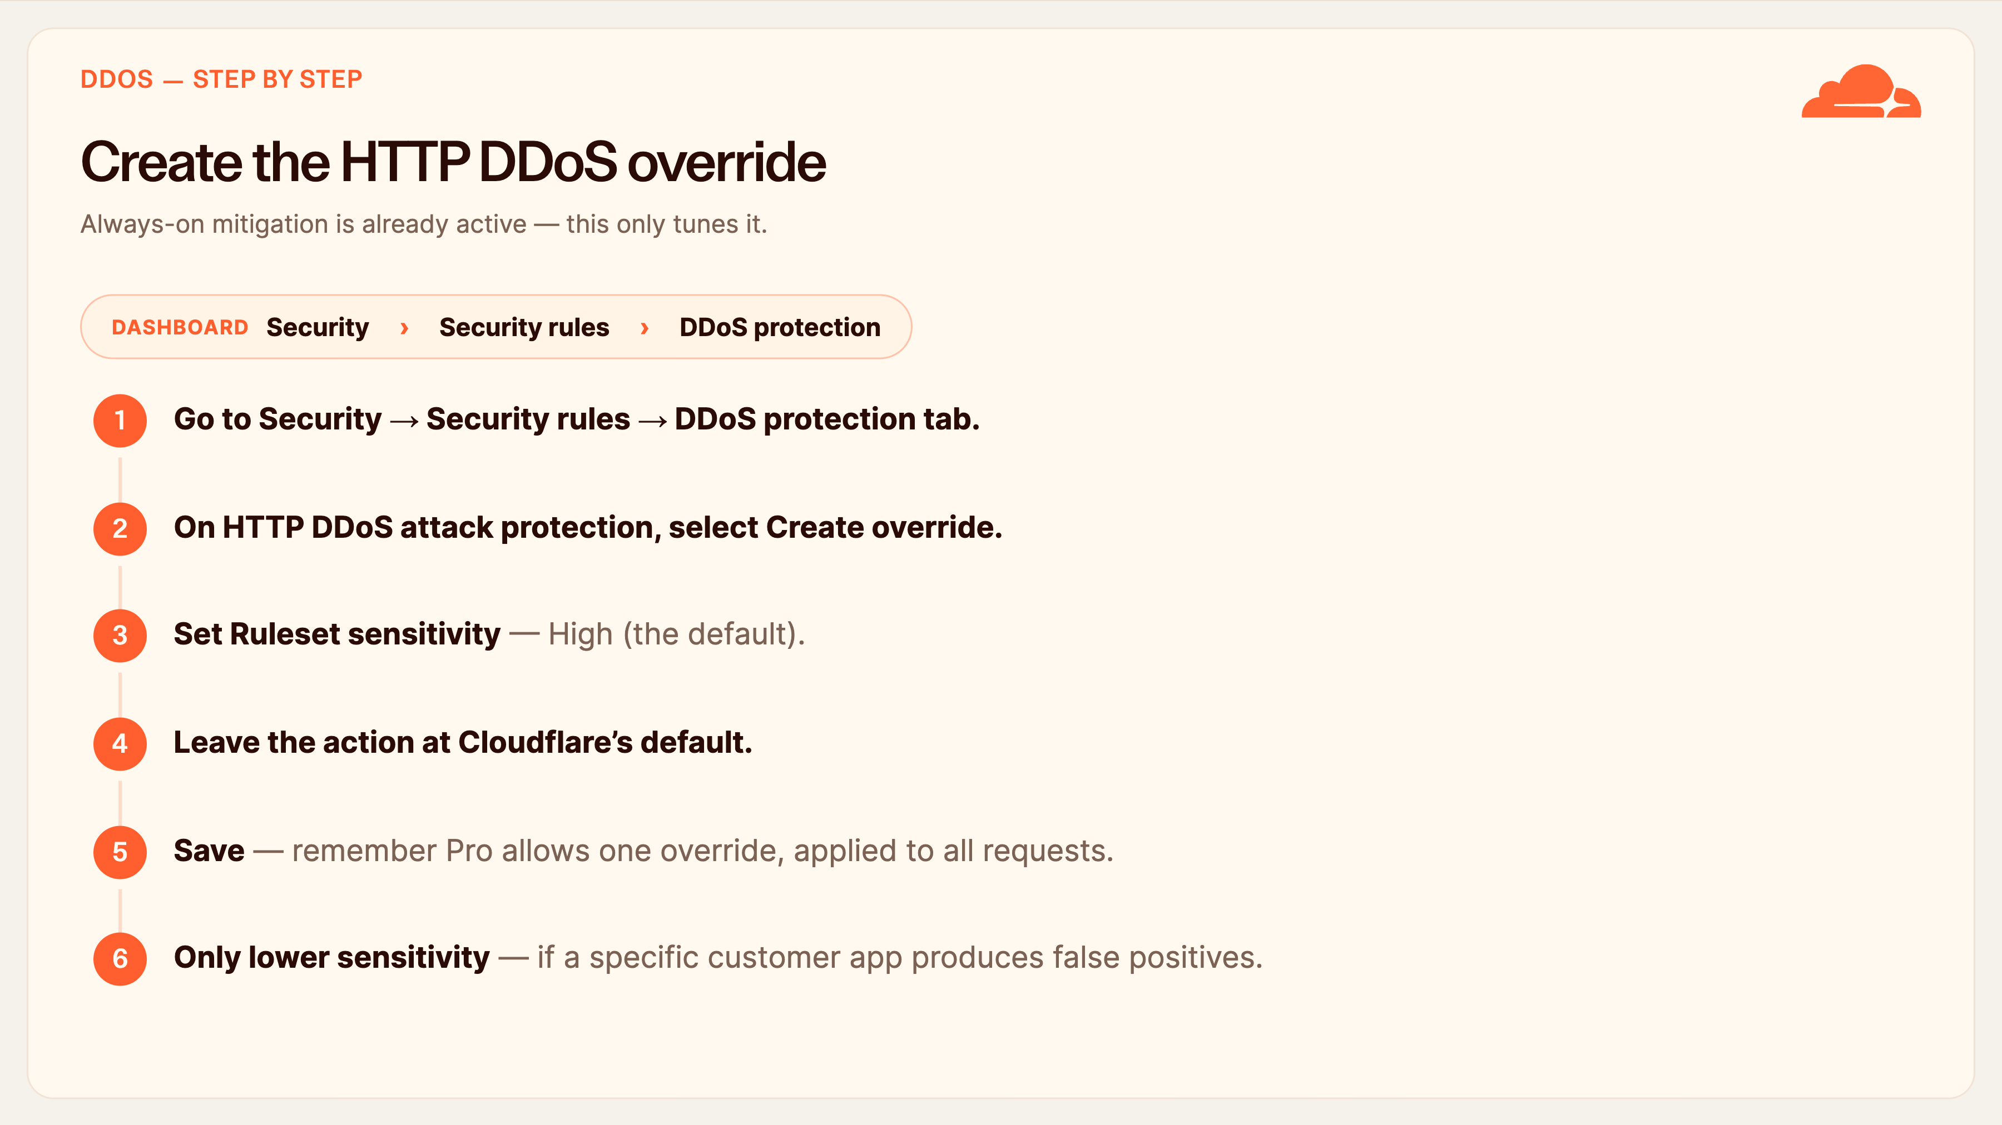
Notes:
Create the HTTP DDoS override
DDoS is quick because the protection is already on — you're just tuning it.
Go to Security, Security rules, and open the DDoS protection tab. On HTTP DDoS attack protection, select Create override. Set the ruleset sensitivity to High, which is the default, and leave the action at Cloudflare's default. Save.
Two things to remember: on Pro you get exactly one override and it applies to all requests — scoped overrides are an Enterprise feature. And only reach for a lower sensitivity if a particular customer application is generating false positives; otherwise High is the right baseline for everyone.

Slide 19
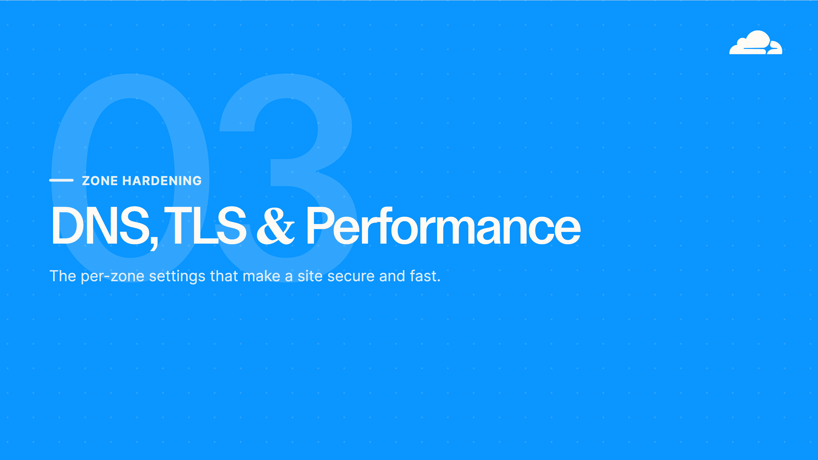
Notes:
DNS, TLS & performance
Part three is zone hardening — the per-domain settings. DNS with DNSSEC, TLS done properly, and the performance layer that doubles as a security control. These are quick to apply but they're where a misconfiguration is most visible to the customer, so precision matters.

Slide 20
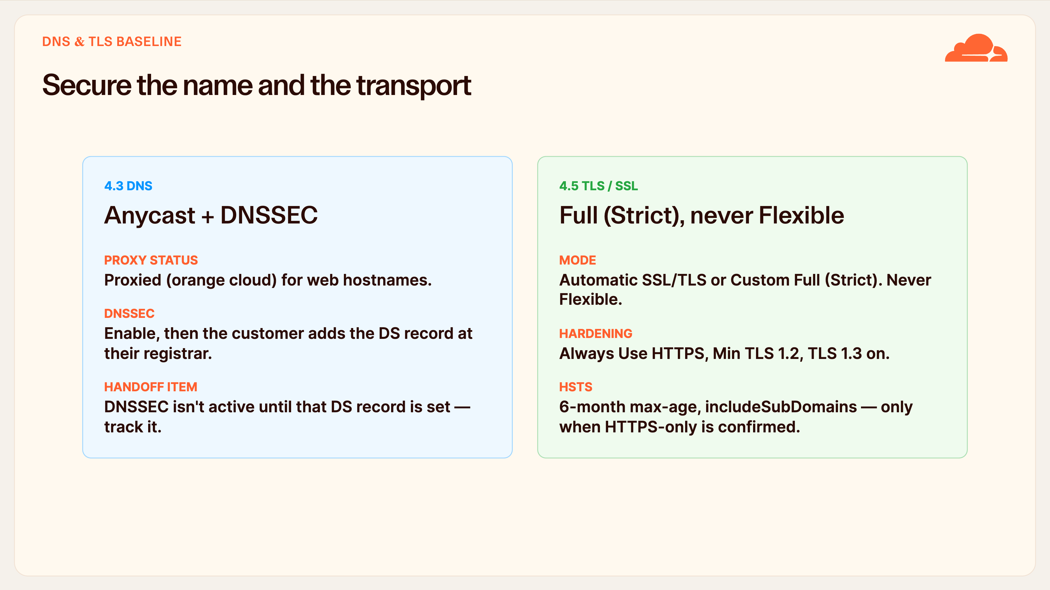
Notes:
Secure the name and the transport
DNS and TLS together, because they're both about securing the customer's front door.
On DNS: web hostnames should be proxied — orange cloud — so they get Cloudflare's protection. Enable DNSSEC, but know that it isn't fully active until the customer places the DS record at their registrar. That's a classic handoff item that gets forgotten, so track it explicitly.
On TLS: the mode is Full (Strict), or Automatic SSL/TLS which settles on Full (Strict). Never Flexible — Cloudflare is explicit about that. Turn on Always Use HTTPS, set minimum TLS to 1.2, enable TLS 1.3.
HSTS is powerful and a little dangerous: once a browser caches it, HTTP is refused for the whole max-age. So only enable it — six months, include subdomains — when the customer has committed to HTTPS-only. Start without preload.

Slide 21
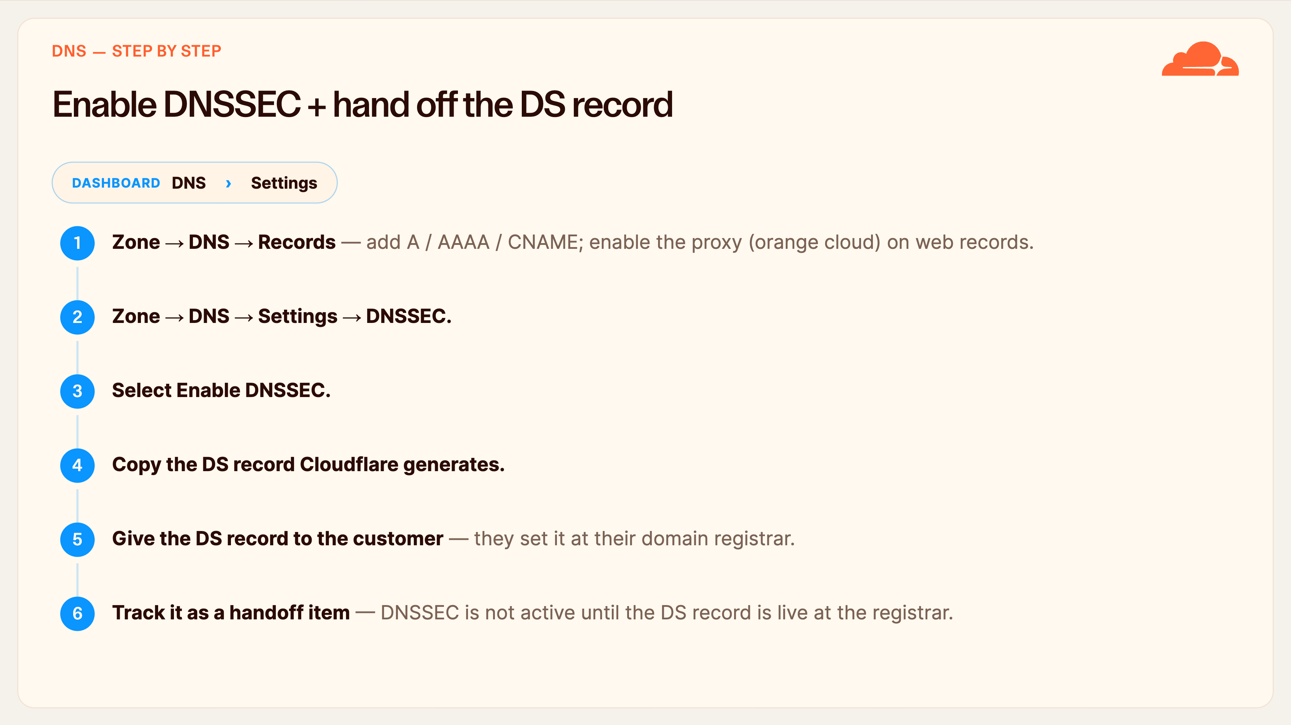
Notes:
Enable DNSSEC + hand off the DS record
DNS hardening, step by step. First, under DNS, Records, make sure the web hostnames have the orange cloud — proxied — so they actually get Cloudflare's protection. Add the A, AAAA or CNAME records the customer needs.
Then go to DNS, Settings, DNSSEC, and select Enable DNSSEC. Cloudflare generates a DS record — copy it. This is the part people miss: DNSSEC does not become active until that DS record is placed at the customer's registrar, which only the customer can do. So hand them the DS record and track it explicitly as an open handoff item until you've confirmed it's live. Otherwise you'll think DNSSEC is on when it isn't.

Slide 22
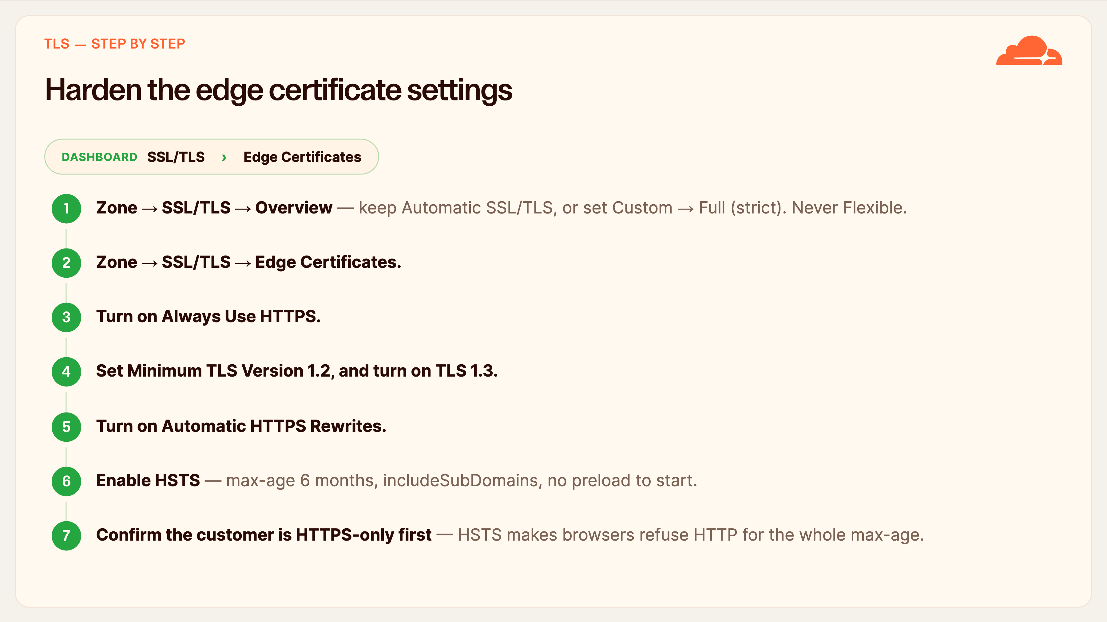
Notes:
Harden the edge certificate settings
TLS, click by click. Start at SSL/TLS, Overview: keep Automatic SSL/TLS, which settles on Full Strict, or explicitly set Custom, Full (strict). Never Flexible — Cloudflare is emphatic about that.
Then SSL/TLS, Edge Certificates. Turn on Always Use HTTPS. Set the minimum TLS version to 1.2 and turn on TLS 1.3. Turn on Automatic HTTPS Rewrites.
Then HSTS, carefully. Set a six-month max-age with includeSubDomains, and leave preload off to start. But before you enable it, confirm the customer is committed to HTTPS-only, because once a browser caches HSTS it will refuse plain HTTP for the entire max-age. It's the one setting here that can take a site offline if the customer isn't ready, so get their sign-off first.

Slide 23
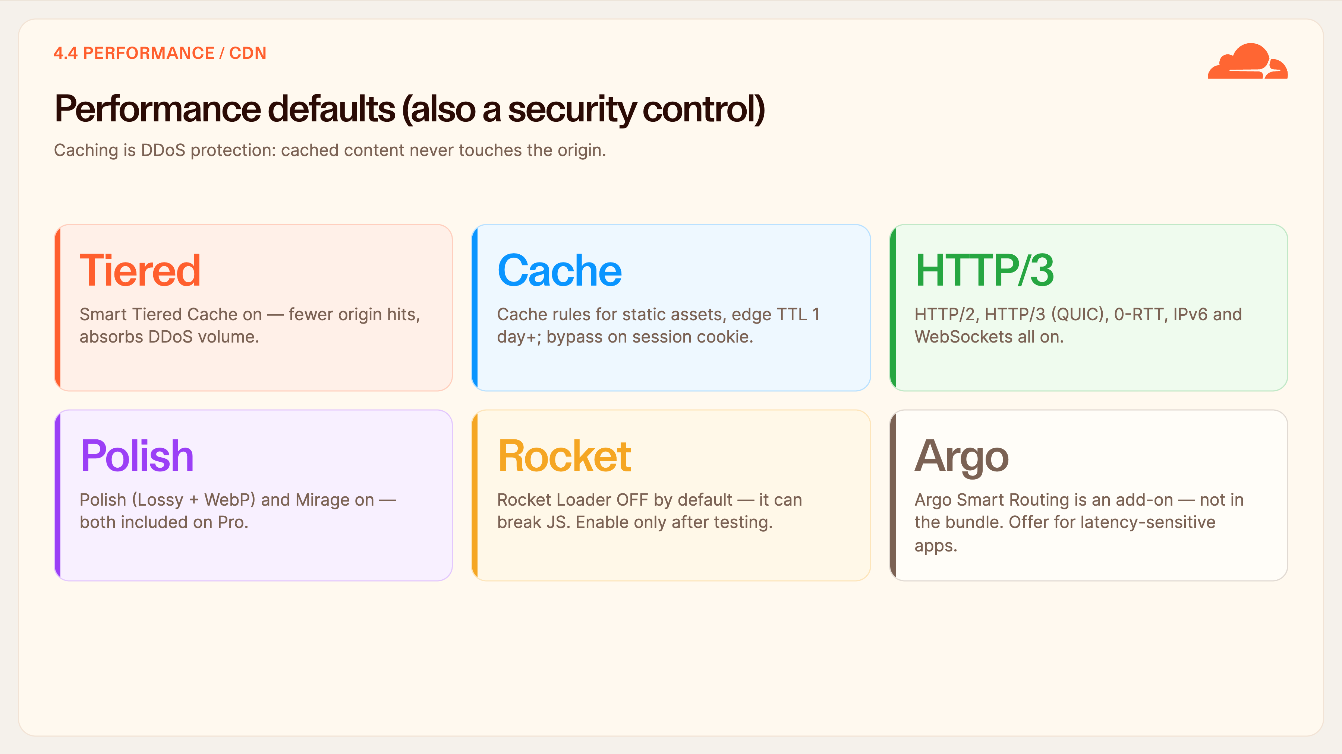
Notes:
Performance defaults
People file the CDN under performance, but on this baseline it doubles as a security control — cached content absorbs load before it reaches the customer's origin.
Turn on Smart Tiered Cache. Add cache rules for static assets with an edge TTL of a day or more, and bypass cache on session cookies so logged-in pages stay dynamic. Enable HTTP/2 and HTTP/3 with 0-RTT, IPv6, and WebSockets. Polish with WebP and Mirage are both included on Pro — turn them on.
Two cautions. Rocket Loader stays off by default; it reorders JavaScript and can break customer sites — only enable it per customer after testing. And Argo Smart Routing is a paid add-on, not in the bundle — mention it for latency-sensitive customers, but it's not part of the standard stamp.

Slide 24
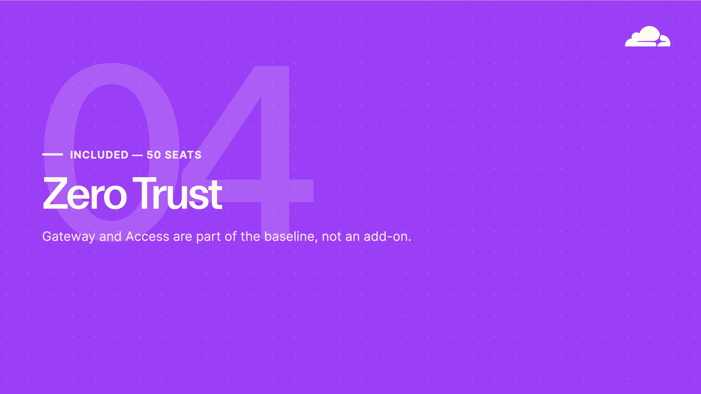
Notes:
Zero Trust
Part four, and this is the part that differentiates the bundle: Zero Trust. The 50 seats are included, so Gateway — the secure web gateway — and Access — Zero Trust network access — are part of the baseline you deliver, not an upsell. Configured at the account level in the Cloudflare One dashboard.

Slide 25
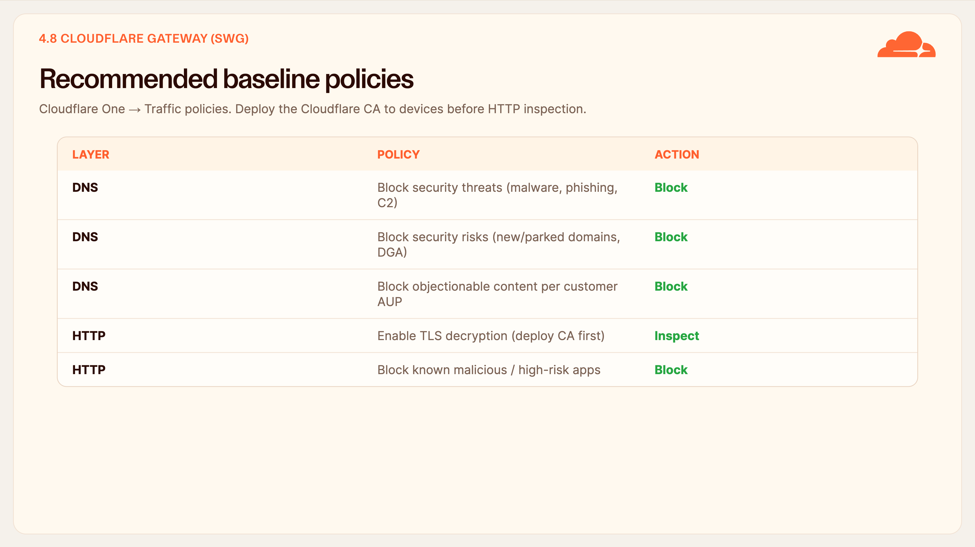
Notes:
Gateway recommended baseline policies
Gateway is the secure web gateway — it protects the customer's users and devices, wherever they are.
Start with DNS-layer policies because they're the fastest win and need no client trust: block security threats — malware, phishing, command-and-control — block security risks like brand-new and parked domains, and block whatever content categories the customer's acceptable-use policy requires.
Then HTTP-layer, which is more involved: you enable TLS decryption to inspect encrypted traffic, but you must deploy the Cloudflare CA certificate to the customer's devices first, or you'll break browsing. Once that's in place you can block known malicious and high-risk applications.
All of this is under Cloudflare One, Traffic policies. Category IDs shift over time, so list the current ones via the API rather than hard-coding.

Slide 26
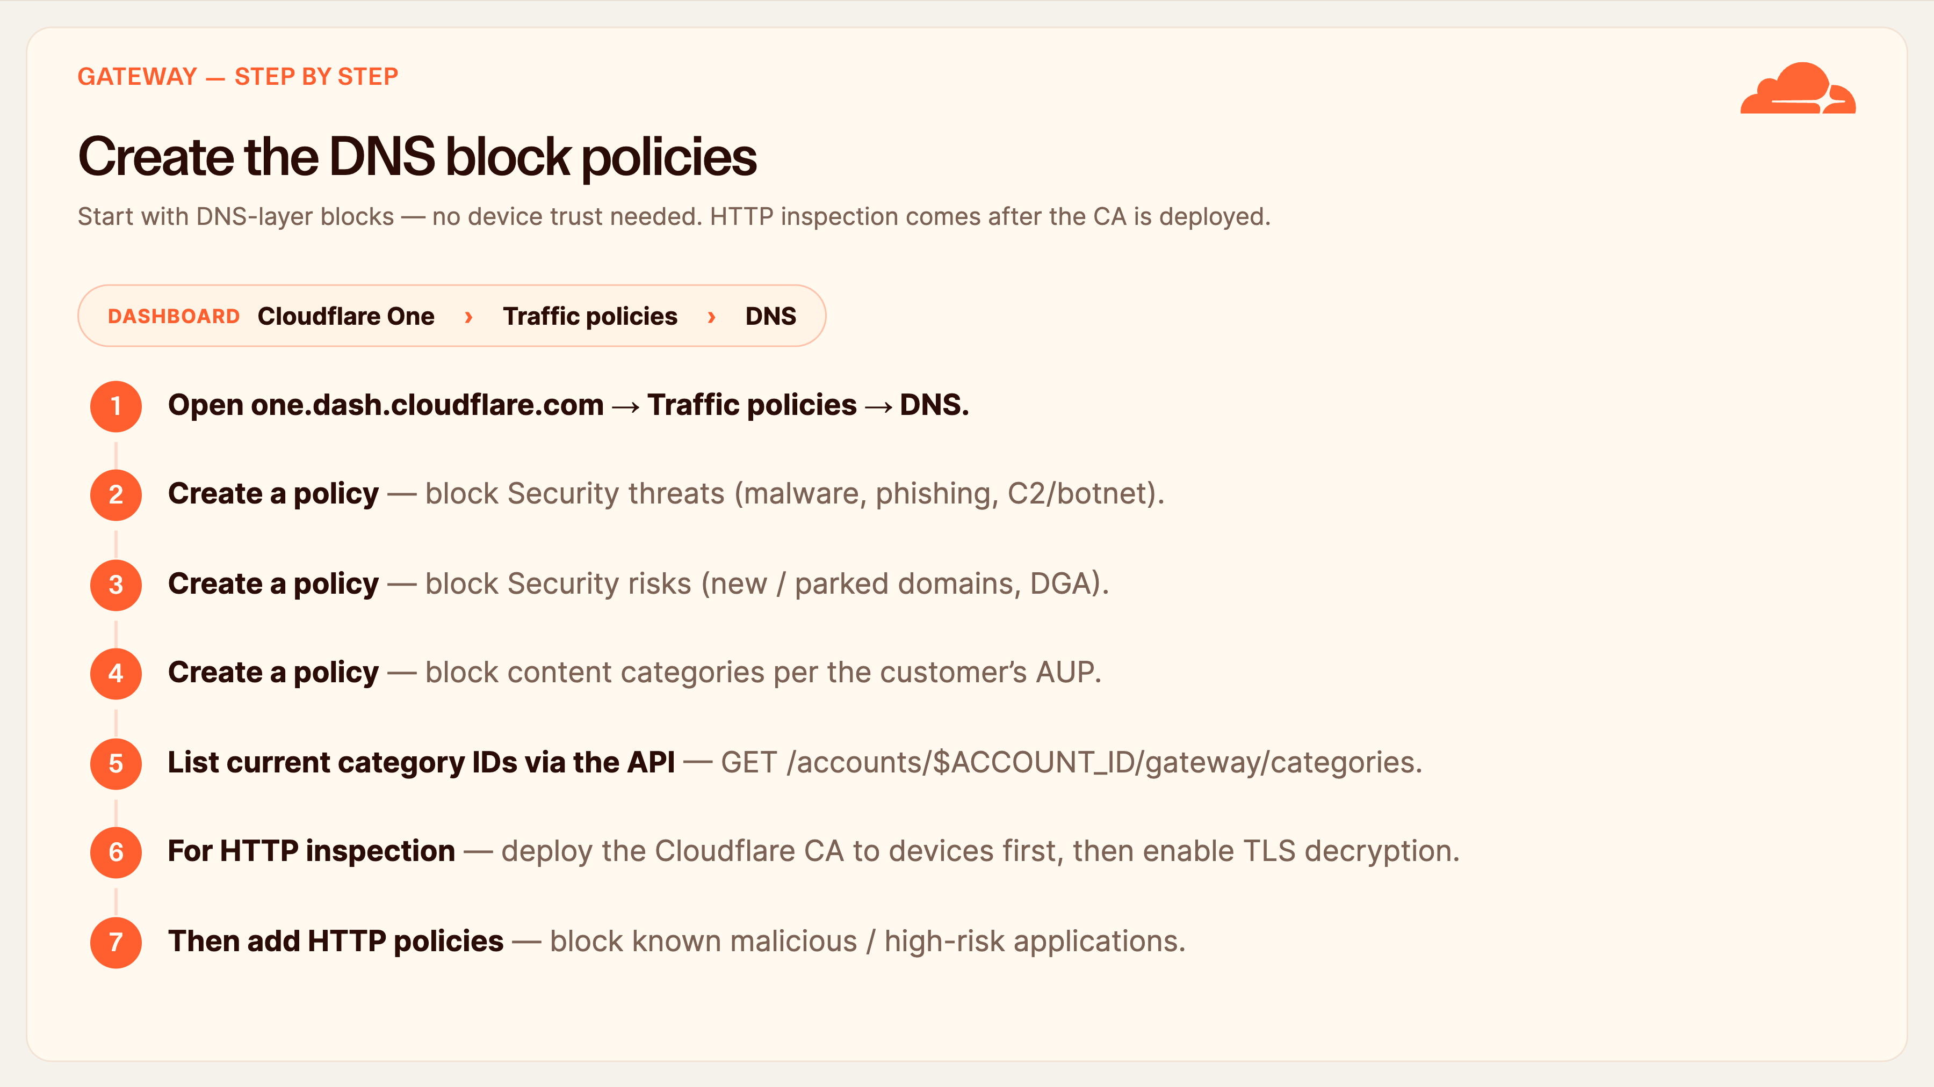
Notes:
Create the DNS block policies
Gateway, step by step — and we lead with DNS because it needs no client trust and delivers value immediately.
In the Cloudflare One dashboard, go to Traffic policies, DNS. Create three block policies: one for Security threats — malware, phishing, command-and-control — one for Security risks like brand-new and parked domains, and one for the content categories the customer's acceptable-use policy requires. The numeric category IDs shift over time, so list the current ones with a GET to the gateway categories endpoint rather than hard-coding them.
HTTP inspection is the second phase and the order matters: deploy the Cloudflare CA certificate to the customer's devices first, then enable TLS decryption, then add HTTP policies to block malicious and high-risk apps. Do it in that order or you'll break browsing.

Slide 27
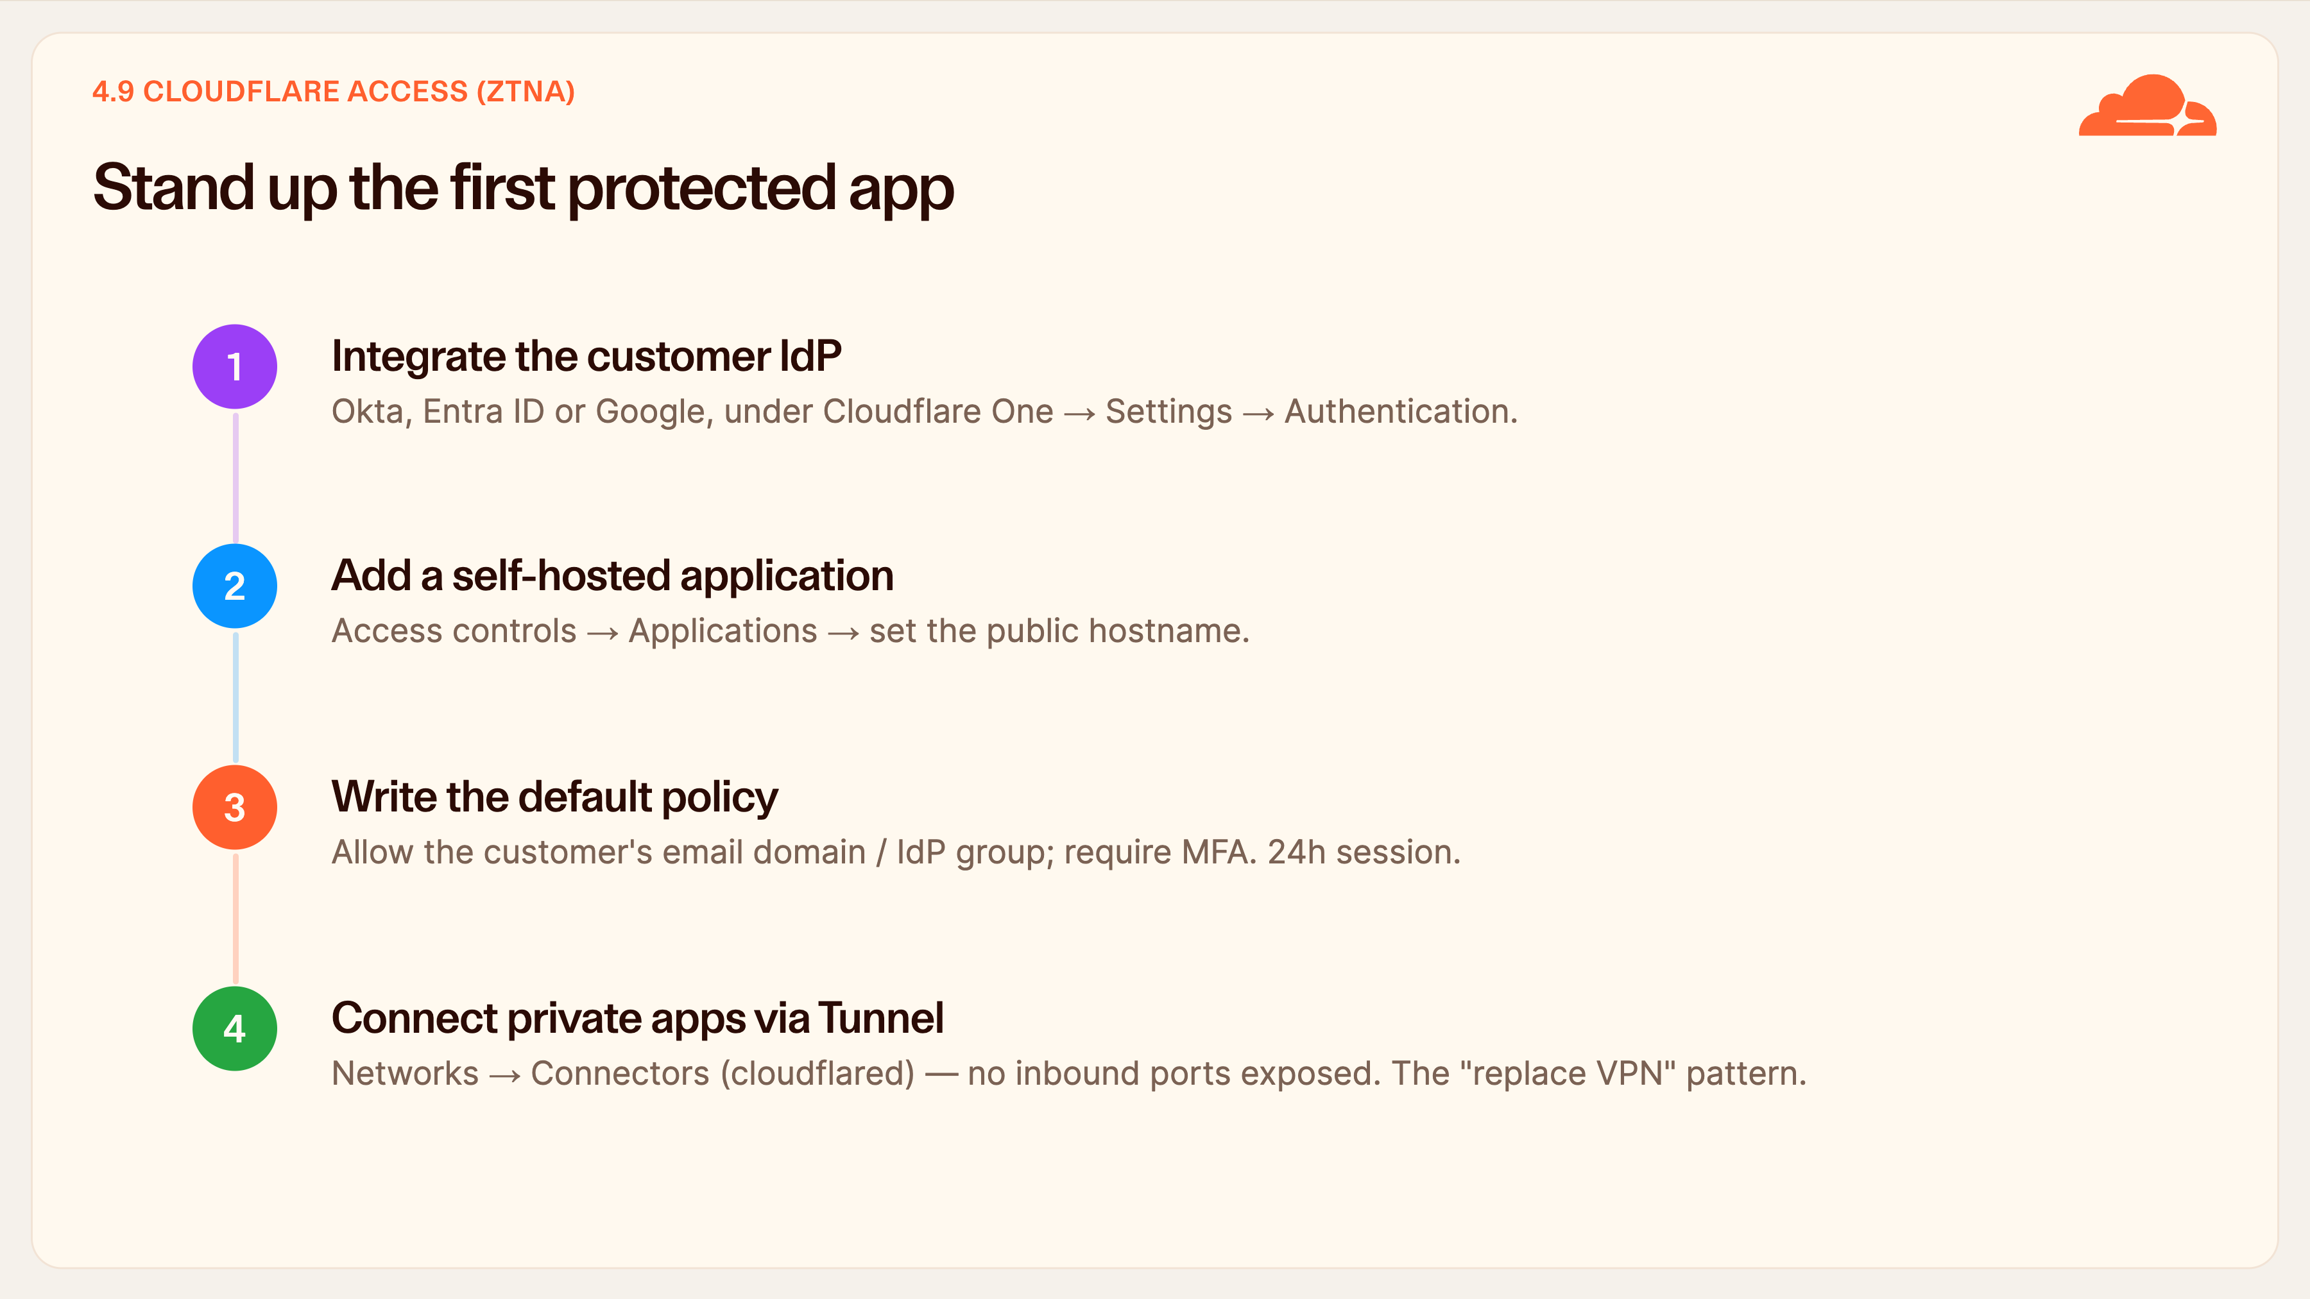
Notes:
Stand up the first protected app
Access is how we replace the customer's VPN with per-application Zero Trust. Four steps to the first app.
One, integrate their identity provider — Okta, Entra ID or Google — under Cloudflare One, Settings, Authentication. Everything keys off identity.
Two, add a self-hosted application and set its public hostname.
Three, write the default policy: allow users whose email is in the customer's domain, or in a specific IdP group, and require MFA. A 24-hour session is a sensible default; shorten it for sensitive apps.
Four, for private apps that shouldn't be on the public internet at all, connect them with a Cloudflare Tunnel under Networks, Connectors. The connector dials out, so there are no inbound ports and no public IP needed — that's the replace-the-VPN pattern, and it's fully covered by the 50 included seats.

Slide 28
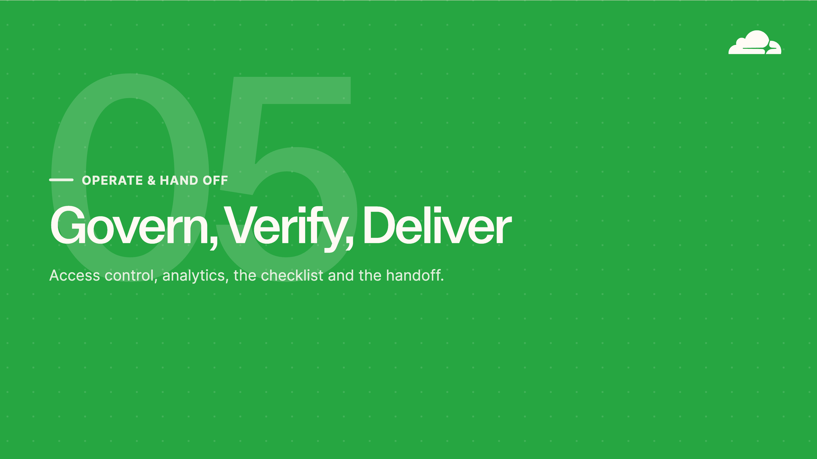
Notes:
Operate and hand off
Final part: operating the account responsibly and handing off cleanly. Who can touch the account, how you watch it, the go-live checklist, and what you give the customer at the end. This is what turns a configured zone into a delivered service.

Slide 29
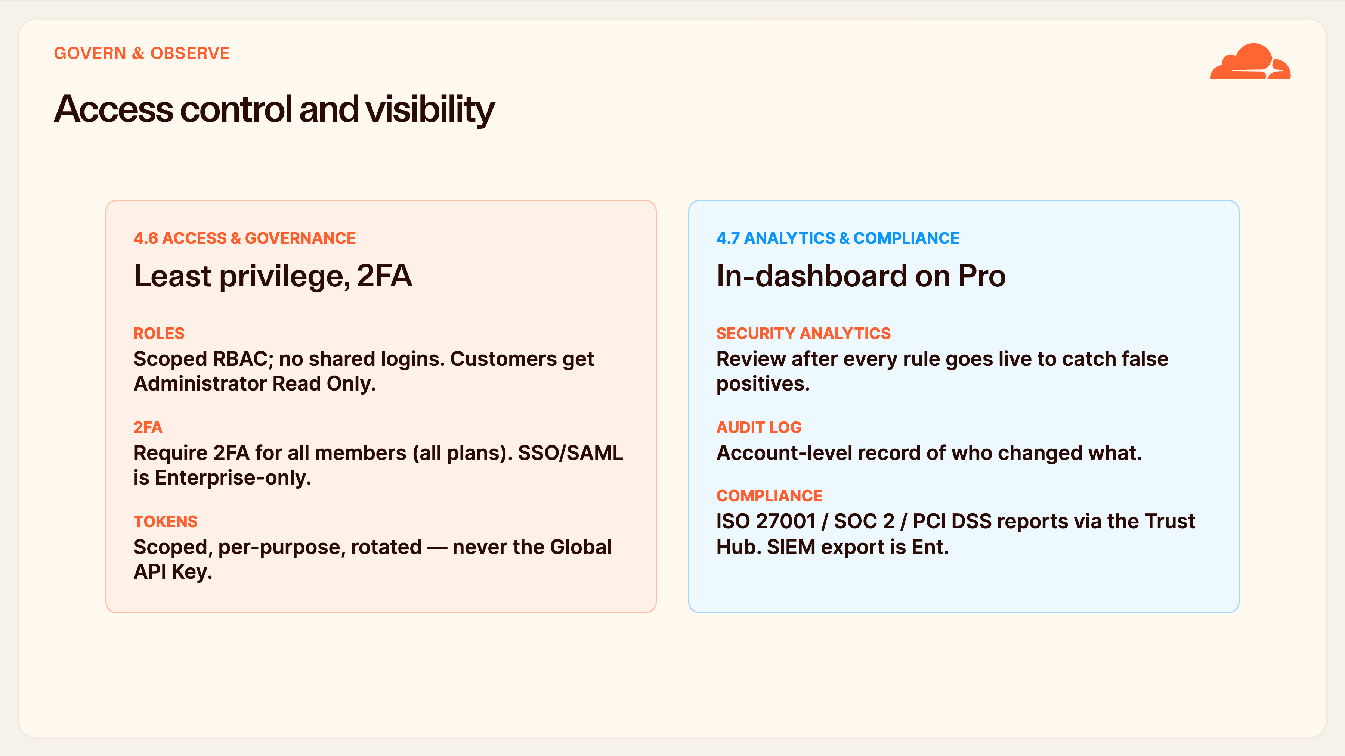
Notes:
Access control and visibility
Two operational disciplines: who can touch the account, and how you watch it.
Governance first. Use scoped, least-privilege roles — no shared logins. Give the customer's team Administrator Read Only so they have visibility without breaking things. Require 2FA for every member; that's available on all plans, whereas SSO and SAML are Enterprise-only. And tokens are scoped, per-purpose, and rotated — never the Global API Key.
Observability second. On Pro you rely on in-dashboard analytics — there's no log export, that's Enterprise. The single most useful habit for this team: check Security Analytics right after enabling any rule. If it's blocking real users you'll see it and can dial back before support tickets land. Use the Audit Log to see who changed what. And Cloudflare's ISO, SOC 2 and PCI reports are available from the Trust Hub for the customer's own compliance scope.

Slide 30
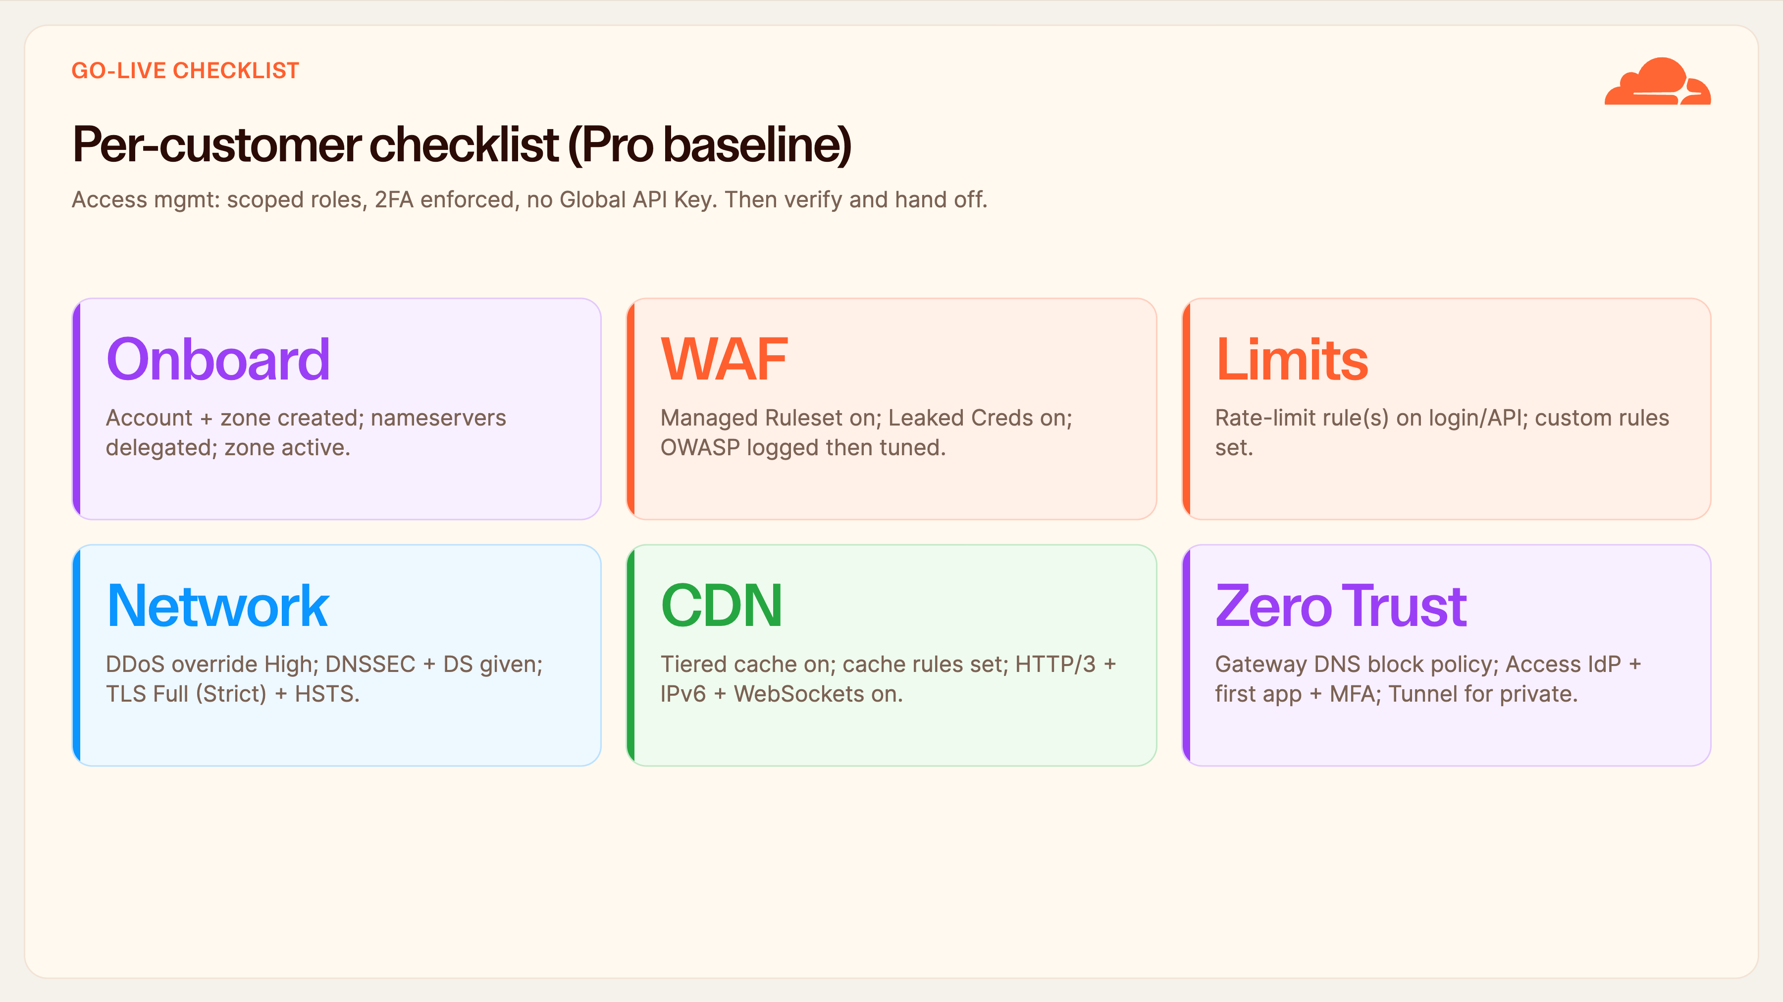
Notes:
Per-customer checklist
This is your go-live checklist — the one-screen version of everything we've covered. Run it for every customer before you call the work done.
Onboarding: account and zone created, nameservers delegated, zone actually resolving through Cloudflare. WAF: Managed Ruleset deployed, Leaked Credential Check on, OWASP logged first and then tuned. Limits: rate-limiting on login and API, custom rules in place.
Network: DDoS override at High, DNSSEC enabled and the DS record handed to the customer, TLS on Full (Strict) with HSTS. CDN: tiered cache, cache rules, HTTP/3, IPv6 and WebSockets on. Zero Trust: the Gateway DNS block policy, Access with the IdP and first app behind MFA, and Tunnel for private apps.
Underpinning it all: scoped roles, 2FA enforced, no Global API Key. Tick these and you're ready to verify.

Slide 31
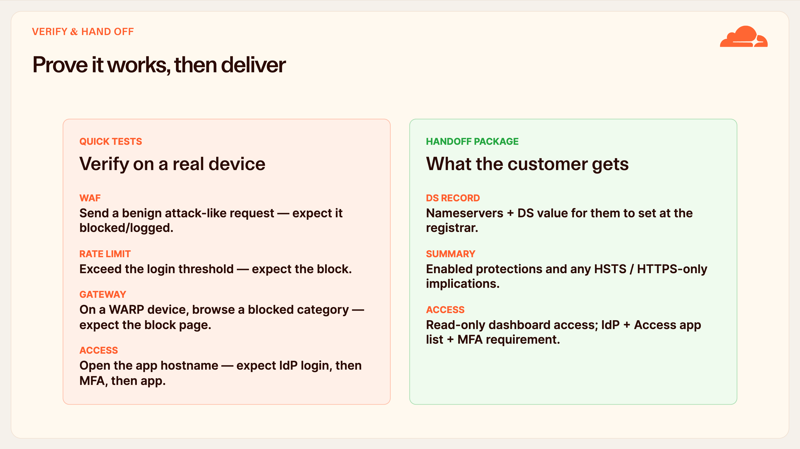
Notes:
Prove it works, then deliver
Never hand off on trust — prove each layer works, then package it.
The quick tests: fire a benign attack-shaped request and confirm the WAF blocks or logs it. Exceed your login rate-limit threshold and confirm the block kicks in. On a WARP-enrolled test device, browse to a blocked category and confirm you get the Gateway block page. Open the Access-protected hostname in a clean browser and confirm you get the IdP login, then MFA, then the app.
The handoff package: give the customer their nameservers and the DS record they must set at the registrar, a plain summary of the protections you enabled and any HSTS or HTTPS-only implications, read-only dashboard access for their team, and the IdP and Access app list with the MFA requirement spelled out. That's a clean, professional delivery.

Slide 32
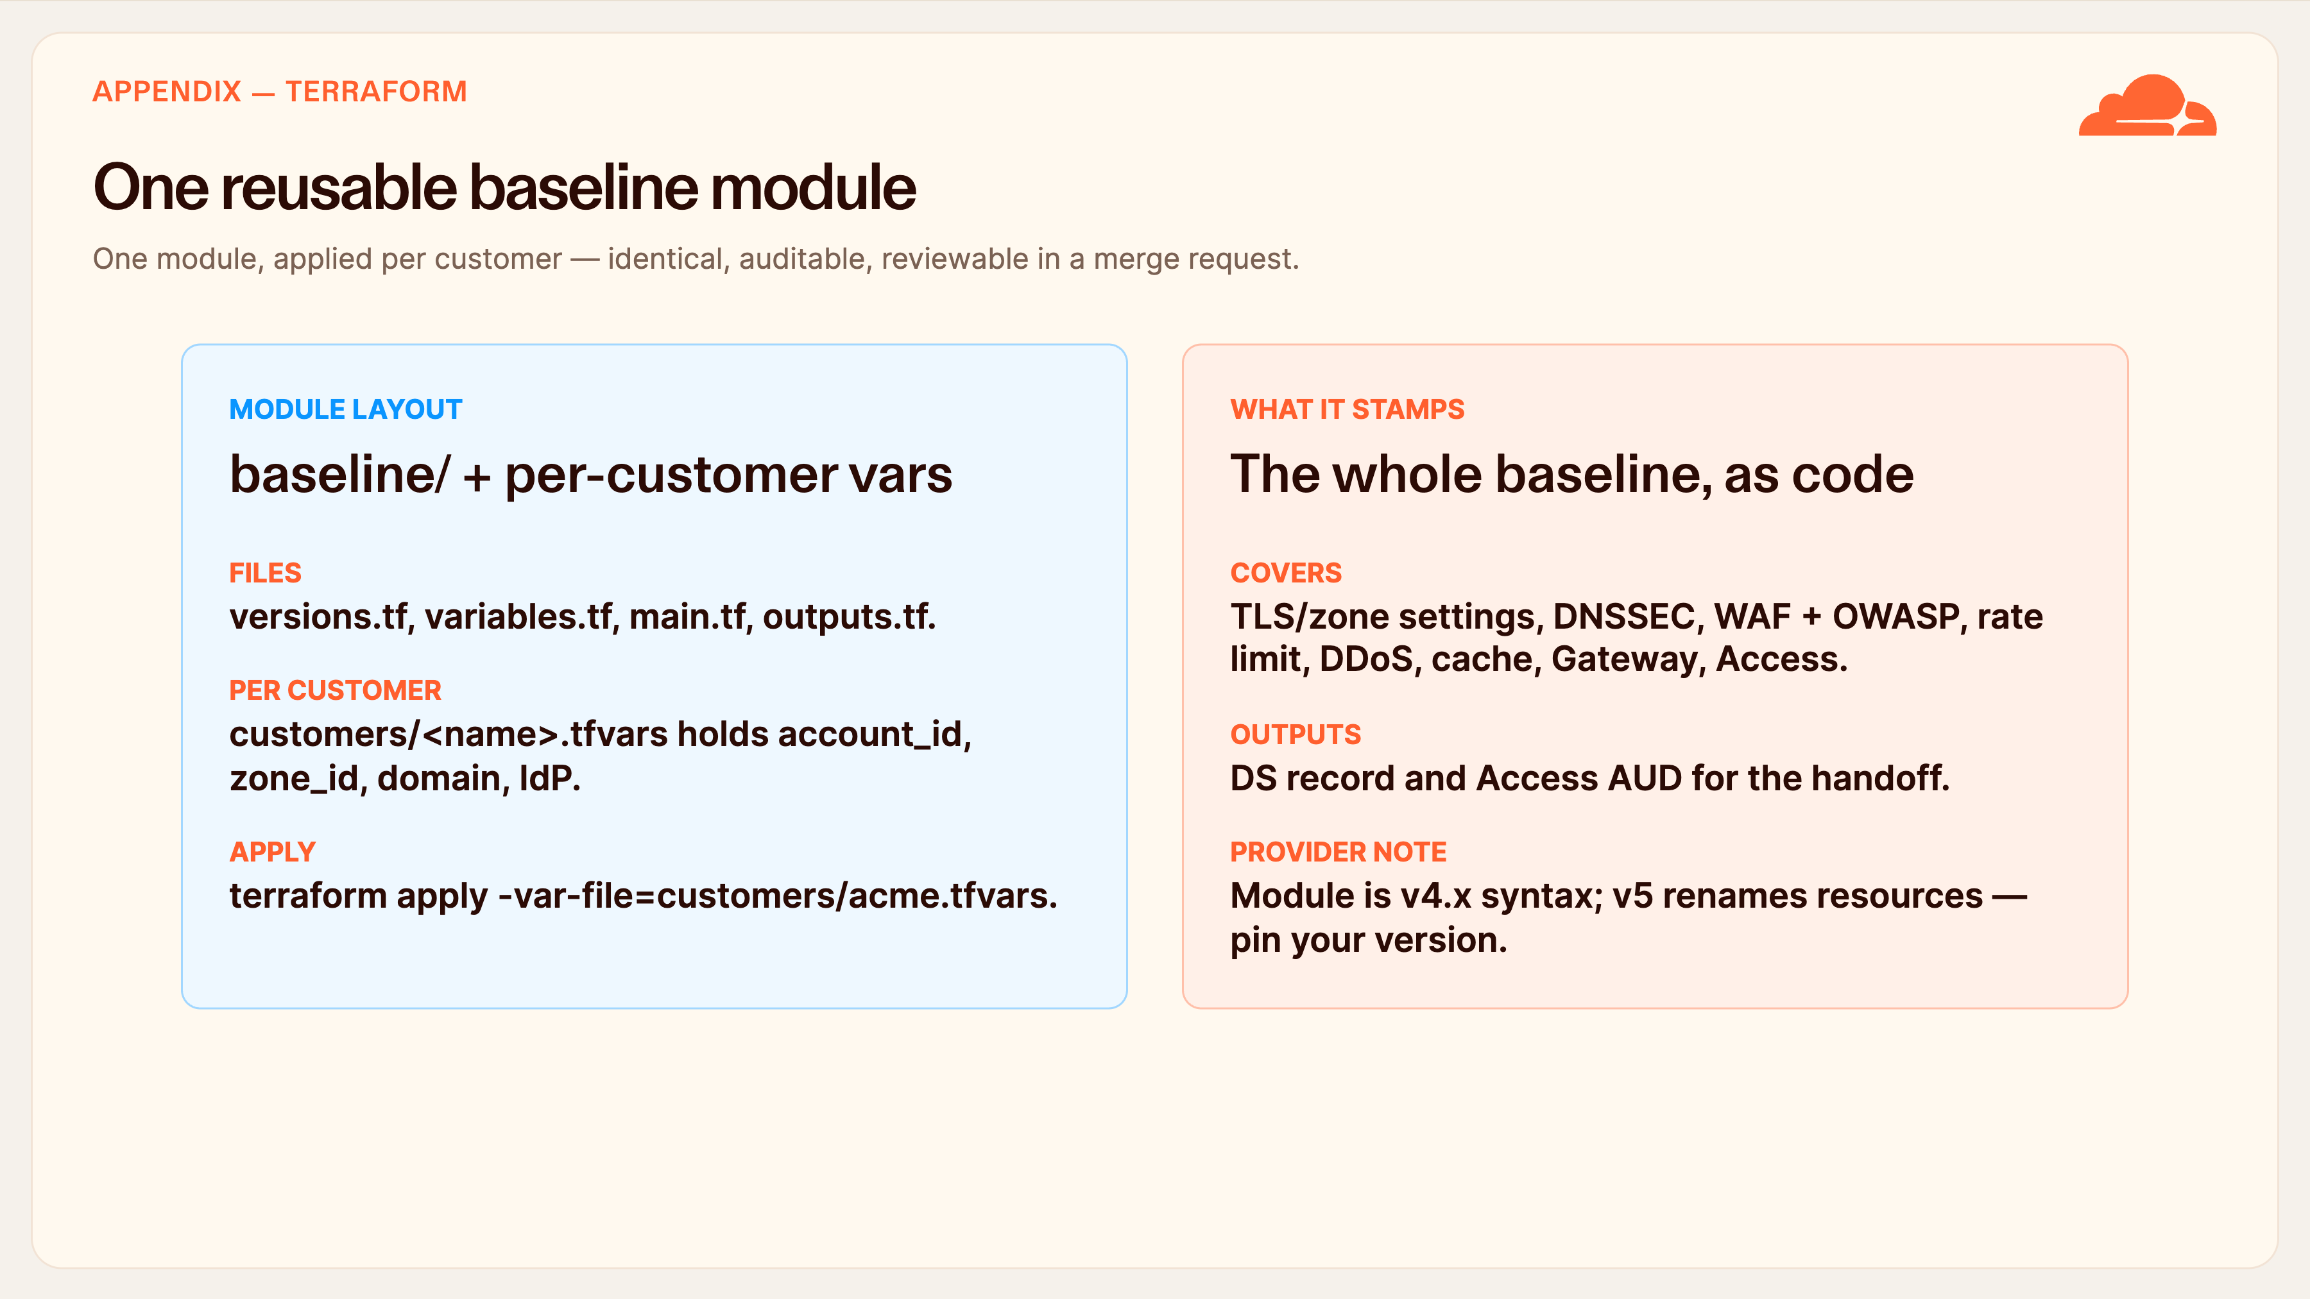
Notes:
One reusable baseline module
For anyone doing this at scale, the appendix is the real payoff: the entire baseline expressed as one Terraform module you reuse per customer.
The layout is standard — versions, variables, main and outputs — plus a tfvars file per customer holding that customer's account ID, zone ID, domain and IdP details. You apply it with a single command pointing at the customer's var-file.
That one module stamps everything we've discussed: TLS and zone settings, DNSSEC, the WAF managed and OWASP rulesets, rate limiting, the DDoS override, cache rules, the Gateway DNS policy and the first Access app. Its outputs even give you the DS record and the Access AUD you need for handoff.
One caveat: the module is written in v4.x provider syntax. Version 5 renames several resources — Teams rules become Zero Trust Gateway policies, for instance — so pin your provider version and migrate deliberately.

Slide 33
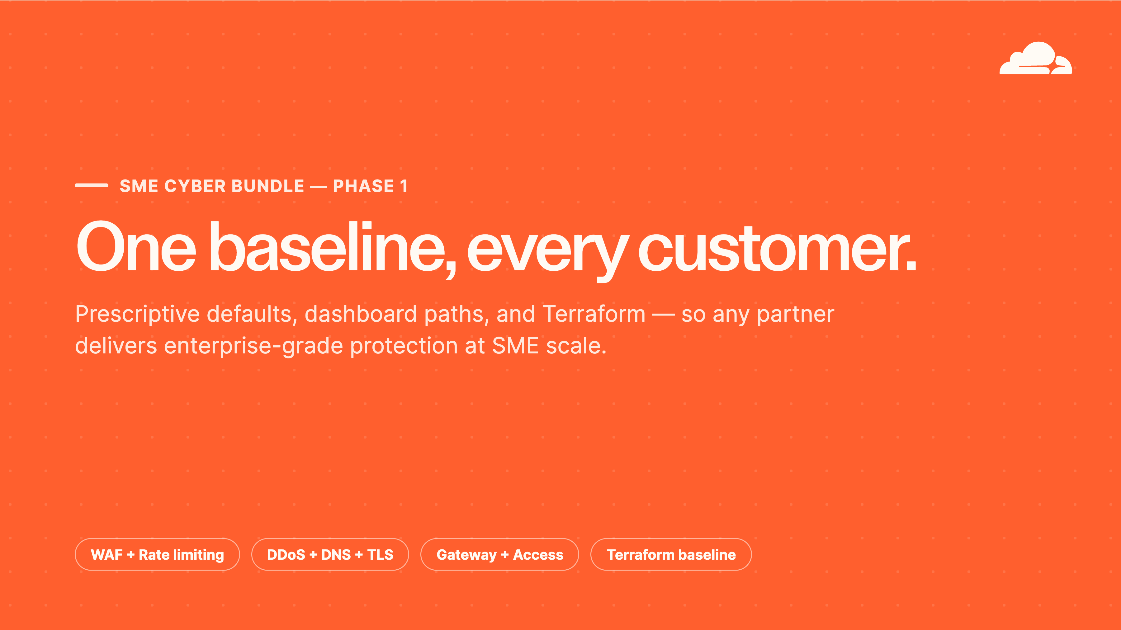
Notes:
One baseline, every customer
To close: the whole point of this guide is repeatability. Five product areas — WAF and rate limiting, DDoS, DNS and TLS, the CDN, and Zero Trust — delivered as one prescriptive baseline that the partner can stamp onto every SME customer.
Click it through the dashboard when you're learning; apply the Terraform module when you're scaling. Either way the customer gets the same enterprise-grade protection, and the partner gets a clean, auditable, supportable service.
Keep this deck and the source guide as your reference. Let's open it up for questions — whether it's a specific setting, the tenant flow, or the Terraform module.

