Slide 1
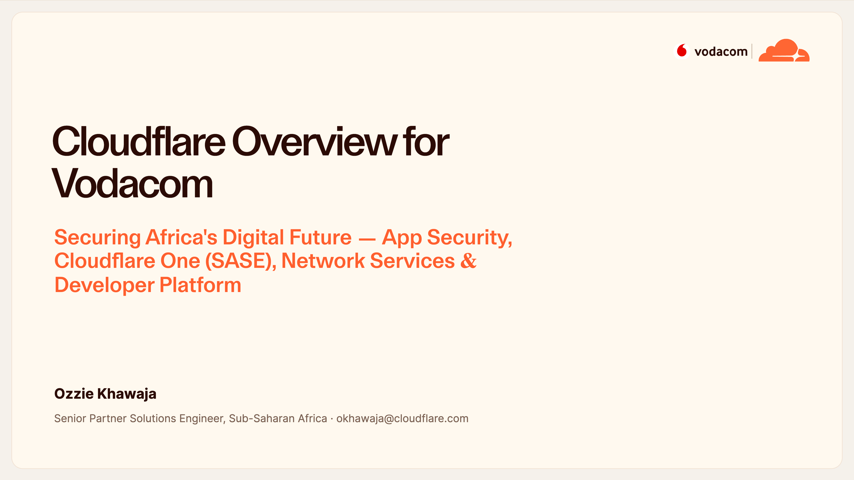
Notes:
Cover — Cloudflare for Vodacom
Welcome, and thank you for having us. This is a broad technical overview of how Cloudflare can secure and accelerate Vodacom across all seven operating companies.
We'll move through four platform pillars — application security, Cloudflare One for SASE, network services, and the developer platform — and tie each one back to Vodacom's specific challenges. It's a big agenda, so I'll keep each section tight.

Slide 2
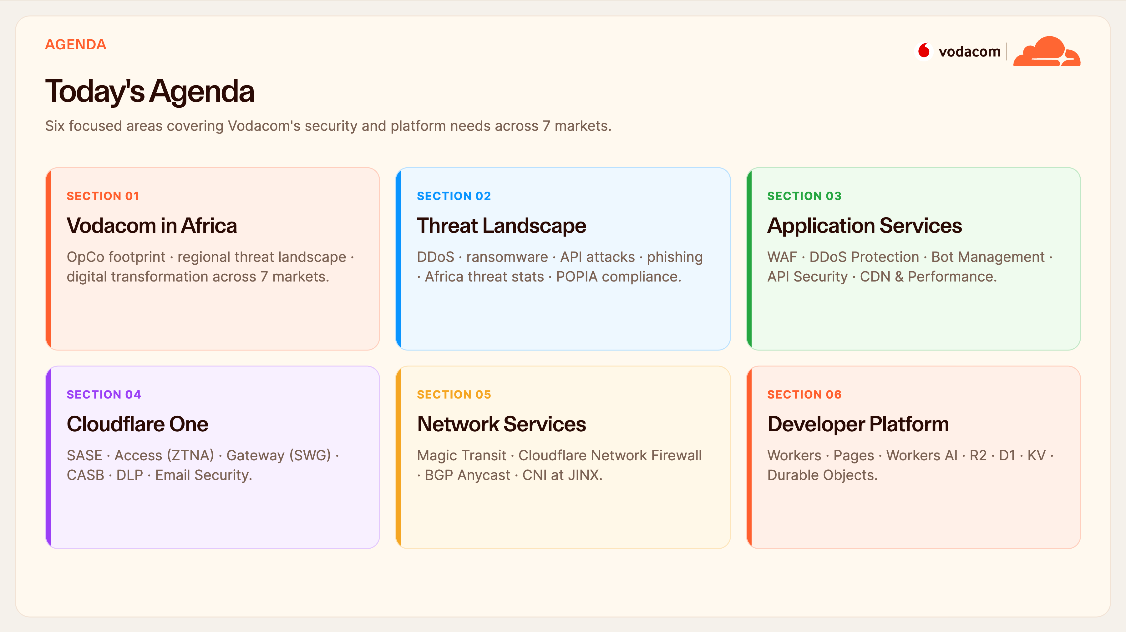
Notes:
Agenda
Six sections. We start with Vodacom's own footprint and the threats you face, then go product-by-product: application services first, then Cloudflare One for your workforce, then network services for your core IP infrastructure, and finally the developer platform. I'll pause for questions at the end of each section rather than as we go.

Slide 3
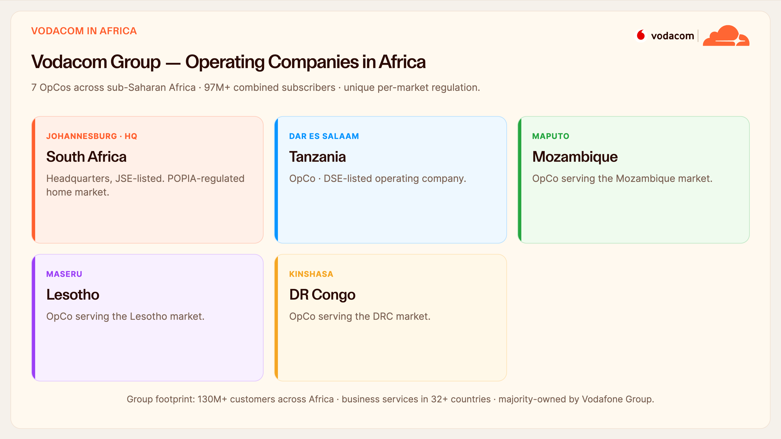
Notes:
Vodacom in Africa
Let's anchor on your footprint. Vodacom runs operating companies across sub-Saharan Africa — South Africa as the JSE-listed HQ, plus Tanzania, Mozambique, Lesotho and the DRC — with well over 97 million subscribers combined.
The important nuance is that each market has its own regulator and its own security obligations. So any platform you adopt has to give you consistent policy centrally while respecting per-market data rules. Keep that in mind — it's a theme we'll return to.

Slide 4
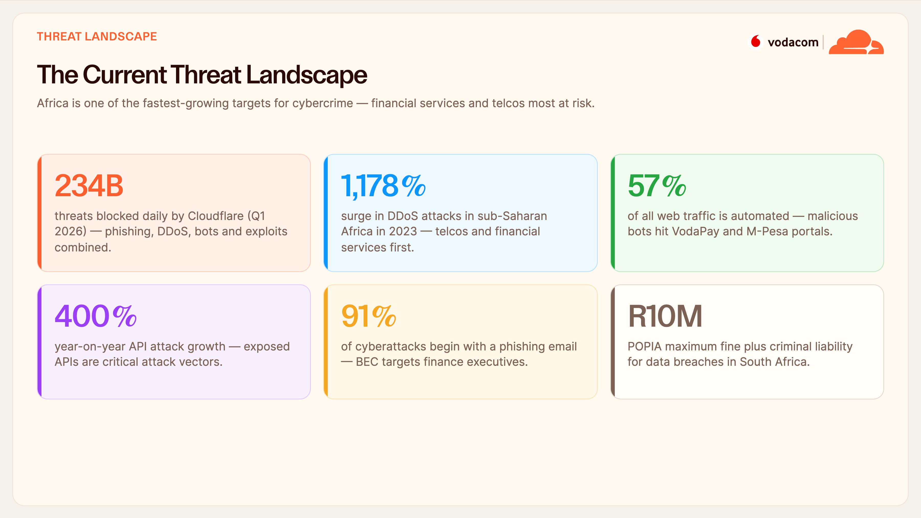
Notes:
Threat Landscape — Stats
Africa is now one of the fastest-growing targets for cybercrime, and telcos and financial services are at the top of the list. A few numbers that should focus the mind: DDoS attacks in sub-Saharan Africa jumped over eleven hundred percent in a single year; more than half of all web traffic is automated bots, which is exactly what hits VodaPay and M-Pesa; and API attacks are up four hundred percent.
And domestically, POPIA carries fines up to ten million rand plus criminal liability — so this is a board-level risk, not just an IT one.

Slide 5
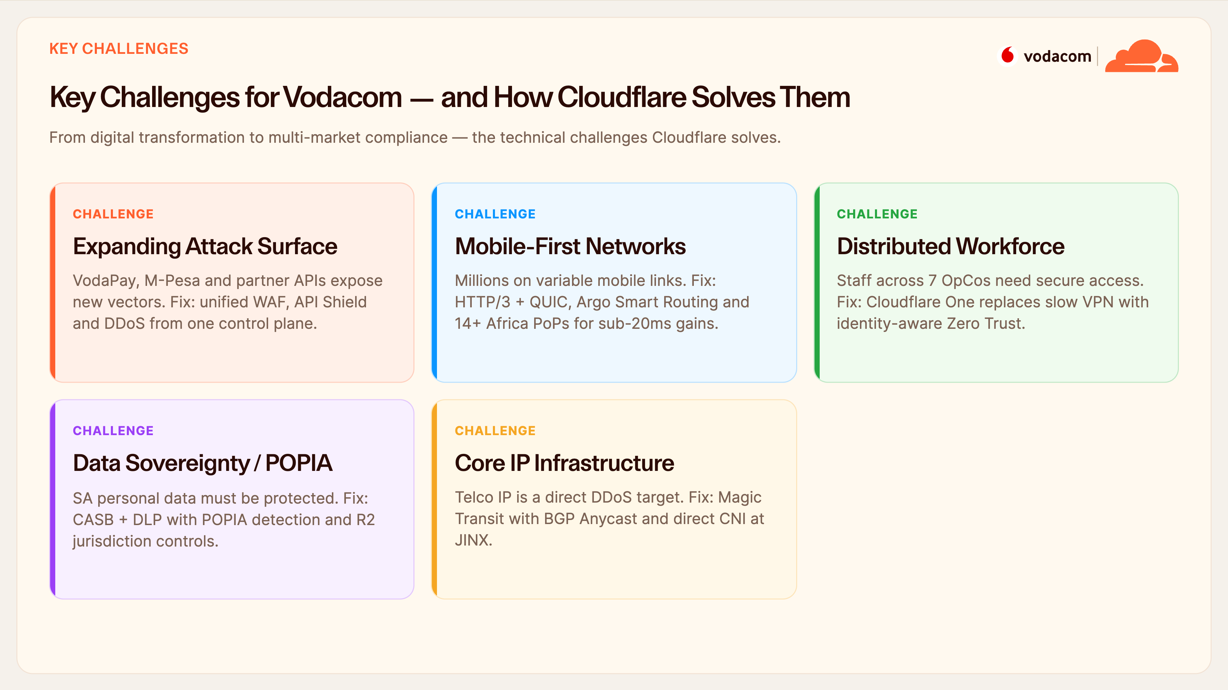
Notes:
Key Challenges
Let's translate those threats into your specific challenges, each with the Cloudflare answer. Your attack surface is expanding with VodaPay, M-Pesa and partner APIs — we unify WAF, API Shield and DDoS in one place. You're mobile-first on variable networks — we bring HTTP/3 and Argo with PoPs in-region. Your workforce is distributed across seven OpCos — Cloudflare One replaces slow VPN.
Data sovereignty under POPIA — CASB, DLP and R2 jurisdiction controls. And your core IP is a direct DDoS target — that's Magic Transit. Every challenge maps to a capability we'll detail.

Slide 6
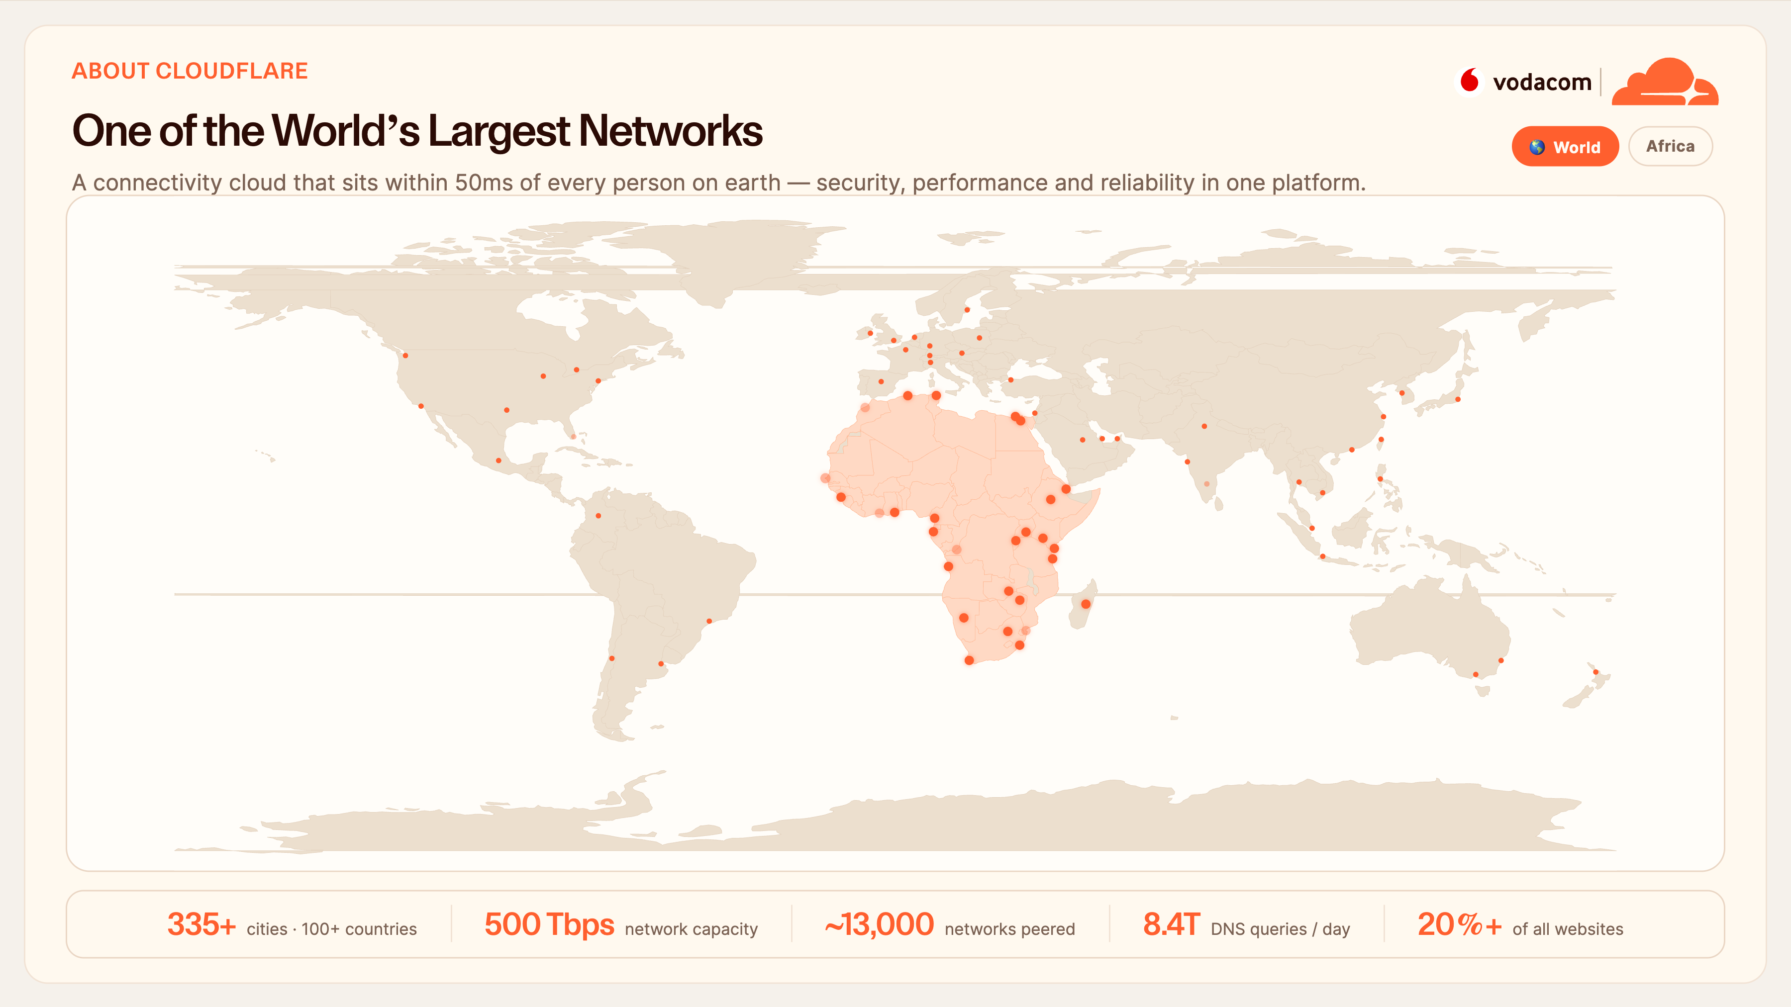
Notes:
About Cloudflare
Quickly, who we are — and this map is the story. Every pulsing dot is a Cloudflare city, and we're in 335-plus of them across 100-plus countries, with 500 terabits of capacity and peering with around thirteen thousand networks including all the major African ISPs. We handle 8.4 trillion DNS queries a day, and over twenty percent of all websites sit behind us.
That scale is the product. It's why we can be within 50 milliseconds of virtually every user, and why our threat intelligence is second to none — we simply see more of the internet than anyone. Let me click Africa to show you how close we already are to your markets — which is exactly where the next slide picks up.

Slide 7
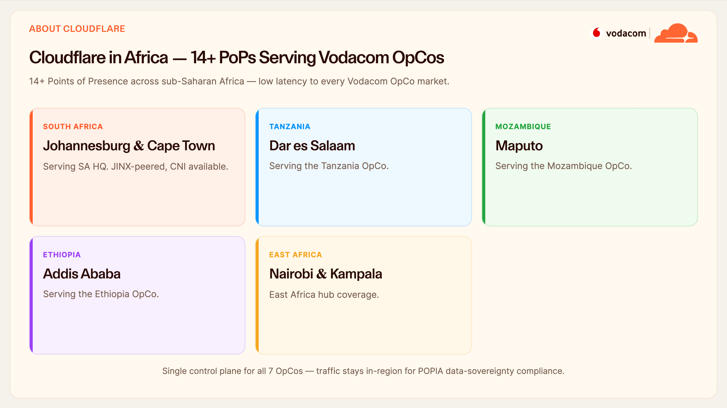
Notes:
Cloudflare in Africa
And crucially, we're on the ground in your markets. We have 14-plus PoPs across sub-Saharan Africa, directly serving every Vodacom OpCo — Johannesburg and Cape Town for SA, plus Dar es Salaam, Maputo, Addis, Nairobi and Kampala. In Johannesburg we're peered at JINX with CNI available.
Why it matters: one control plane covers all seven OpCos, but traffic stays in-region — which is exactly what POPIA data sovereignty requires.

Slide 8
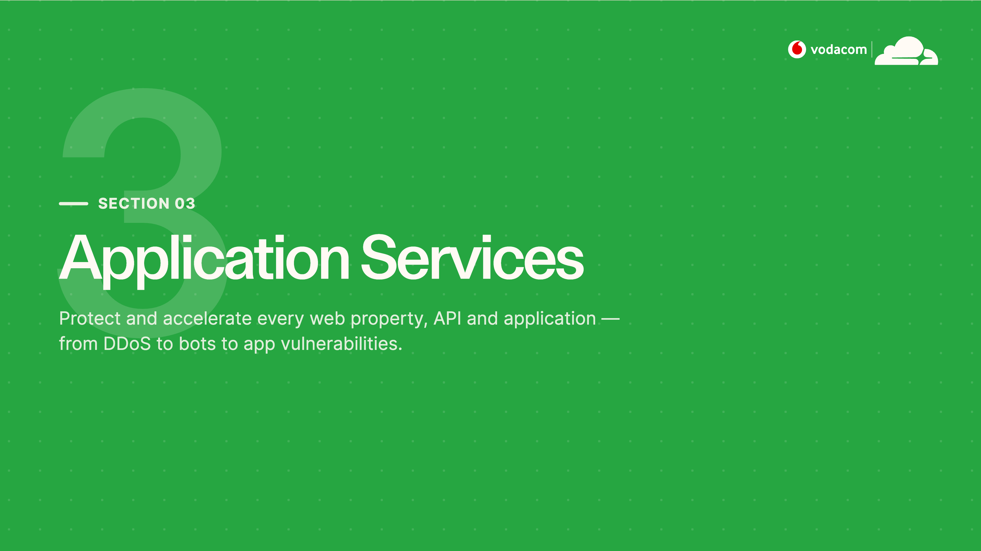
Notes:
Section 03 — Application Services
Into the first product pillar: application services. This is everything that protects and accelerates your public-facing properties — WAF, DDoS, Bot Management, API Security and CDN. For a business running VodaPay and customer portals, this is the front line.

Slide 9
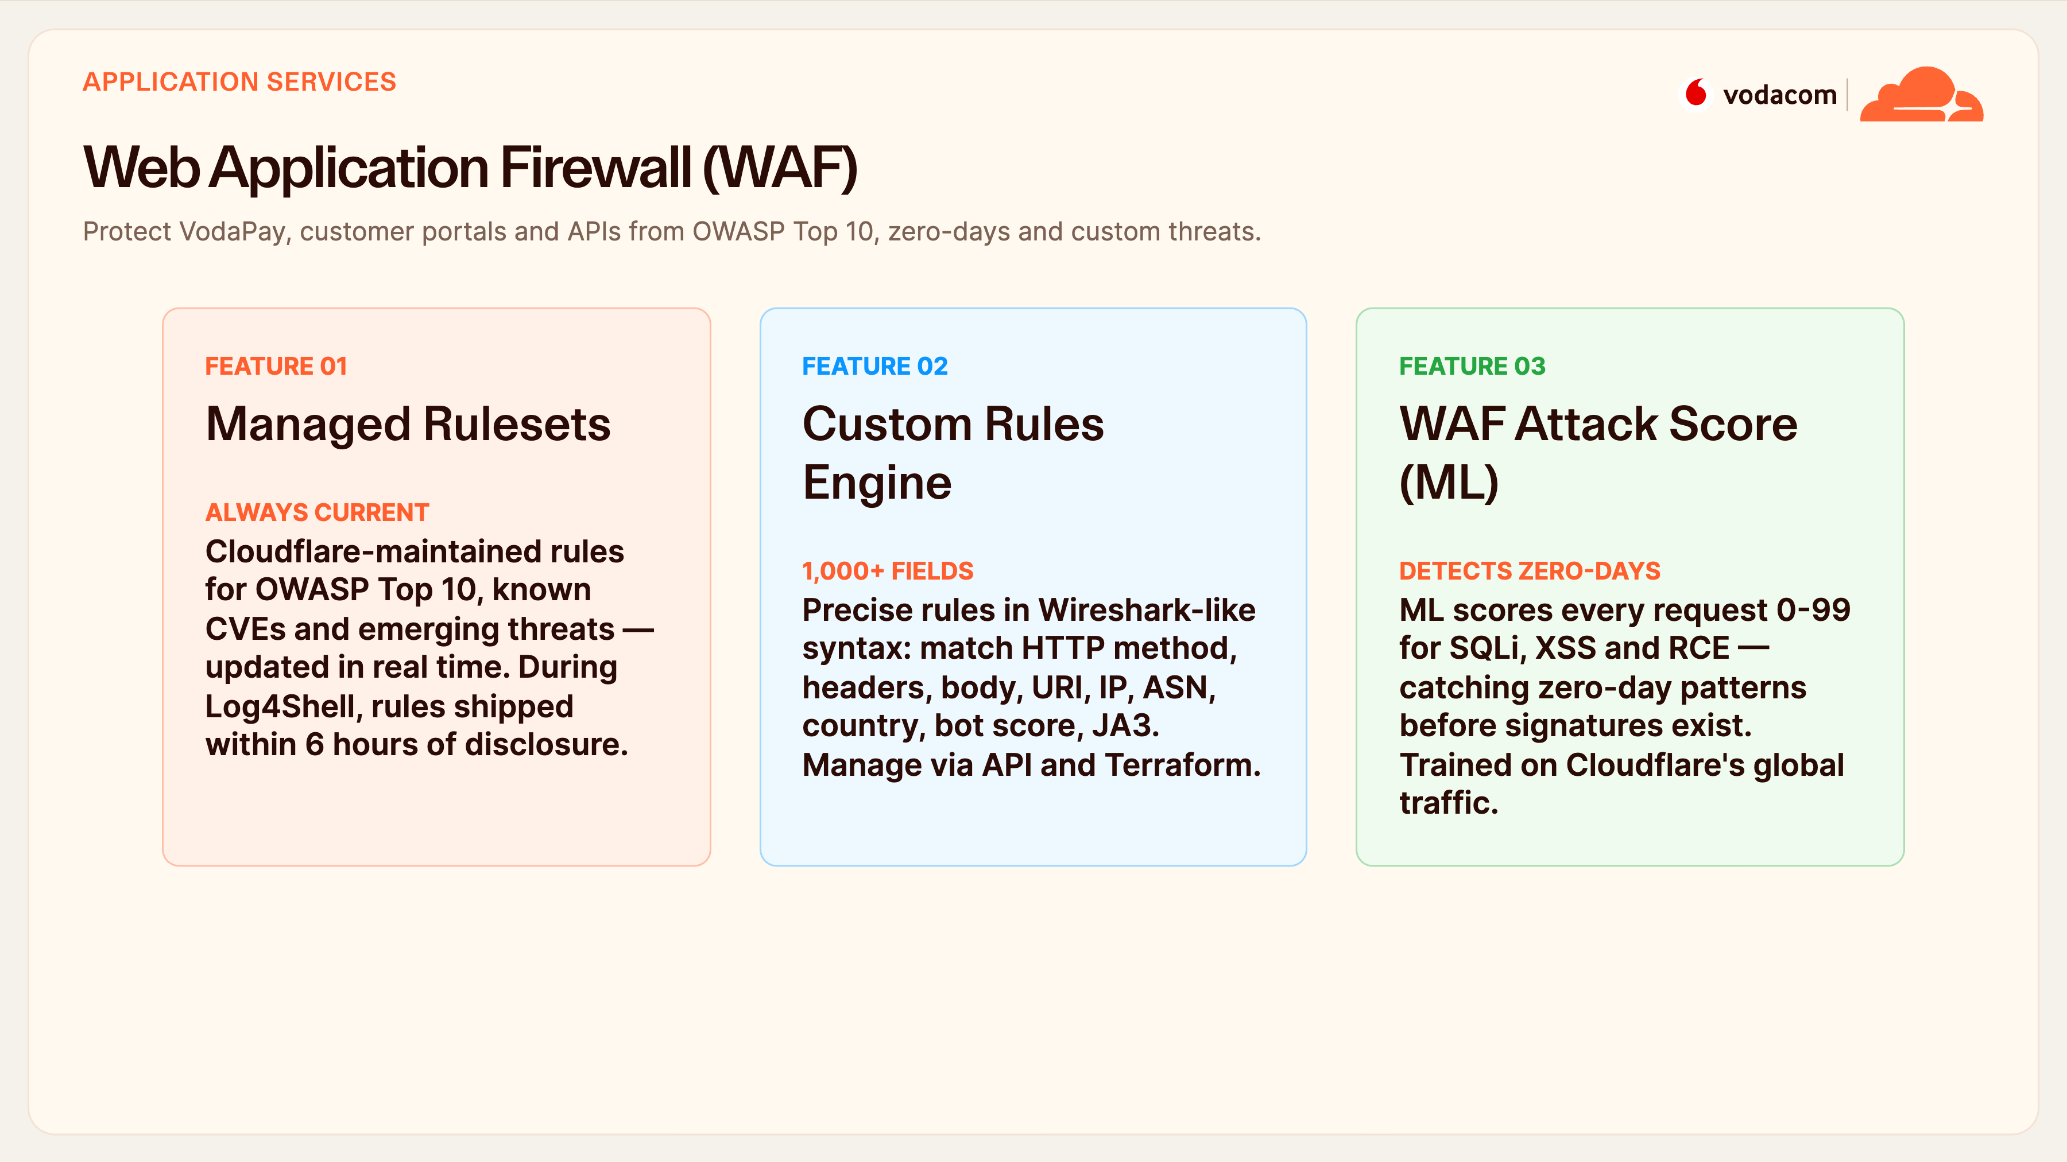
Notes:
WAF
The WAF protects VodaPay, portals and APIs. Managed rulesets cover the OWASP Top 10 and known CVEs and update in real time — during Log4Shell we shipped protection within six hours of disclosure, before most teams had even finished reading the advisory. Custom rules let your engineers match on over a thousand attributes using familiar Wireshark-style syntax, all via API and Terraform.
And the ML Attack Score catches zero-day patterns before a signature exists — that's the layer that stops the attack nobody's seen yet.

Slide 10
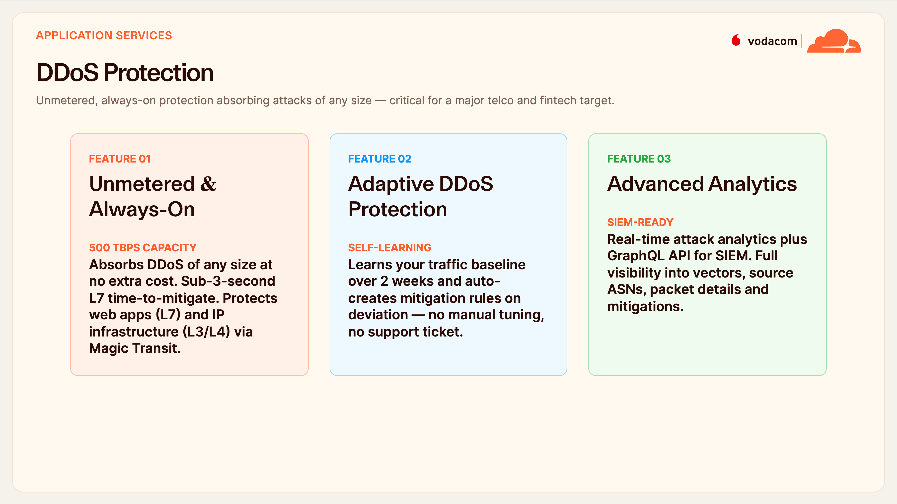
Notes:
DDoS Protection
DDoS is existential for a telco, so this matters. It's unmetered and always-on — we absorb an attack of any size at no extra cost, with sub-three-second time-to-mitigate, protecting both your web apps and, via Magic Transit, your IP infrastructure. There's no bill shock after a big attack.
Adaptive protection learns your baseline over a couple of weeks and writes its own mitigation rules, so it self-tunes. And your SOC gets full real-time analytics and a GraphQL API to pull it all into Splunk or Sentinel.

Slide 11
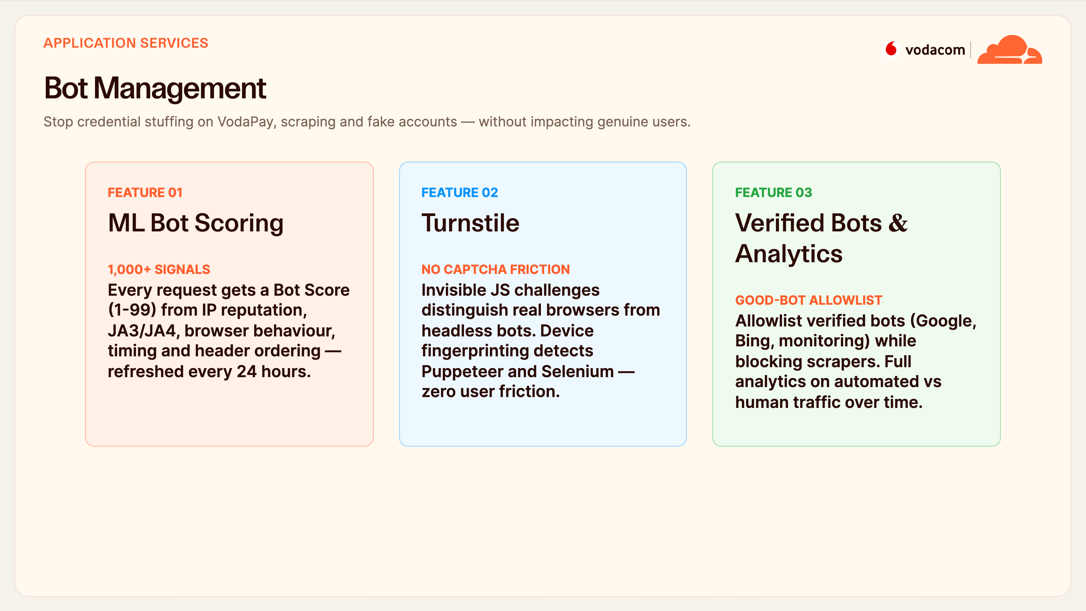
Notes:
Bot Management
Bot Management is squarely aimed at VodaPay and M-Pesa — credential stuffing, fake accounts, scraping. Every request gets a bot score from one to ninety-nine, built from over a thousand signals like TLS fingerprint and behavioural timing, refreshed daily. Turnstile replaces those annoying CAPTCHAs with an invisible challenge, so real users feel nothing while headless bots get caught.
And you keep a verified-bot allowlist so Google, Bing and your own monitoring keep working, with full analytics on human-versus-bot traffic.

Slide 12
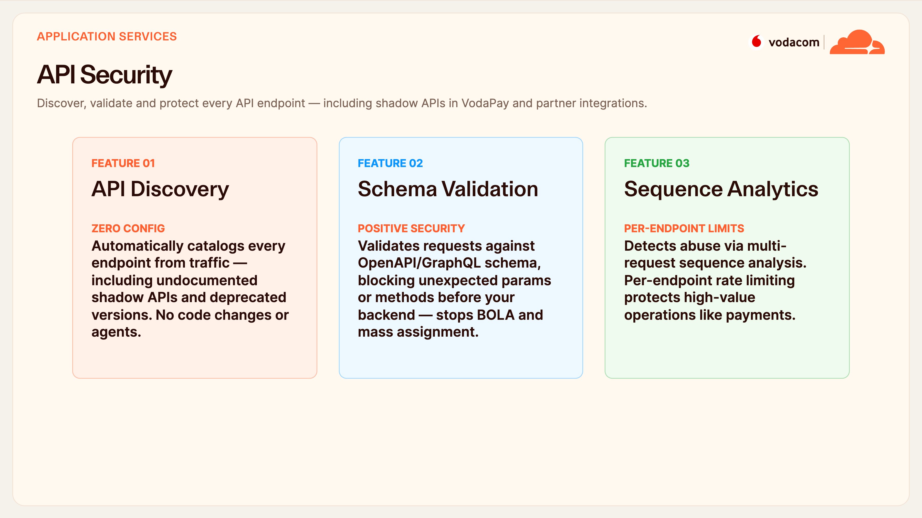
Notes:
API Security
APIs are where fintech risk concentrates, and the first problem is you can't protect what you can't see. API Discovery catalogs every endpoint from live traffic — including the shadow and deprecated APIs nobody documented — with no code changes. Then schema validation enforces a positive security model against your OpenAPI spec, blocking BOLA and mass-assignment attacks before they reach the backend.
And sequence analytics spots abuse across multiple requests, with per-endpoint rate limits protecting your payment operations specifically.

Slide 13
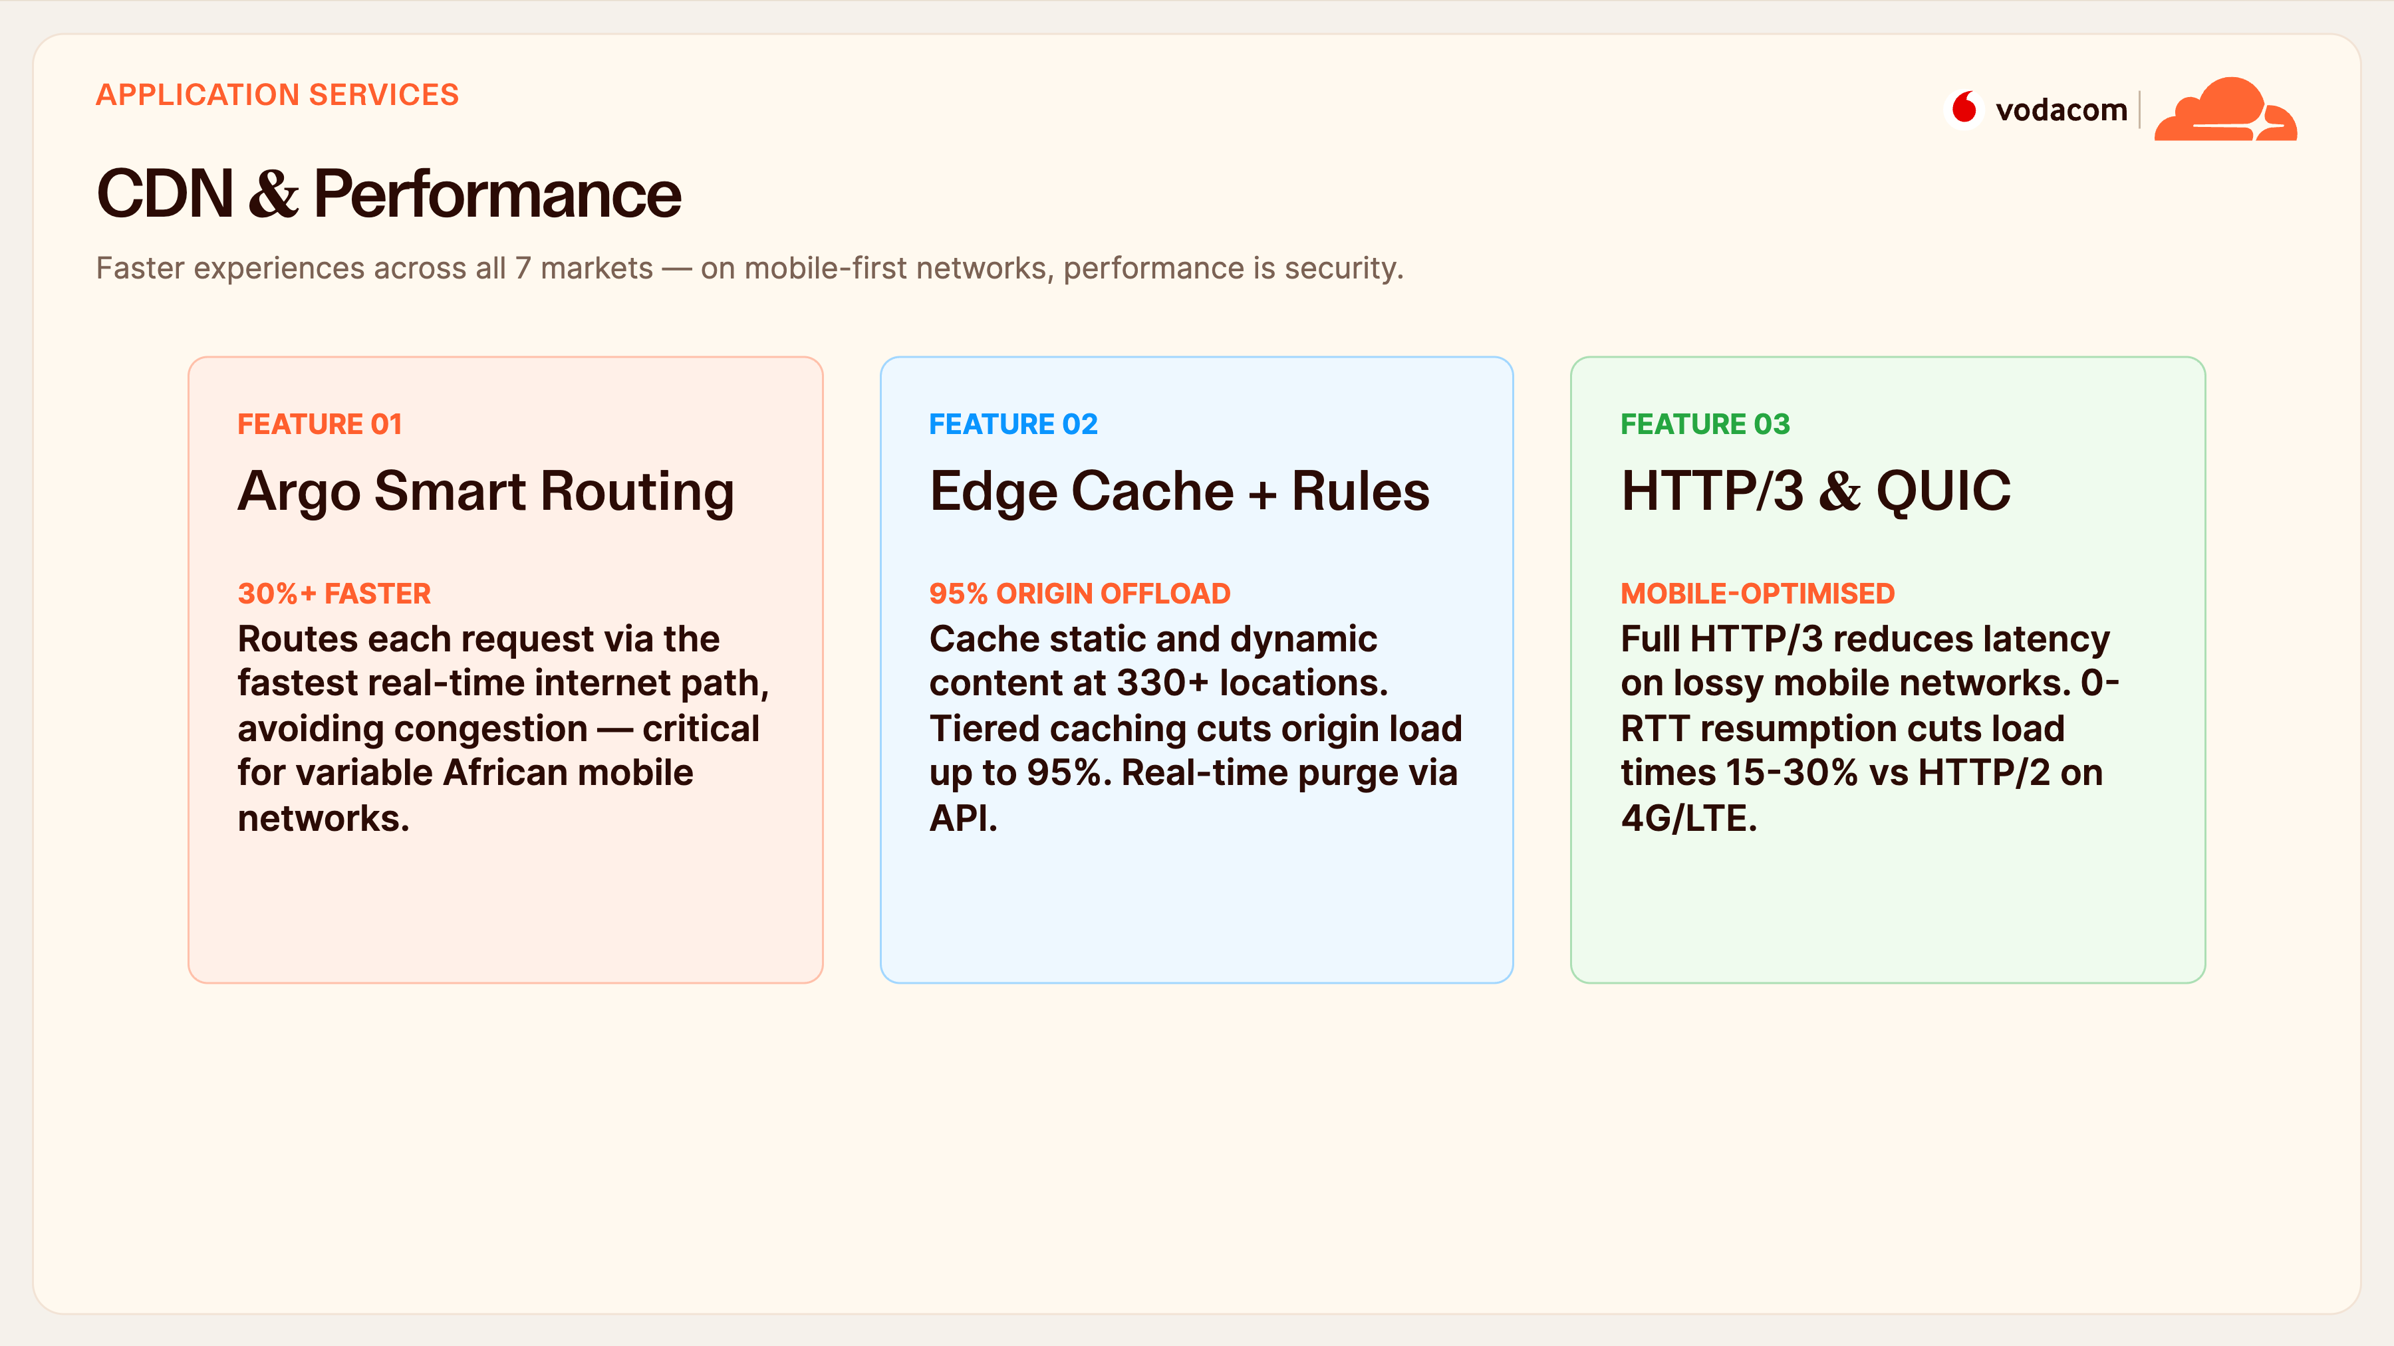
Notes:
CDN & Performance
On a mobile-first network, performance is a form of security — slow apps drive users to insecure workarounds. Argo Smart Routing picks the fastest real-time path and gives thirty-percent-plus improvements, with the biggest gains right here in Africa. Edge caching offloads up to ninety-five percent of origin traffic across 330-plus locations.
And full HTTP/3 with QUIC is a real win on lossy 4G and LTE — fifteen to thirty percent faster page loads for your rural and mobile users.

Slide 14
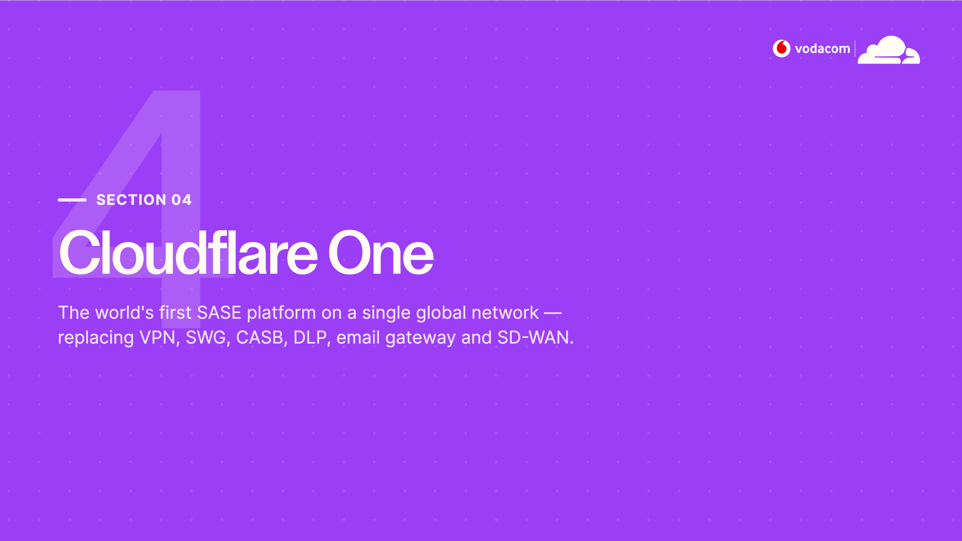
Notes:
Section 04 — Cloudflare One
Now we pivot from protecting your websites to protecting your organisation — Cloudflare One, our SASE platform. This is the piece that replaces a whole shelf of legacy products: VPN, secure web gateway, CASB, DLP, email gateway, even SD-WAN — all on the same network we just described.

Slide 15
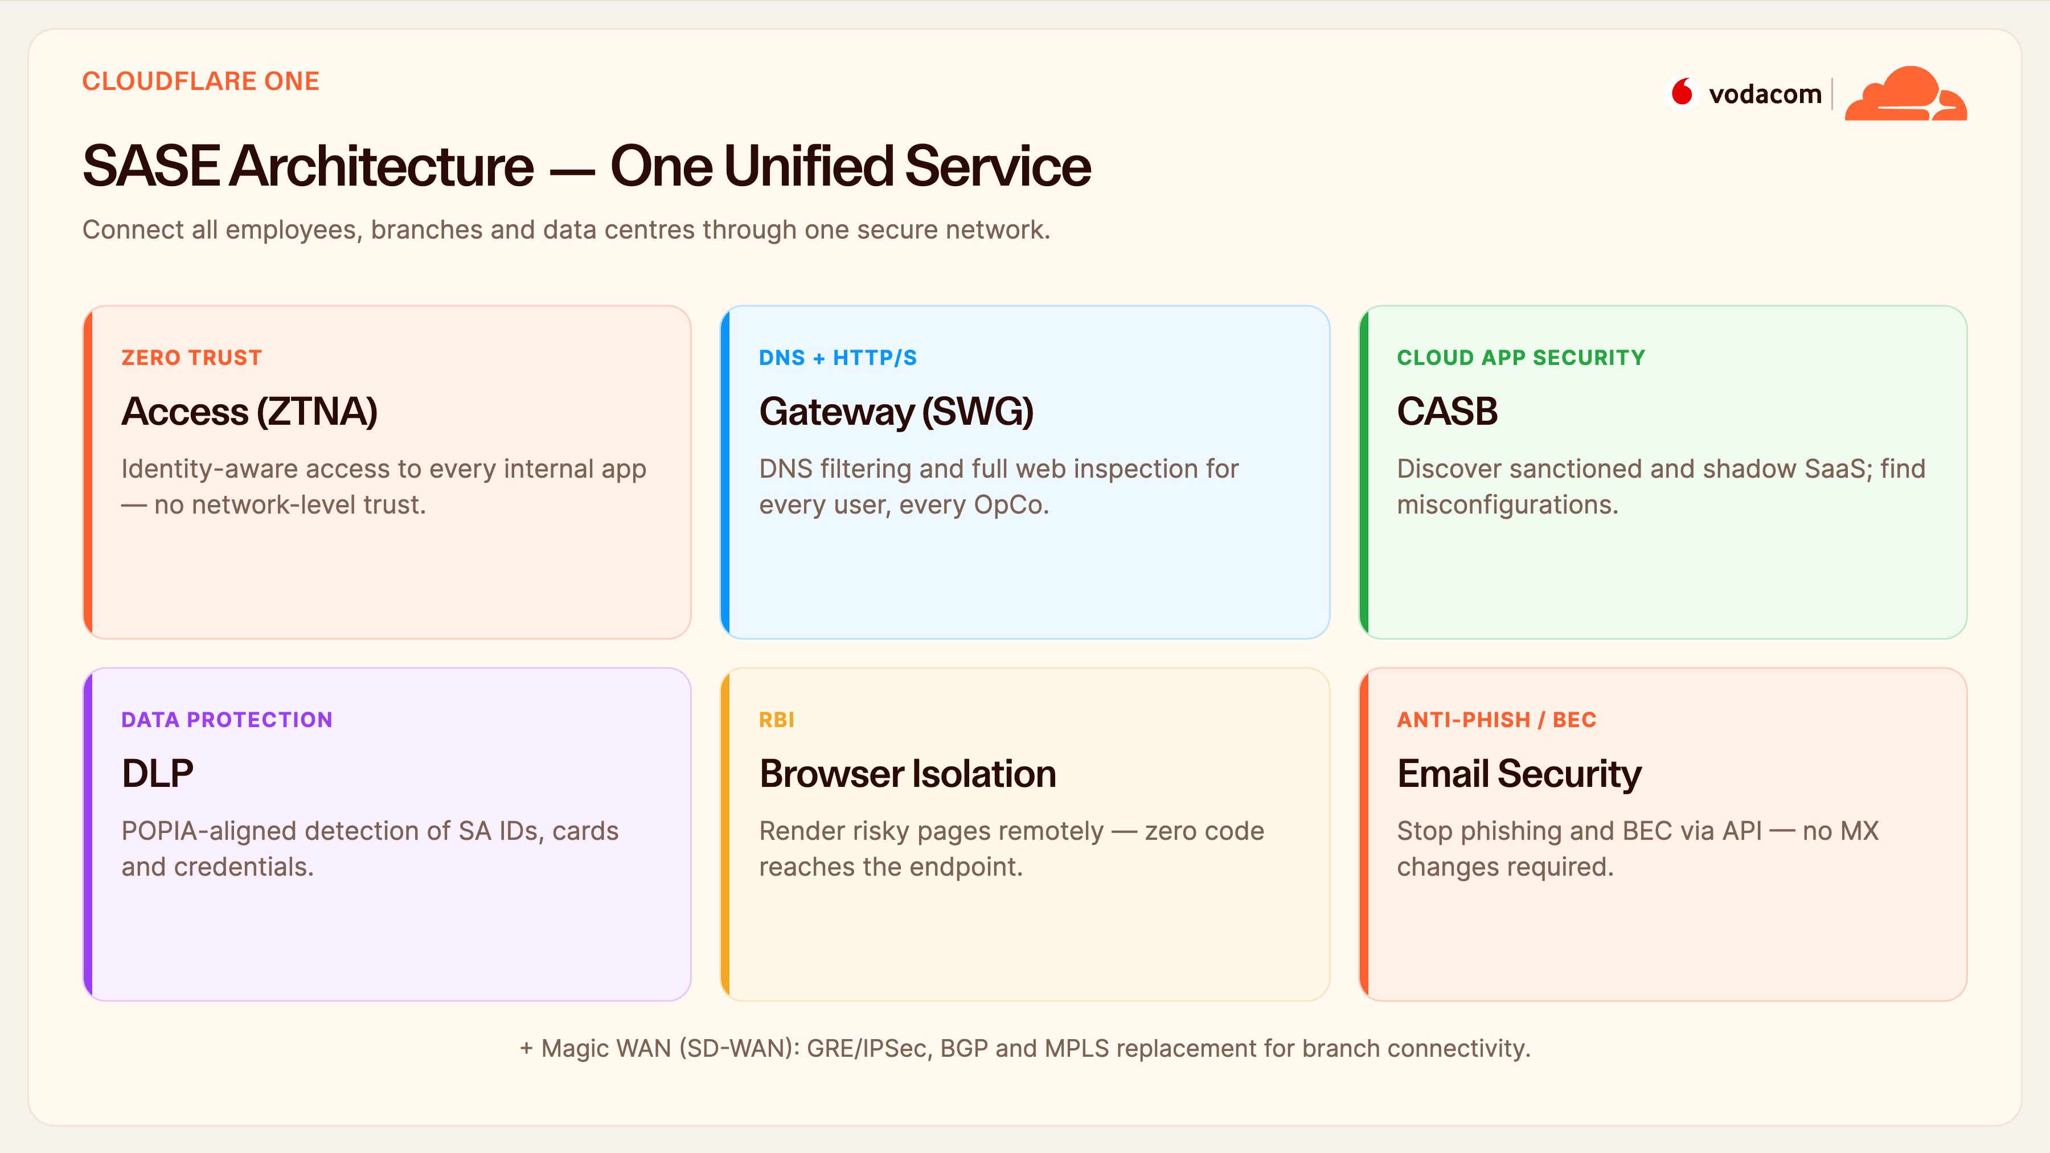
Notes:
SASE Architecture
This is the architecture on one slide. Six services — Access, Gateway, CASB, DLP, Browser Isolation and Email Security — plus Magic WAN for branch connectivity, all sharing one identity model and one network. A user's traffic hits the nearest PoP, gets identity and posture checked, and every one of these services can apply in a single pass.
The strategic message for Vodacom: instead of stitching six vendors together across seven OpCos, it's one platform with one policy. We'll now go through the key components.

Slide 16
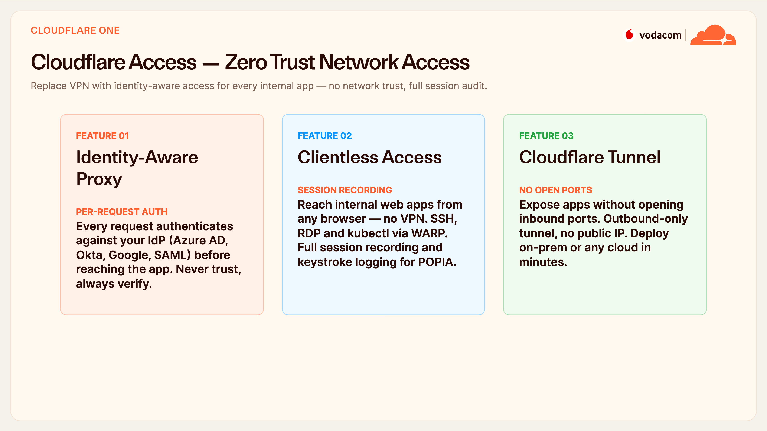
Notes:
Access (ZTNA)
Access is the VPN replacement. Instead of granting network-level trust, every single request is authenticated against your IdP — Azure AD, Okta, whatever you use — before it touches the app. For contractors and staff, they reach internal apps through any browser, with SSH and RDP over WARP, and full session recording for POPIA audit.
And the tunnel is outbound-only, so you expose apps with no open inbound ports and no public IP. For a distributed workforce across seven OpCos, this is faster and far safer than legacy VPN concentrators.

Slide 17
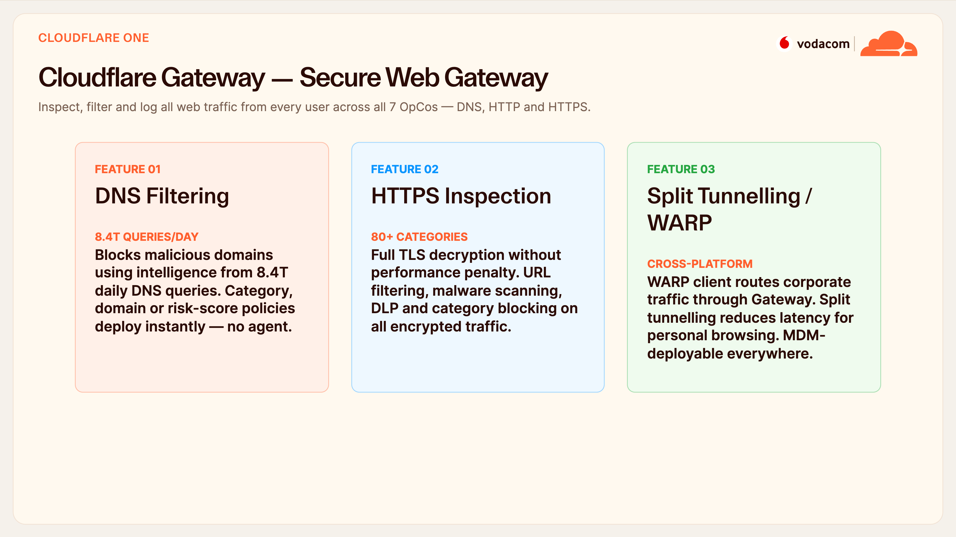
Notes:
Gateway (SWG)
Gateway secures outbound traffic for every employee. DNS filtering blocks malicious domains using intelligence from those 8.4 trillion daily queries, and for an office it deploys instantly with no agent. When you need depth, HTTPS inspection decrypts and filters encrypted traffic across eighty-plus categories without a performance hit.
The WARP client extends that to laptops and phones, and split tunnelling keeps personal browsing fast while routing only corporate traffic through us. It's MDM-deployable across all platforms.

Slide 18
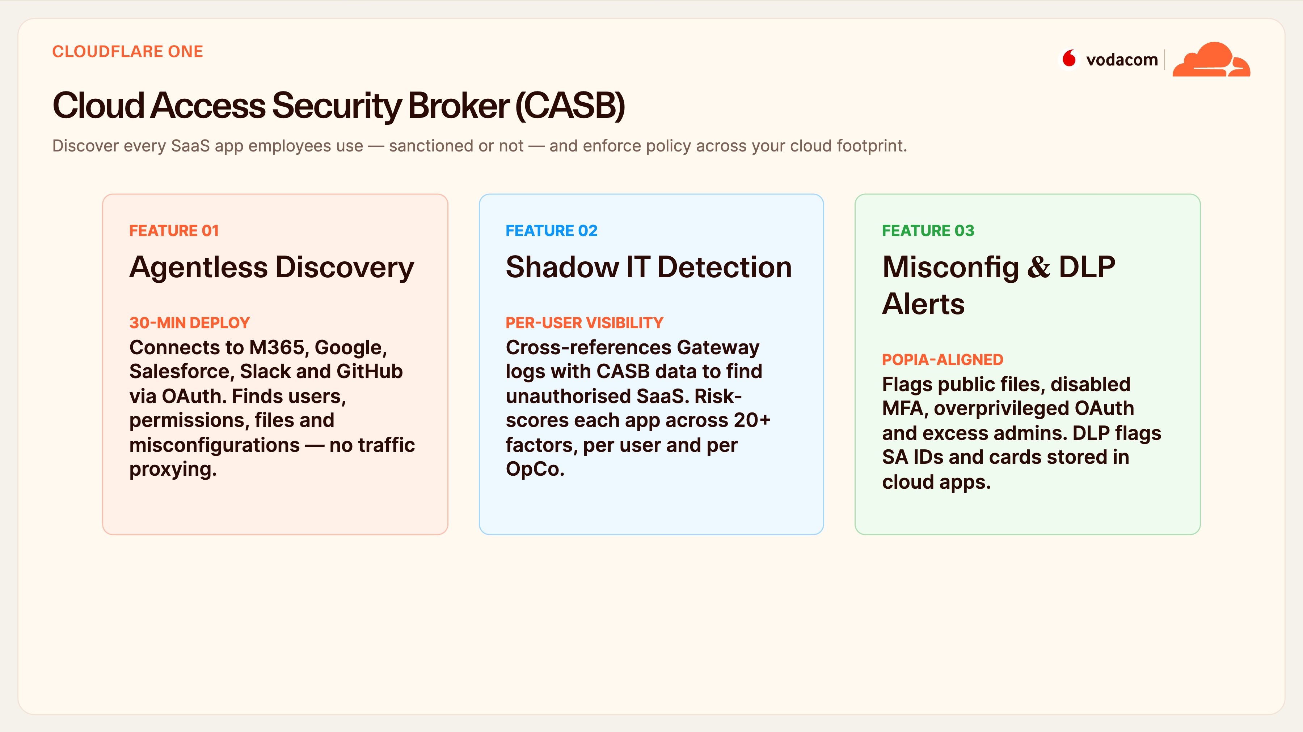
Notes:
CASB
CASB answers a question most orgs can't: which SaaS apps are we actually using, and are they safe? It connects to M365, Google, Salesforce and others over API in about thirty minutes — no proxying — and surfaces every user, permission and misconfiguration. By cross-referencing Gateway logs it also finds shadow IT, risk-scored per user and per OpCo.
Then it flags the dangerous stuff: publicly shared files, disabled MFA, overprivileged OAuth apps — and DLP finds SA IDs and card data sitting in the cloud, which is a direct POPIA exposure.

Slide 19
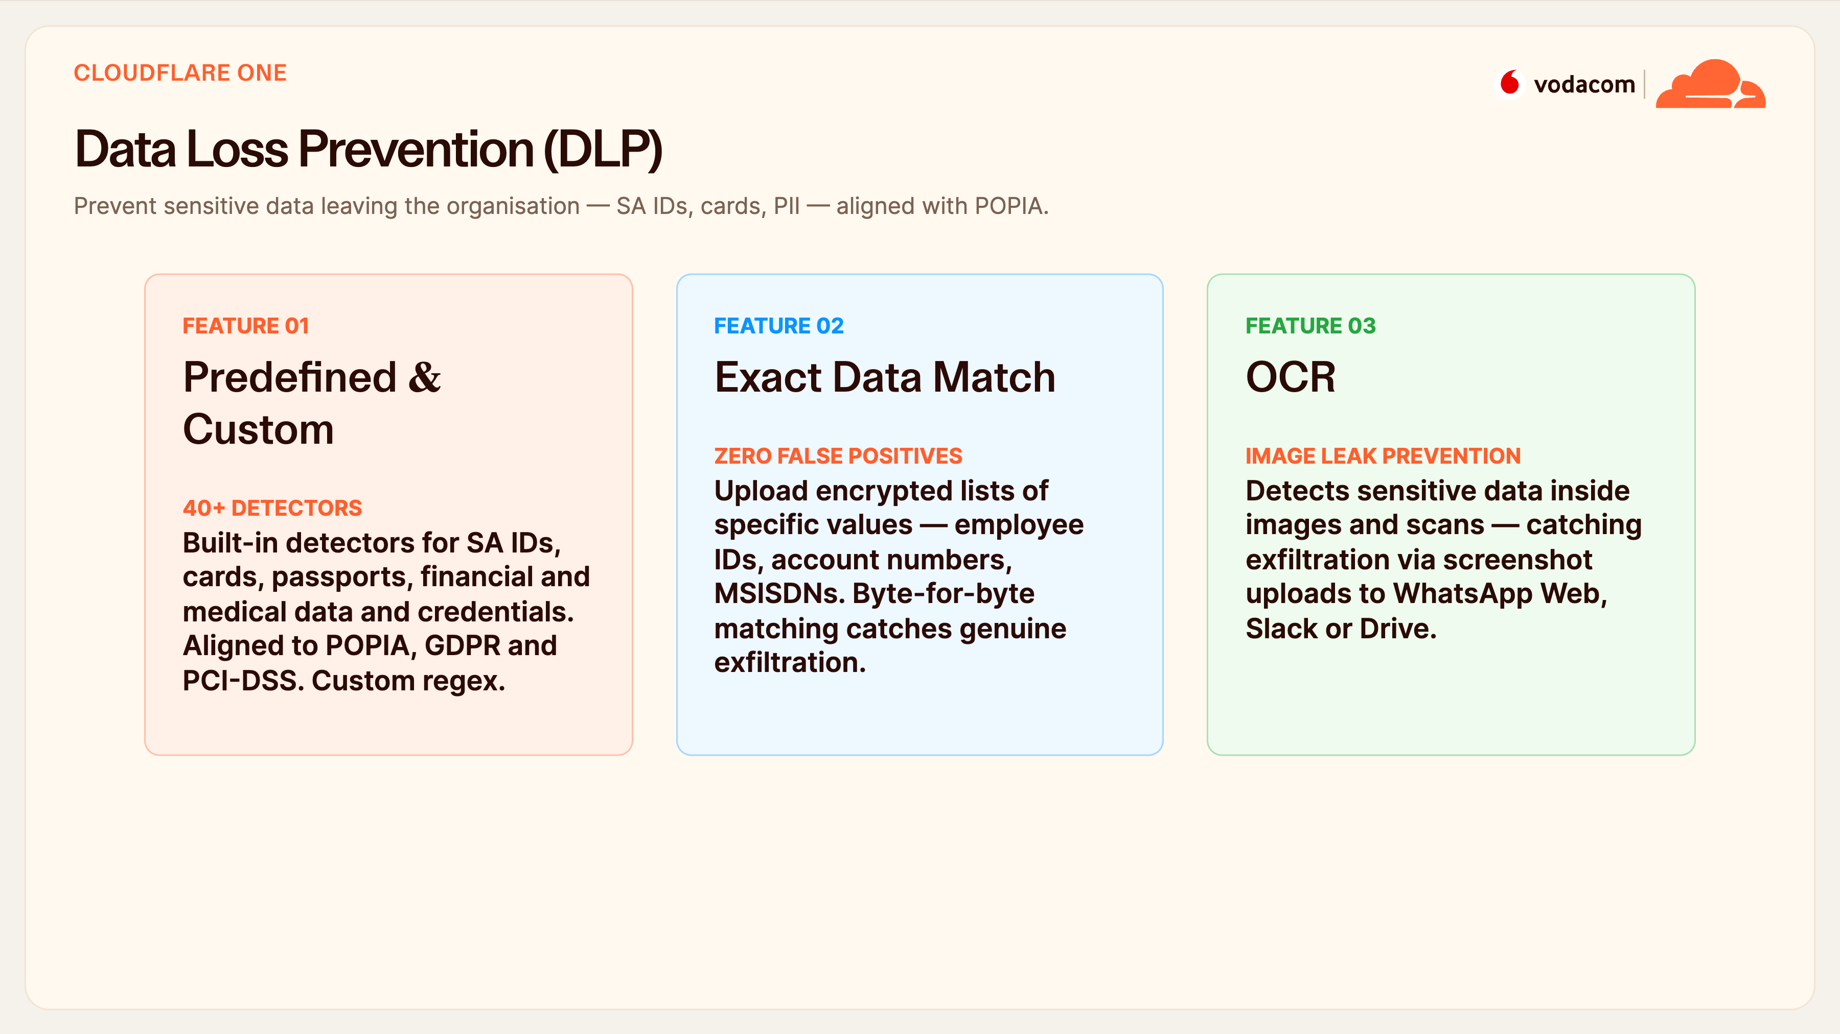
Notes:
DLP
DLP is your POPIA enforcement engine. Out of the box there are forty-plus detectors, including South African ID numbers, cards and passports, aligned to POPIA, GDPR and PCI-DSS, plus custom regex for Vodacom-specific formats. Exact Data Match lets you upload encrypted lists — employee IDs, account numbers, MSISDNs — for byte-for-byte matching with essentially zero false positives.
And OCR closes a common gap: it reads sensitive data inside images, so someone can't exfiltrate a screenshot of customer data to WhatsApp Web or personal email.

Slide 20
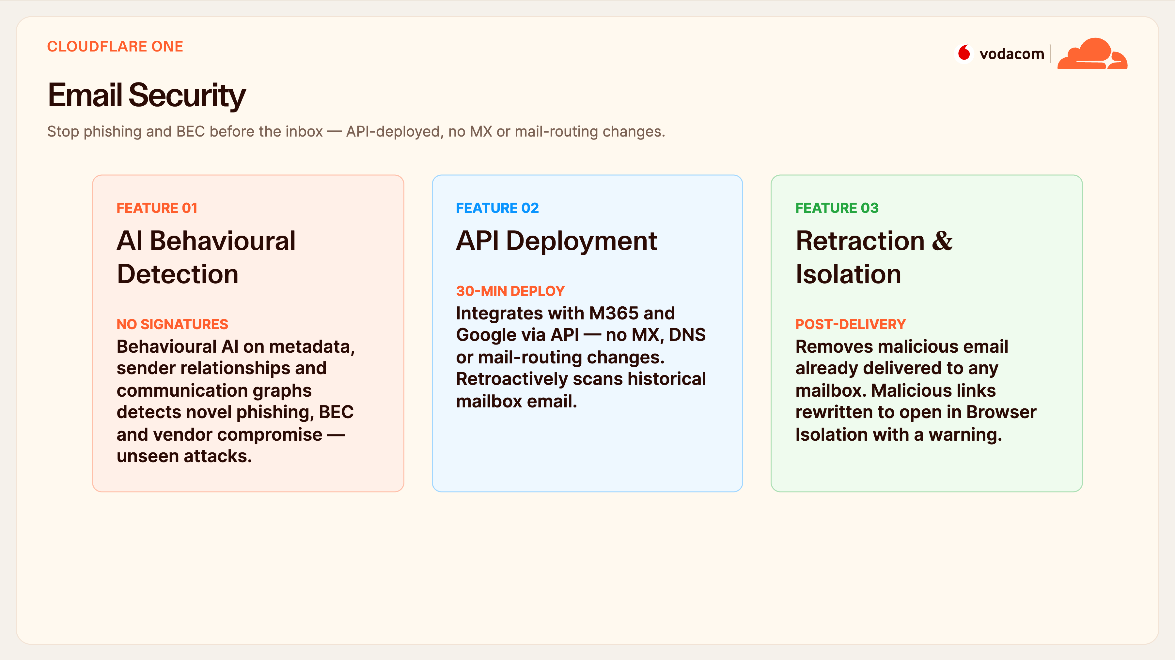
Notes:
Email Security
Since ninety-one percent of attacks start with email, this is critical. Our behavioural AI models sender relationships and communication graphs to catch novel phishing and BEC — including CEO-fraud and vendor compromise — without relying on signatures. It deploys over API to M365 or Google in about thirty minutes with no MX or mail-routing changes, and it retroactively scans email already in mailboxes.
If something does get through, we can retract it post-delivery from every mailbox, and malicious links are rewritten to open safely in Browser Isolation.

Slide 21
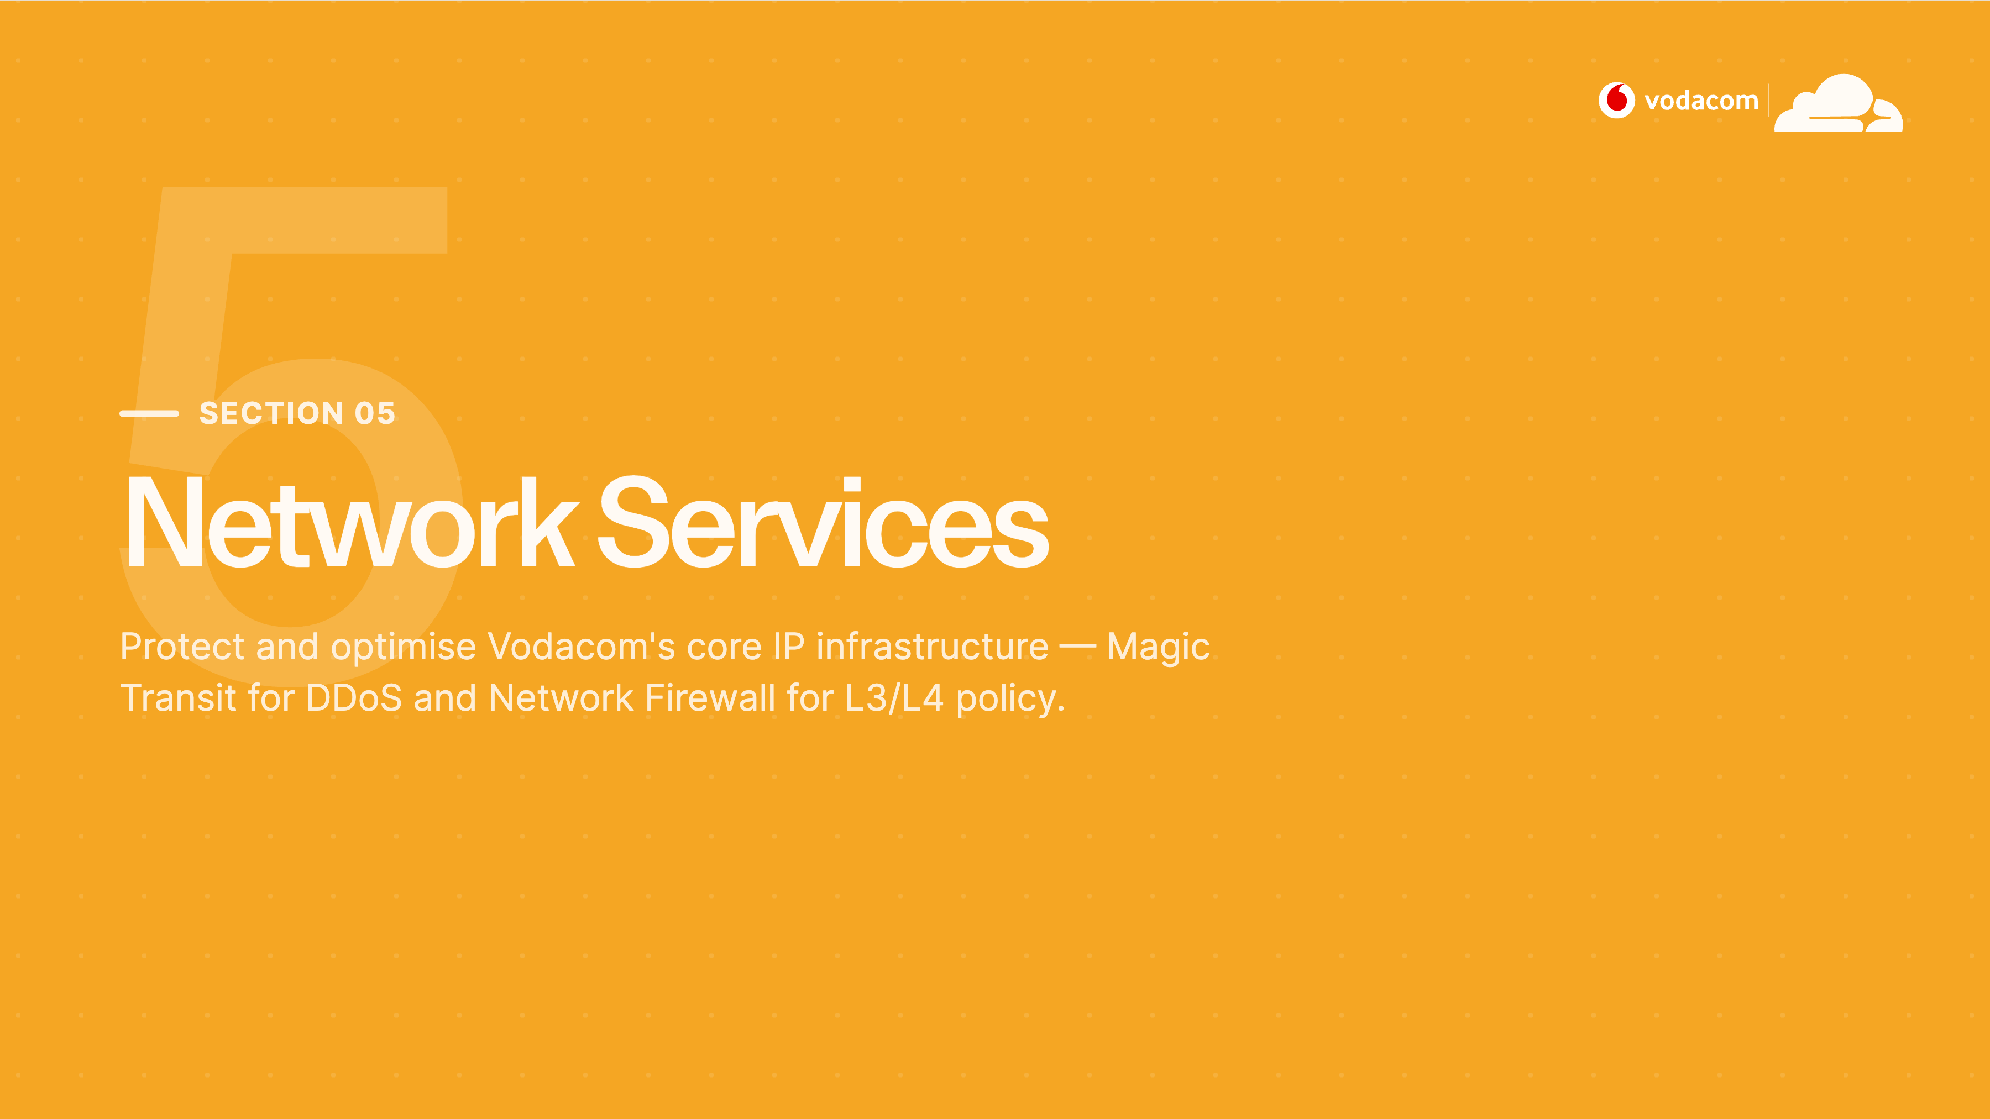
Notes:
Section 05 — Network Services
Section five goes below the application layer to your core IP infrastructure — the network itself. As a telco, your IP space is a target in its own right, so this covers Magic Transit for volumetric DDoS and our global network firewall for L3/L4 policy.

Slide 22
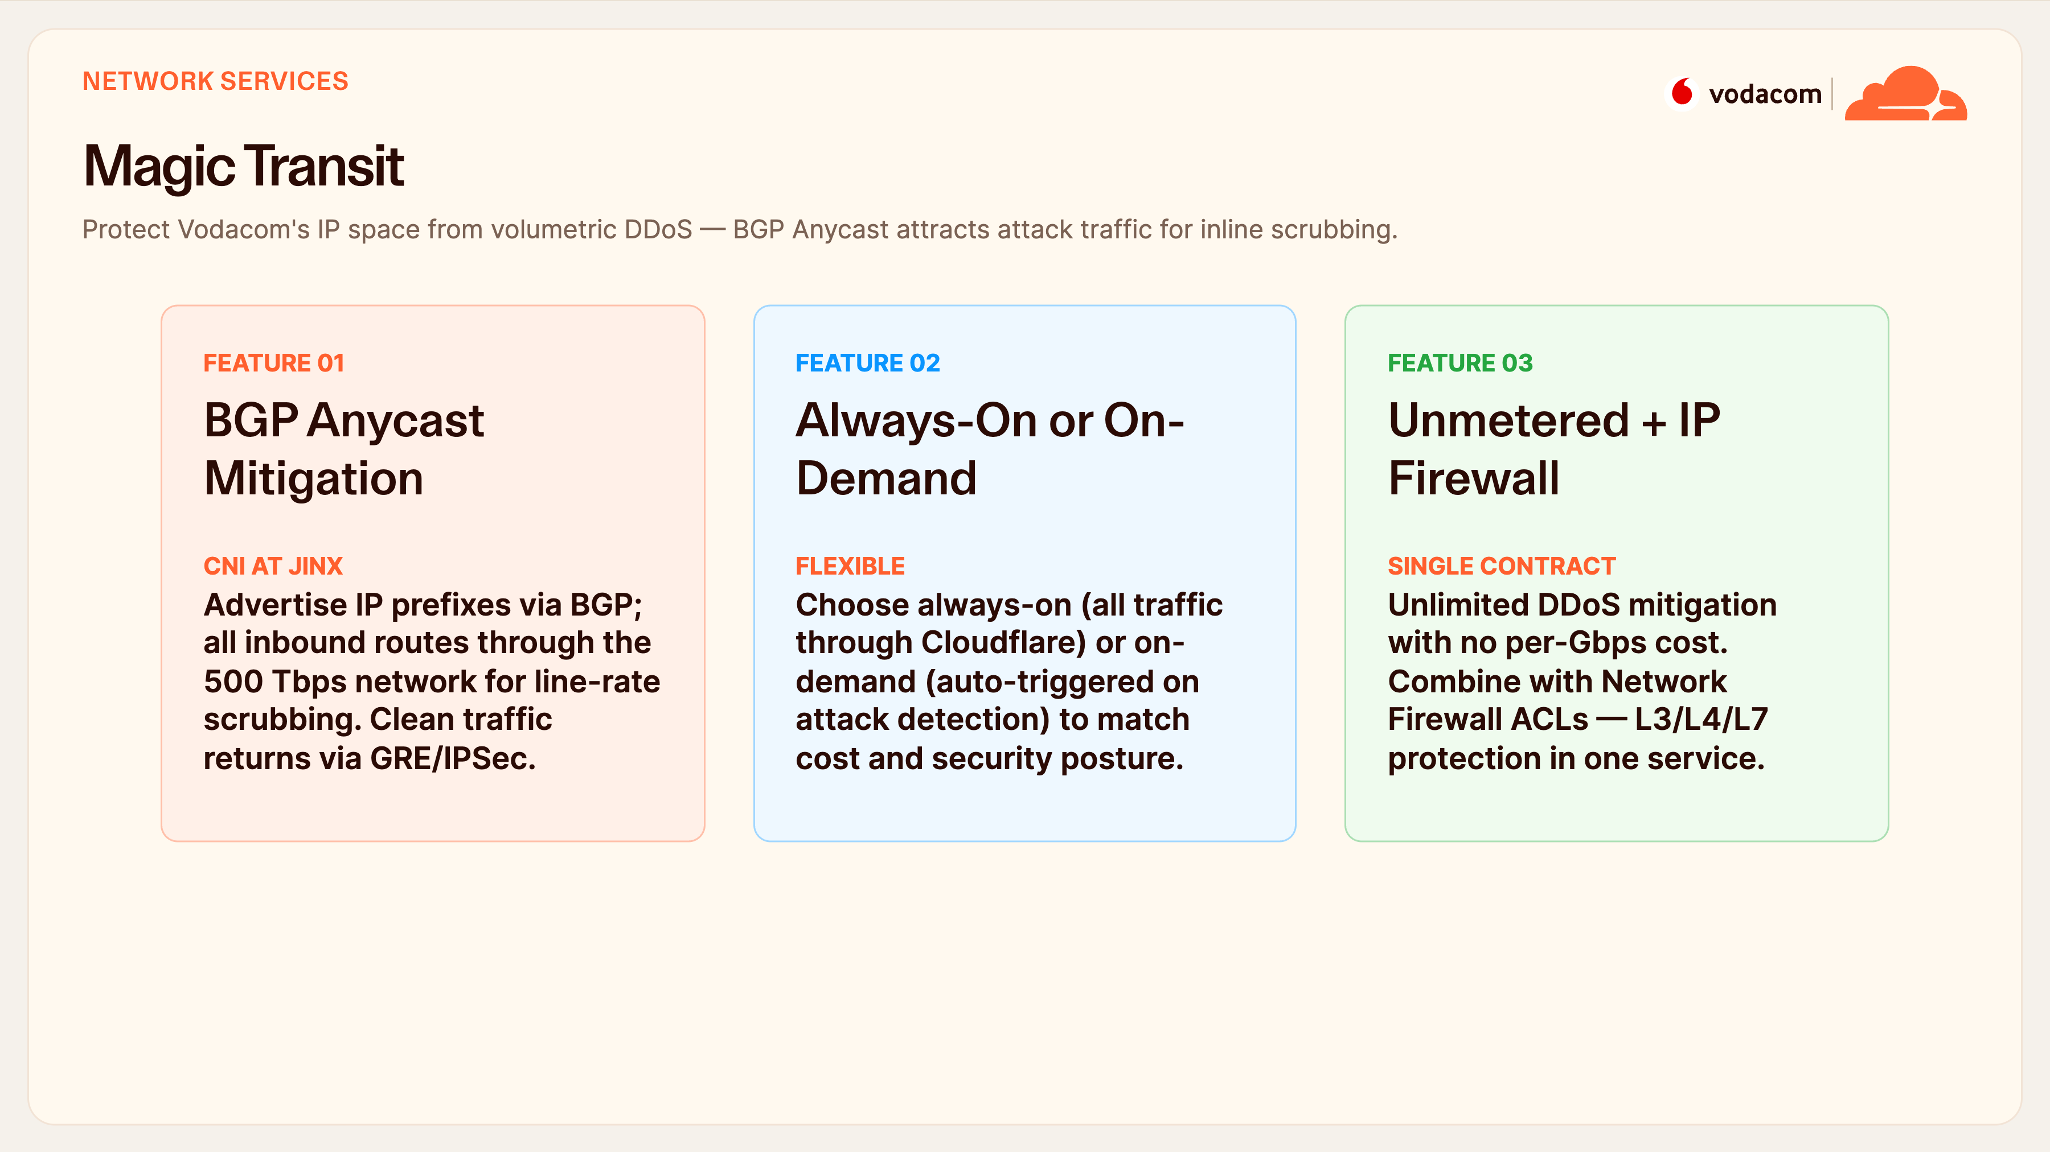
Notes:
Magic Transit
Magic Transit protects your actual IP prefixes. You advertise them to us over BGP, so all inbound traffic routes through our 500-terabit network, gets scrubbed at line rate, and clean traffic comes back to your data centre over GRE or IPSec — with direct CNI at JINX in Johannesburg for low latency.
You can run it always-on or trigger on-demand when an attack is detected, and it's unmetered — no per-gigabit cost no matter how big the attack. Combined with the network firewall, that's L3, L4 and L7 in one contract.

Slide 23
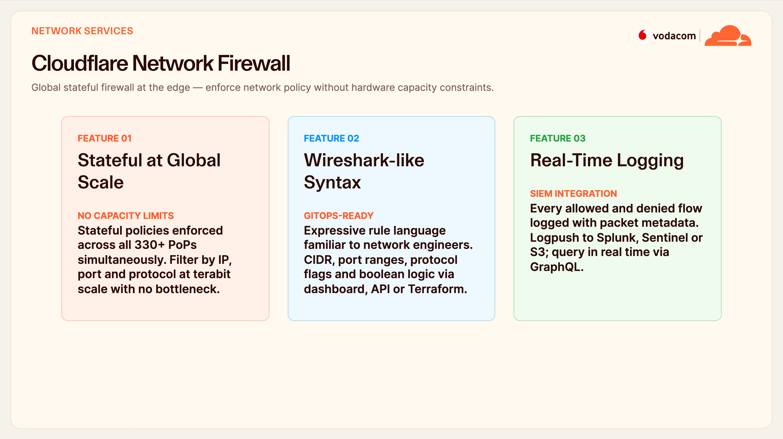
Notes:
Network Firewall
The network firewall gives you a global, stateful firewall at the edge — no hardware to size or scale. Policies enforce across all 330-plus PoPs simultaneously at terabit scale, so you never hit a capacity ceiling the way you would with an appliance. Rules use Wireshark-like syntax your network engineers already know, managed by dashboard, API or Terraform for GitOps.
And every allowed or denied flow is logged with full metadata and Logpushed into your existing SOC — Splunk, Sentinel, or Chronicle.

Slide 24
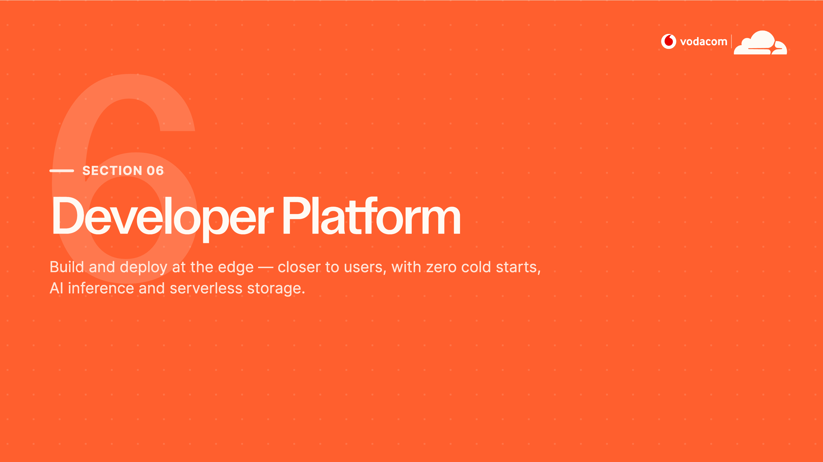
Notes:
Section 06 — Developer Platform
Our final pillar is about building, not just protecting. The developer platform lets Vodacom run code and store data at the edge, within milliseconds of your customers. This is where you can differentiate — fraud scoring, personalisation, AI — all in-region.

Slide 25
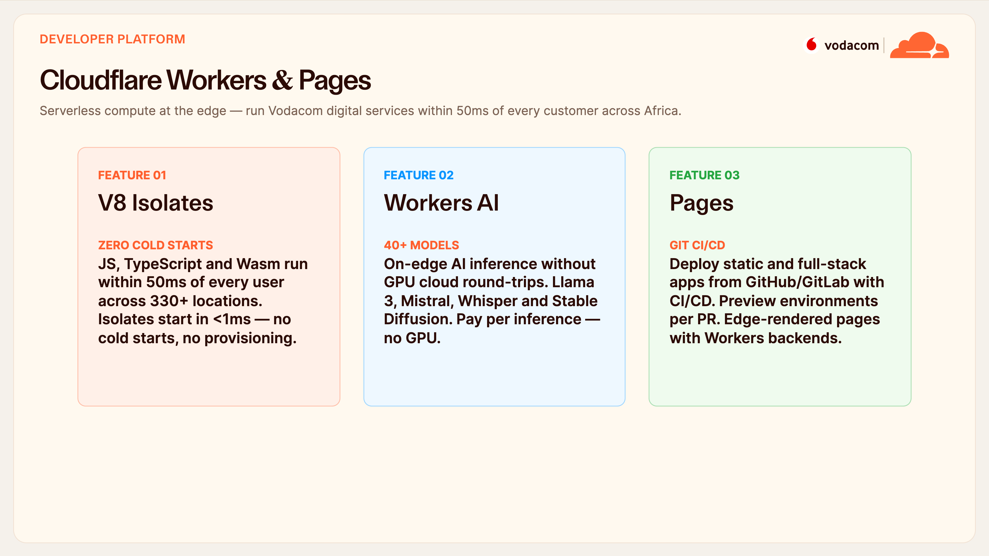
Notes:
Workers & Pages
Workers is serverless compute that runs within fifty milliseconds of every customer, on V8 isolates that start in under a millisecond — so there are no cold starts and nothing to provision. Workers AI runs inference right at the edge across forty-plus models like Llama 3 and Whisper, with no GPU round-trip to a distant cloud, billed per inference.
For Vodacom that means things like fraud pre-screening or content personalisation running in-region — fast, cheap, and keeping data local. Pages rounds it out with Git-based CI/CD for your web apps.

Slide 26
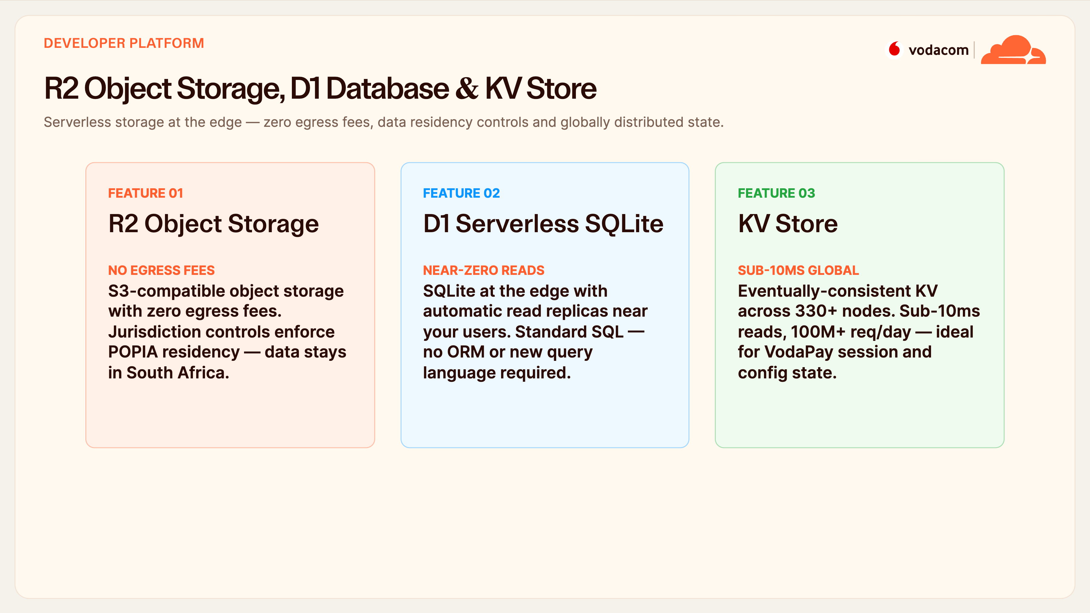
Notes:
R2, D1 & KV
On storage, R2 is the headline for a telco — S3-compatible object storage with zero egress fees, so serving content to millions of customers doesn't come with surprise bandwidth bills. And R2 jurisdiction controls enforce POPIA residency, keeping data physically in South Africa.
D1 is serverless SQLite with read replicas near your users, and KV is a globally distributed key-value store with sub-ten-millisecond reads — perfect for VodaPay session state and feature flags at scale.

Slide 27
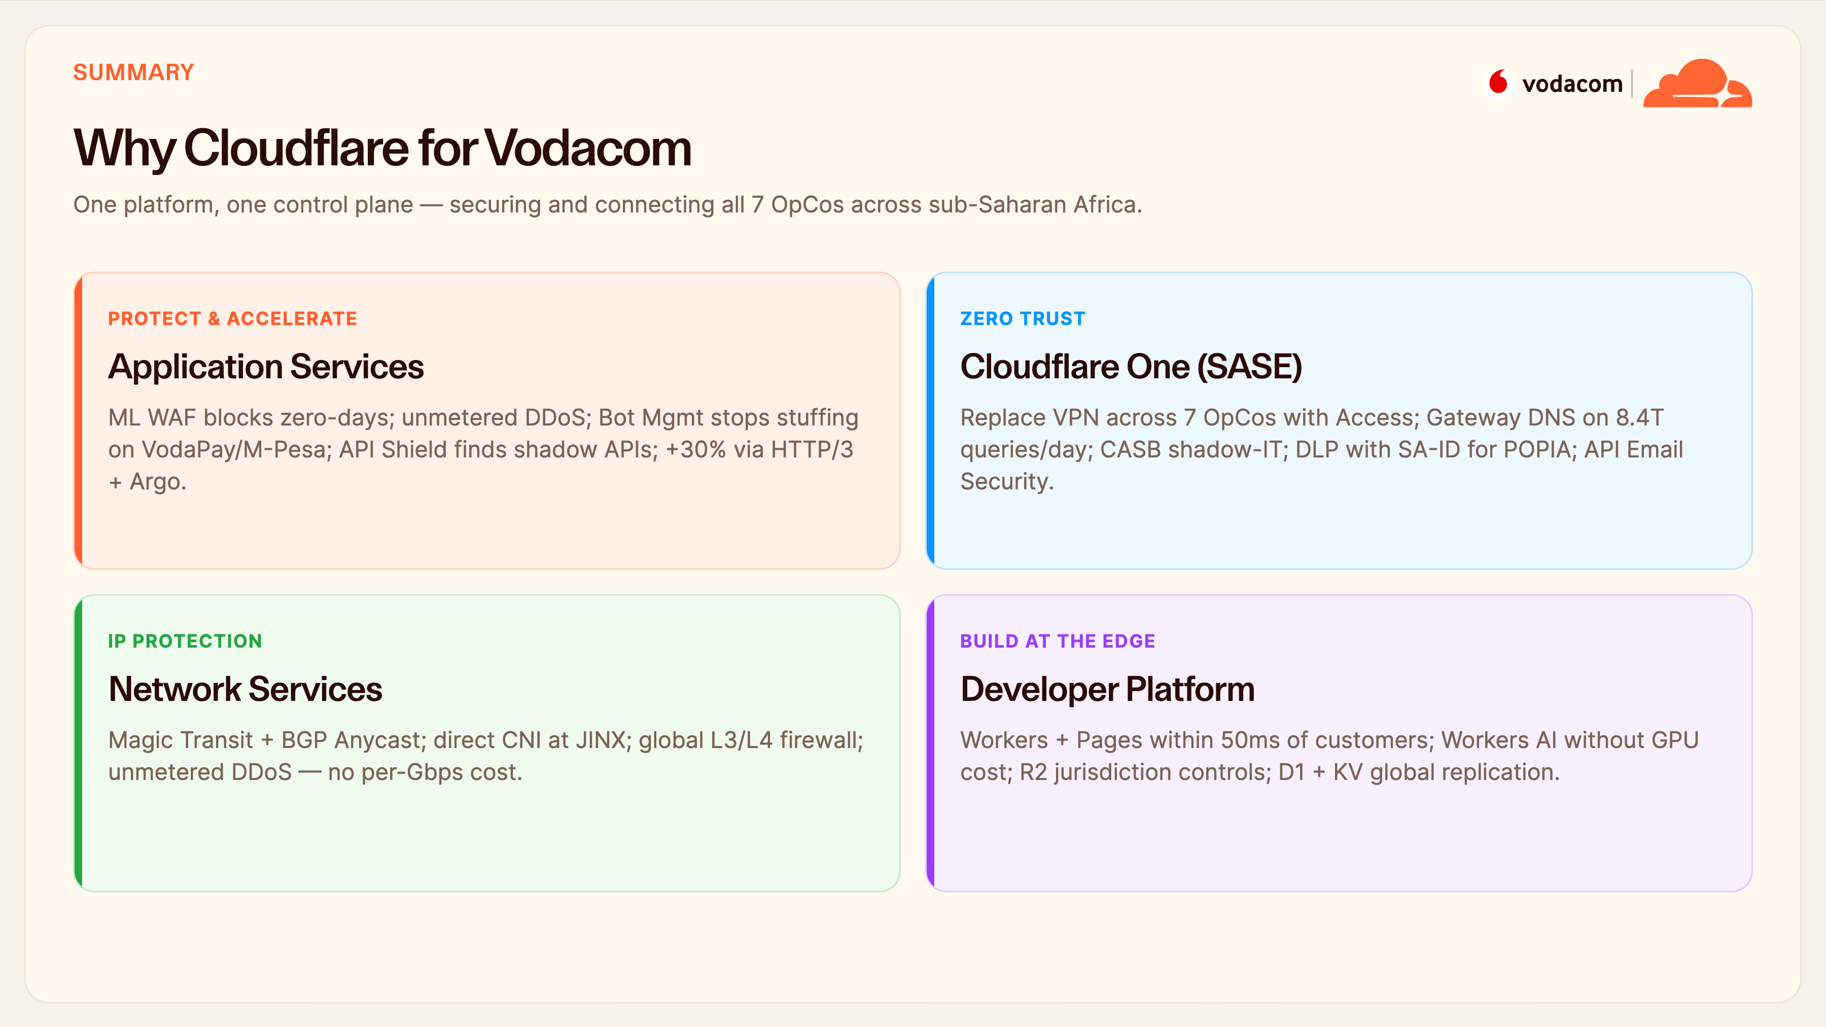
Notes:
Why Cloudflare — Summary
Let's bring the four pillars back together. Application services protect and accelerate everything customer-facing. Cloudflare One replaces your VPN and secures your workforce with POPIA-aligned DLP. Network services shield your core IP infrastructure with unmetered DDoS. And the developer platform lets you build in-region.
The thread through all of it: one platform, one control plane, all seven OpCos. That's the strategic difference — not four products, one.

Slide 28
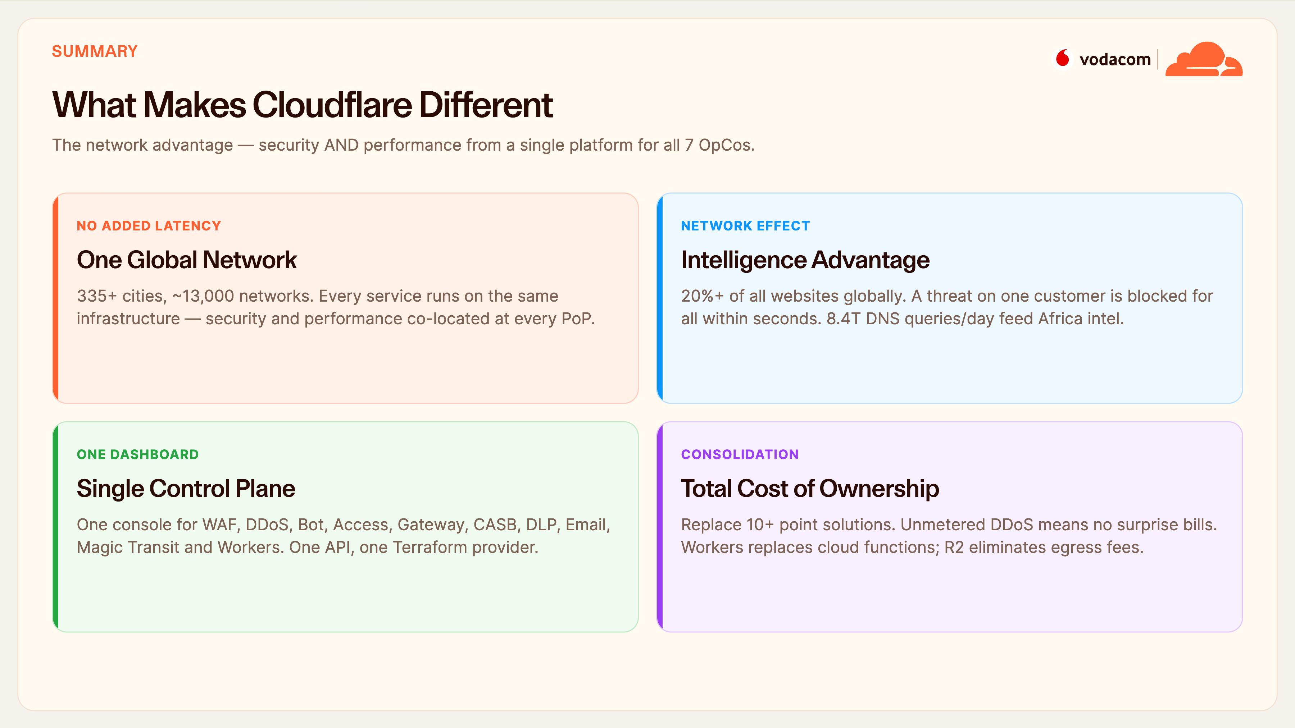
Notes:
What Makes Us Different
Why us over the alternatives? Four reasons. One network — every service runs on the same infrastructure, so adding security doesn't add latency. The intelligence advantage — seeing twenty percent of the web means a threat detected on one customer protects everyone within seconds. A single control plane — one dashboard and one Terraform provider for everything, no product-stitching.
And total cost of ownership — you're replacing ten-plus point solutions, unmetered DDoS removes bill shock, and R2 kills egress fees. Better security that's also cheaper to run.

Slide 29
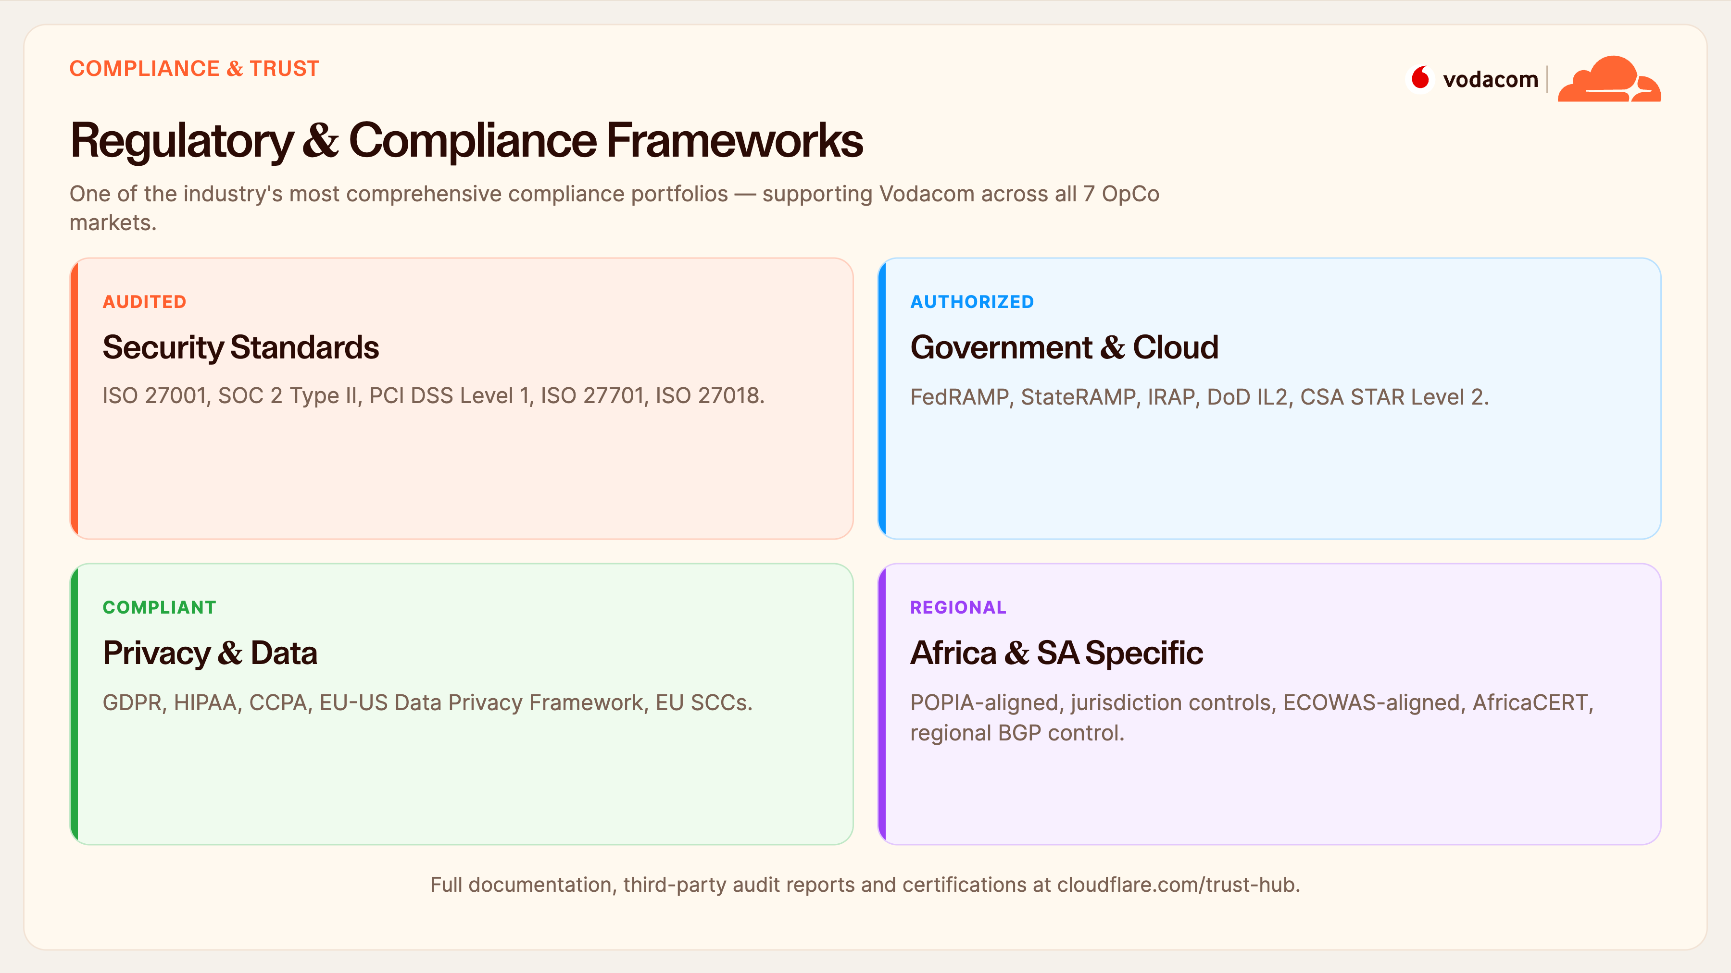
Notes:
Compliance & Trust
Compliance is often where a deal lives or dies, so this matters. We hold one of the most comprehensive portfolios in the industry: the core security standards like ISO 27001, SOC 2 Type II and PCI DSS Level 1; government authorisations like FedRAMP and IRAP; and the full privacy set — GDPR, the EU-US framework, standard contractual clauses.
Most relevant for you: we're POPIA-aligned with jurisdiction controls for data residency, and regional BGP control to keep traffic in-region. All the audit reports are available on our Trust Hub.

Slide 30
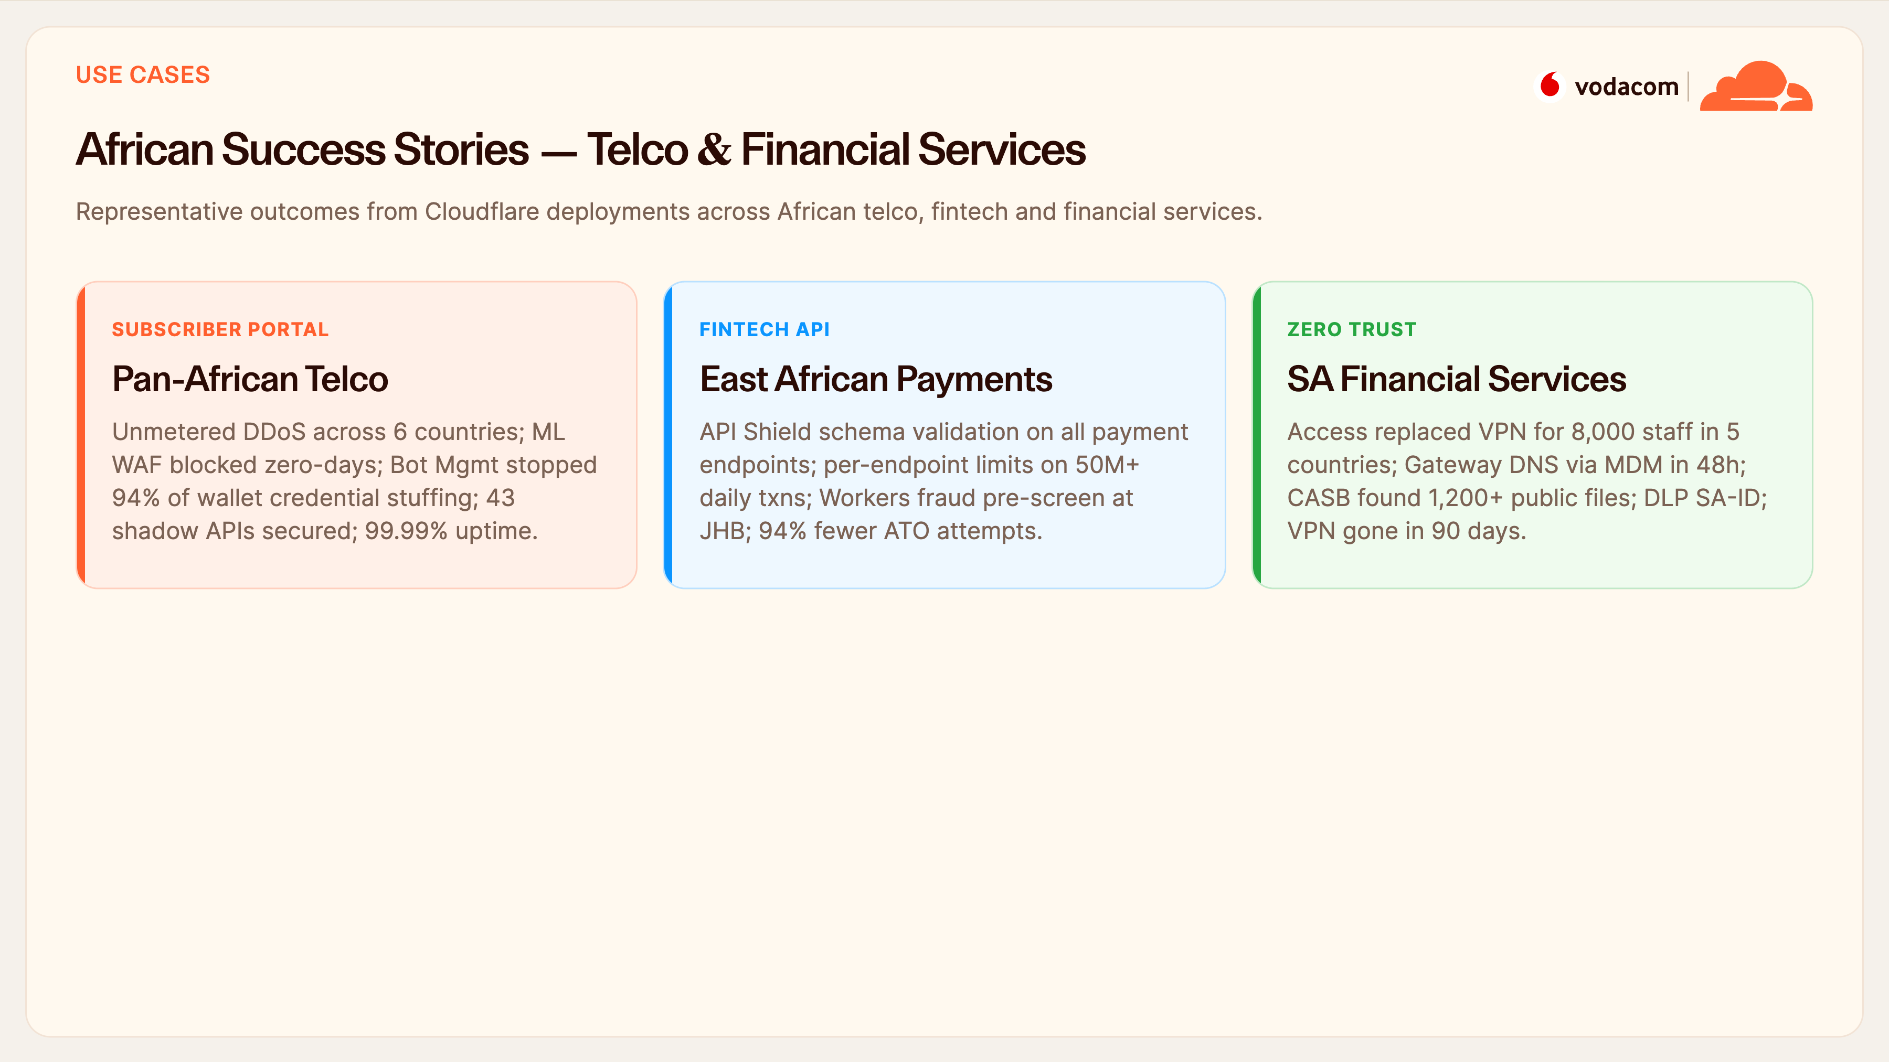
Notes:
African Success Stories
This isn't theoretical — here are representative outcomes from African telco and fintech deployments. A pan-African telco ran unmetered DDoS across six countries, blocked zero-days with the ML WAF, and stopped ninety-four percent of wallet credential stuffing while finding forty-three shadow APIs. An East African payments platform put schema validation on every payment endpoint and cut account-takeover attempts by ninety-four percent.
And a South African financial services group replaced VPN for eight thousand staff and fully decommissioned it in ninety days. These are exactly your use cases.

Slide 31
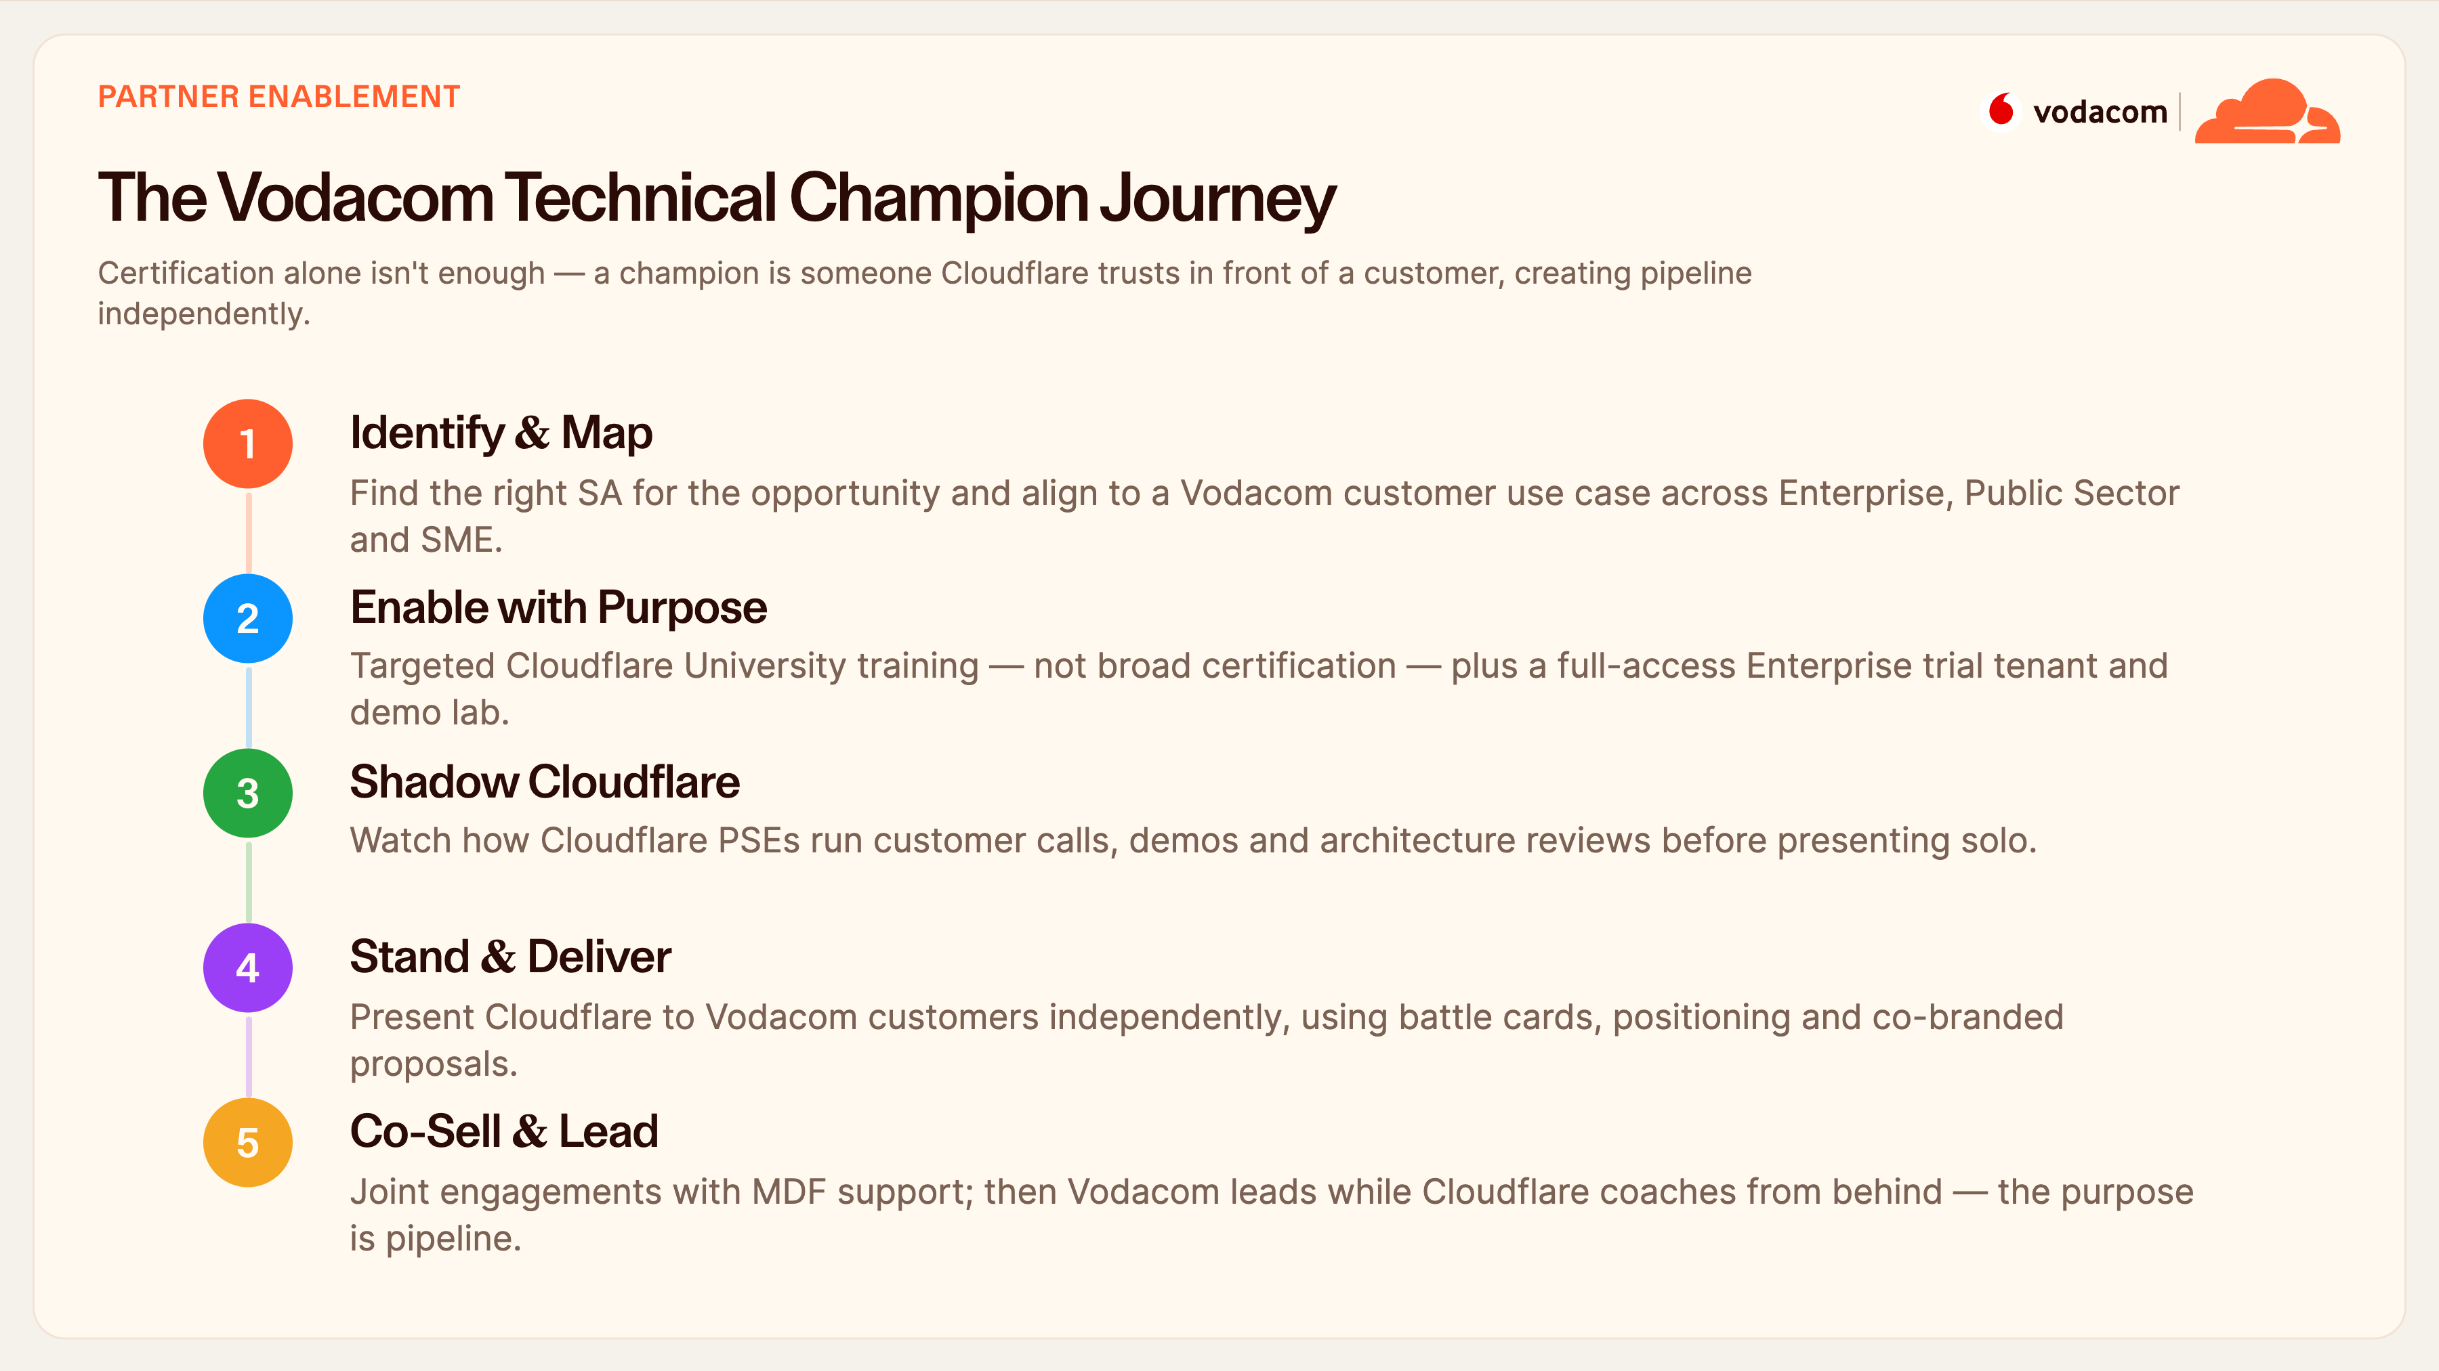
Notes:
Partner Enablement
For the Vodacom team specifically, here's how we turn your SEs into Cloudflare technical champions. We identify the right person for an opportunity and map them to a real customer use case; we enable them with targeted training and a full trial tenant, not a generic cert; they shadow our PSEs on live calls; then they stand and deliver independently; and finally they co-sell and lead, with us coaching from behind.
The key point on the slide: certification alone doesn't make a champion. A champion is someone we trust in front of a customer — and the purpose of the whole journey is pipeline.

Slide 32
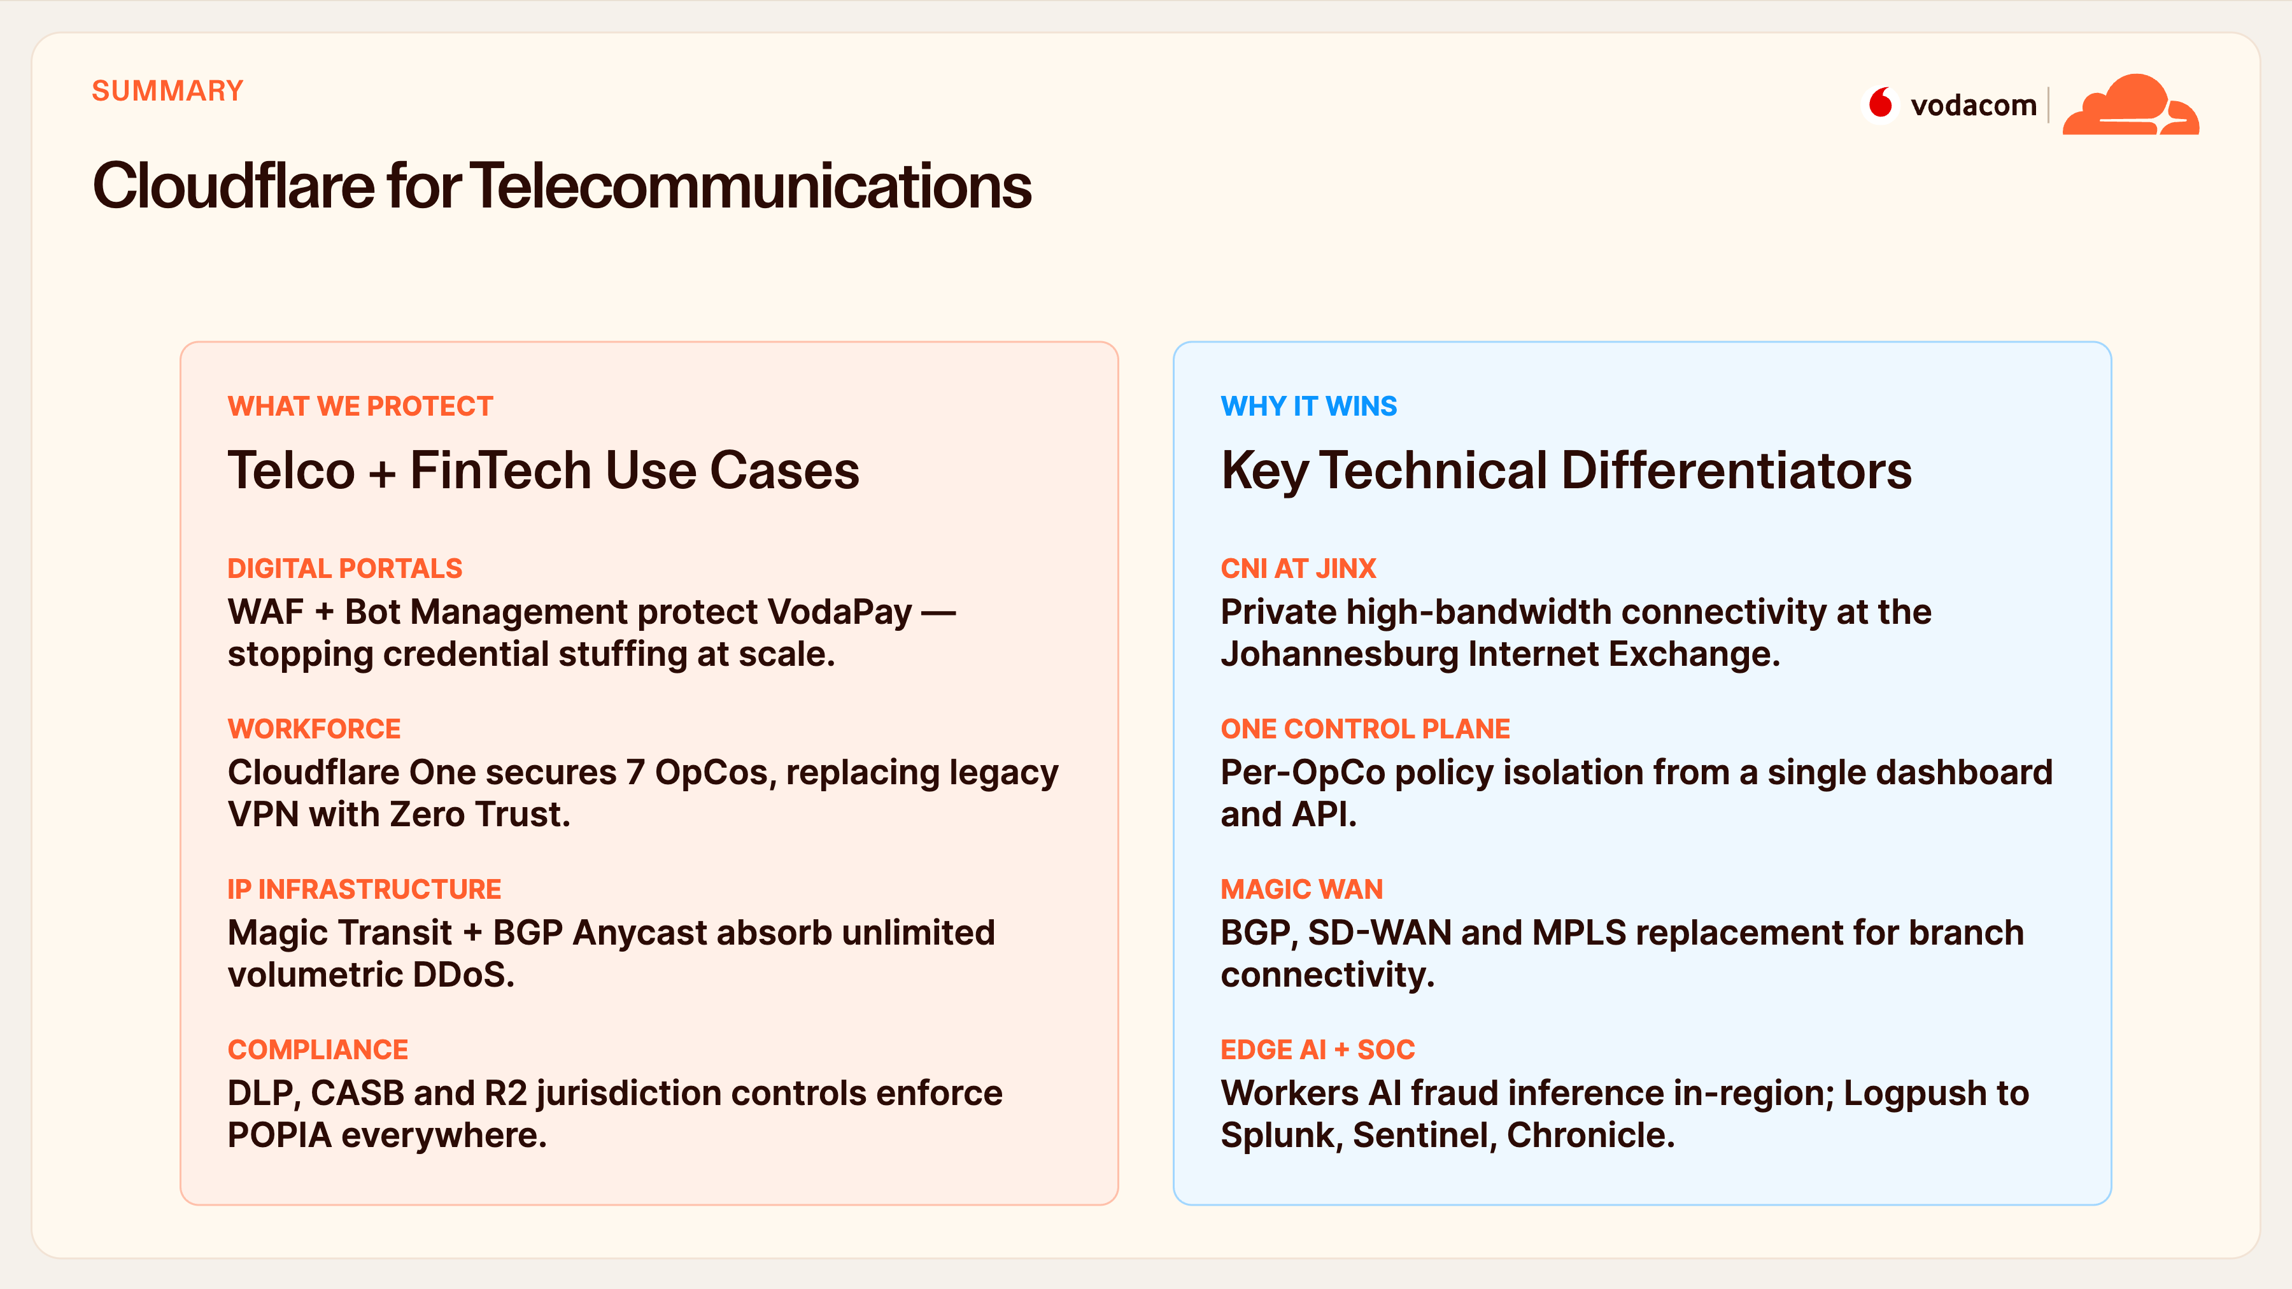
Notes:
Cloudflare for Telco
Pulling the telco story together: on the left, what we protect — your digital portals and VodaPay, your distributed workforce, your core IP infrastructure, and your compliance posture. On the right, why it wins technically — private connectivity via CNI at JINX, one control plane with per-OpCo isolation, Magic WAN to replace MPLS, and edge AI keeping fraud inference in-region.
This is the slide that says: we understand telco and fintech requirements specifically, and we've built the platform to meet them.

Slide 33
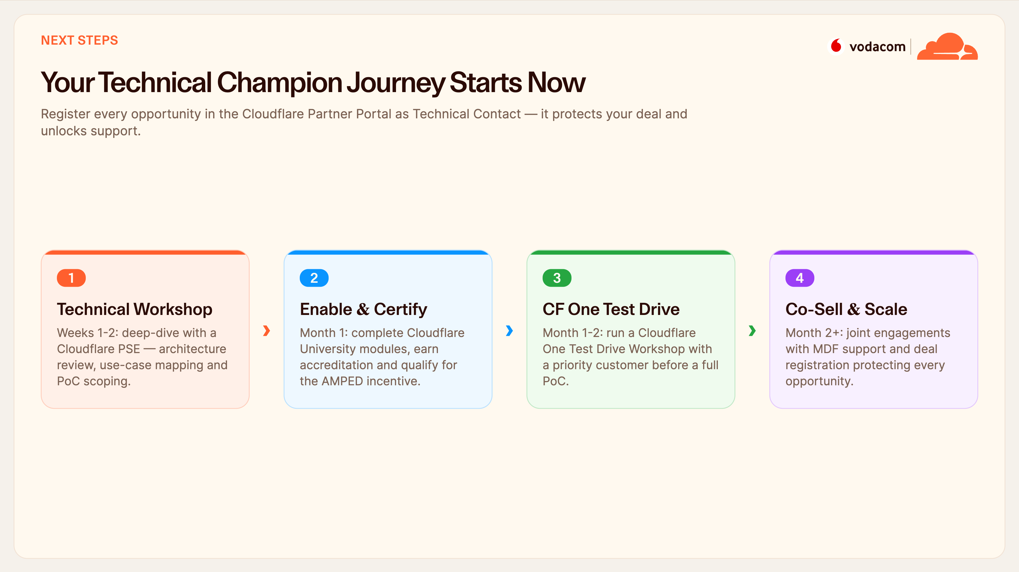
Notes:
Next Steps
Here's the concrete plan. In the next couple of weeks, a technical workshop with our PSE to review architecture and scope a PoC. In month one, complete the Cloudflare University modules — that earns accreditation and enters you into the AMPED incentive. Then a Cloudflare One Test Drive with a priority customer, and from month two, joint co-selling with MDF support.
One ask that protects you: register every opportunity in the Partner Portal as the technical contact. That secures your credit and gives us the visibility to support you.

Slide 34
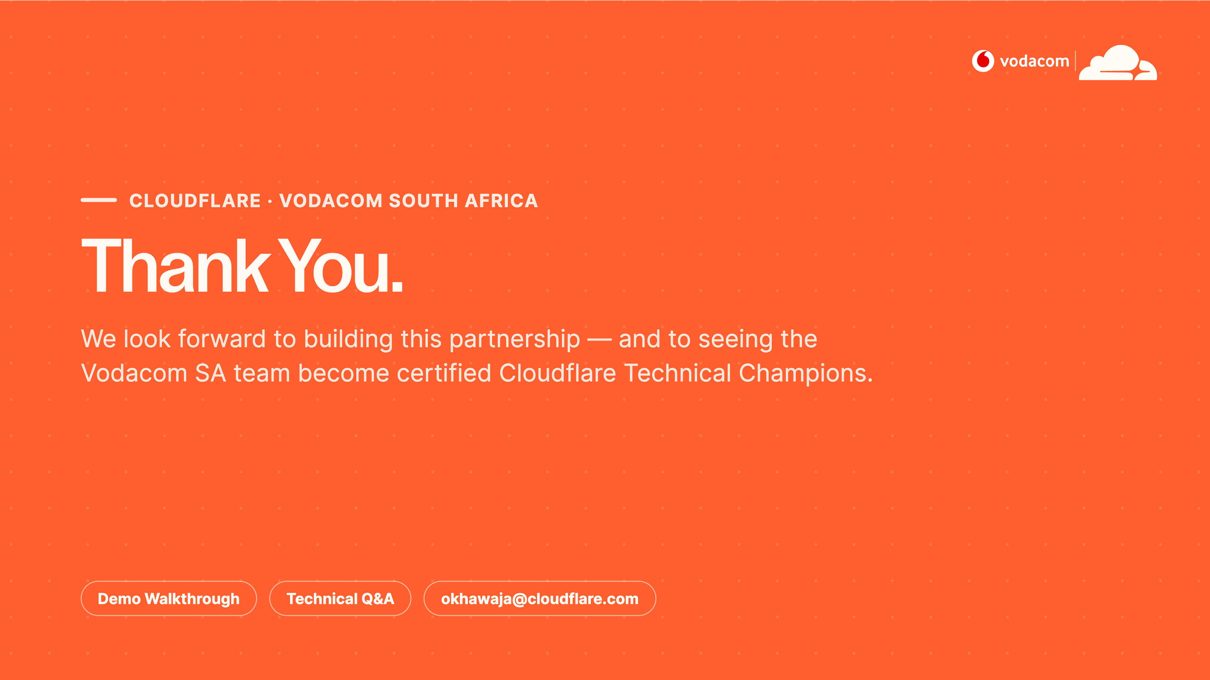
Notes:
Thank You / Q&A
Thank you — that's the full Cloudflare picture for Vodacom, across application security, Cloudflare One, network services and the developer platform. We're genuinely excited about this partnership and about getting your team certified as technical champions.
Two next actions before we close: let's book a live demo walkthrough tailored to your architecture, and then open the floor — any question on architecture, integration, compliance or commercials. Nothing's off limits.

